Slide 1
Tree Leaf Terminology
Deciduous Tree id

Slide 2
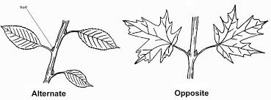
Branching pattern
**detectable only when you are standing in front of the tree**
Alternate (most common)
Opposite (diagnostic)
one leaf per node two leaves per node

Slide 3
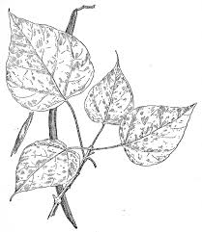
Whorled branching - really unusual
Northern Catalpa
3 branches off each node
Notes:
🍐 This is a Pear Deck Multiple Choice Slide. Your current options are: A: Whorled means the same as a planet, B: Whorled means to spin, C: Whorled is what you do to prepare a pork hock to make bacon,
🍐 To edit the type of question or choices, go back to the "Ask Students a Question" in the Pear Deck sidebar.

Slide 4
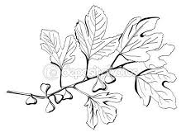
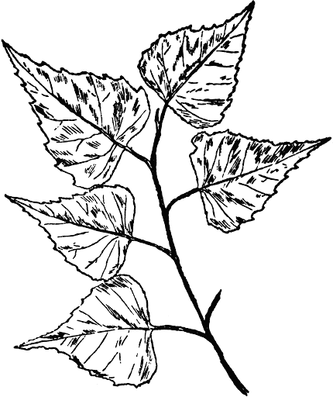
Alternate branching
This usually applies to branch-branching as well as leaf branching

Slide 5
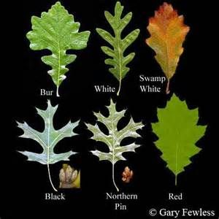
The most common alternate-branching deciduous trees around here ...
What are they?
hint: they’re all the same genus
Notes:
🍐 This is a Pear Deck Text Slide
🍐 To edit the type of question, go back to the "Ask Students a Question" in the Pear Deck sidebar.

Slide 6
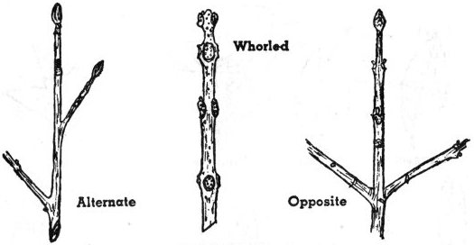
MADog: Opposite branching
Maple
Ash
Dogwood

Slide 7
opposite branching
with U-shaped sinuses
with V-shaped sinuses
What are they?
Notes:
🍐 This is a Pear Deck Multiple Choice Slide. Your current options are: A: Oak, B: Maple,
🍐 To edit the type of question or choices, go back to the "Ask Students a Question" in the Pear Deck sidebar.

Slide 8
another alternate branching - not a Maple
guesses?
Notes:
🍐 This is a Pear Deck Text Slide
🍐 To edit the type of question, go back to the "Ask Students a Question" in the Pear Deck sidebar.

Slide 9
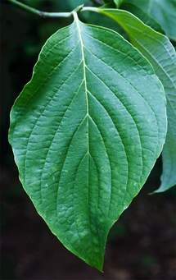
another one with opposite branching
What was that mnemonic?
Notes:
🍐 This is a Pear Deck Multiple Choice Slide. Your current options are: A: My Very Earnest Mother Just Served Nine Pizzas, B: MADog, C: My Dog Always Sleeps,
🍐 To edit the type of question or choices, go back to the "Ask Students a Question" in the Pear Deck sidebar.

Slide 10
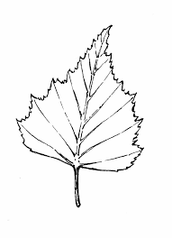
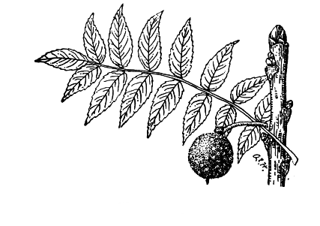
Basic leaf structure
Simple:
blade is solid
Compound: blade of leaf is composed of many leaflets

Slide 11
alternate and simple
guesses?
These are very common and right out by the
BHS main entrance!
Notes:
🍐 This is a Pear Deck Text Slide
🍐 To edit the type of question, go back to the "Ask Students a Question" in the Pear Deck sidebar.

Slide 12
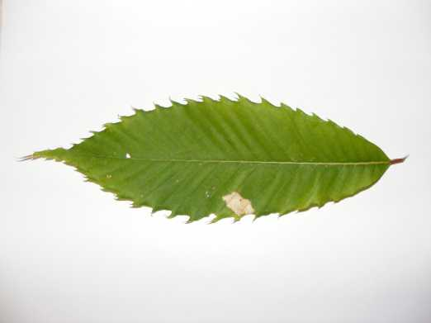
The leaf edge (of simple leaves)
Entire:
no breaks in the edge
Lobed: edge is broken with sinuses
Where else do you have lobes?
Notes:
🍐 This is a Pear Deck Multiple Choice Slide. Your current options are: A: head, B: neck, C: elbows, D: ankles,
🍐 To edit the type of question or choices, go back to the "Ask Students a Question" in the Pear Deck sidebar.

Slide 13
alternate branching
Notes:
🍐 This is a Pear Deck Multiple Choice Slide. Your current options are: A: simple and entire, B: compound and lobed, C: simple and lobed, D: compound and entire,
🍐 To edit the type of question or choices, go back to the "Ask Students a Question" in the Pear Deck sidebar.

Slide 14
Pointy-lobed
Alternate, simple, and lobed,
oh, and each lobe ends in a bristle

Slide 15
Alternate, simple, and lobed.
This one, too, each lobe ends in a bristle,
but the sinuses aren’t as deep

Slide 16
Ah, this one has rounded lobes!
(p.s. like a snowball)
What’s the color of a fresh snowball?
What’s the name of this tree?
Notes:
🍐 This is a Pear Deck Text Slide
🍐 To edit the type of question, go back to the "Ask Students a Question" in the Pear Deck sidebar.

Slide 17
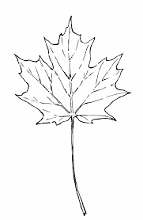
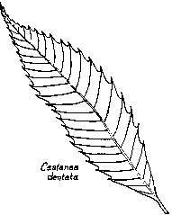
Vein patterns
Pinnate (most)
Palmate
like the vanes of a feather.
Parallel … super uncommon among trees

Slide 18
Toothed leaf
If I tell you this was from a tree that had alternate branching, and this is a single leaf,
What else could you say about the leaf that might help you id this tree?
Notes:
🍐 This is a Pear Deck Text Slide
🍐 To edit the type of question, go back to the "Ask Students a Question" in the Pear Deck sidebar.

Slide 19
Beech
Alternate branching, simple leaves that are entire, with pinnate veins, each vein ending in a single tooth

Slide 20
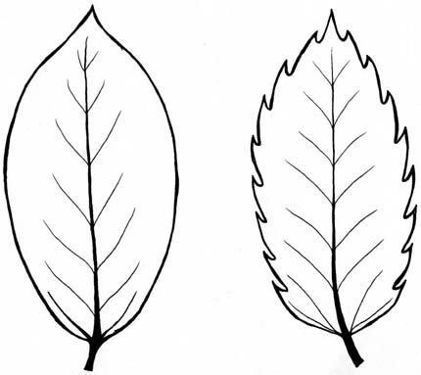
Leaf Margin
Toothed (most trees)
Smooth
Wavy, double-toothed … next slide

Slide 21
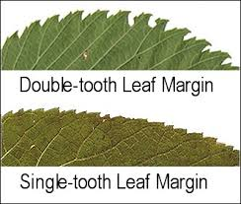
Leaf margins
Oh, that I could ever bear,
green, entire, and wavy
… that’s a ______
Notes:
🍐 This is a Pear Deck Multiple Choice Slide. Your current options are: A: Hare, B: Chair, C: Corsair, D: Pear,
🍐 To edit the type of question or choices, go back to the "Ask Students a Question" in the Pear Deck sidebar.

Slide 22
opposite branching
What’s this?
Notes:
🍐 This is a Pear Deck Multiple Choice Slide. Your current options are: A: simple and finely toothed - must be Birch, B: compound and finely toothed - must be Ash, C: Simple and lobed - must be Oak, D: Lobed and wavy - must be Avocado,
🍐 To edit the type of question or choices, go back to the "Ask Students a Question" in the Pear Deck sidebar.

Slide 23
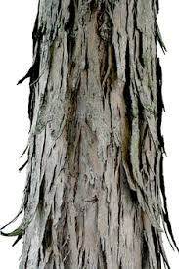
Take a guess!
If I tell you this was from a tree that had alternate branching, and this is a single leaf,
What else could you notice that might help you id this tree?
Notes:
🍐 This is a Pear Deck Text Slide
🍐 To edit the type of question, go back to the "Ask Students a Question" in the Pear Deck sidebar.

Slide 24
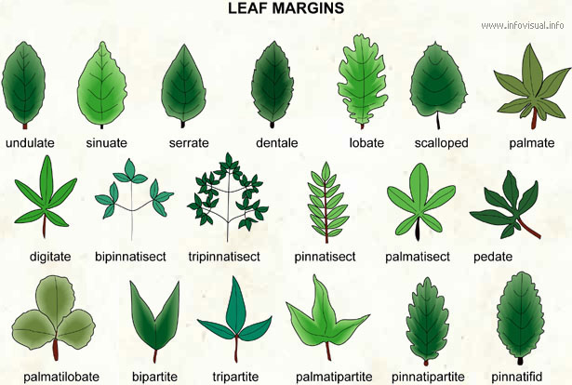
Dendrology: a skill you can learn

Slide 25
Trees:
To know them is to know where you stand

