Slide 1
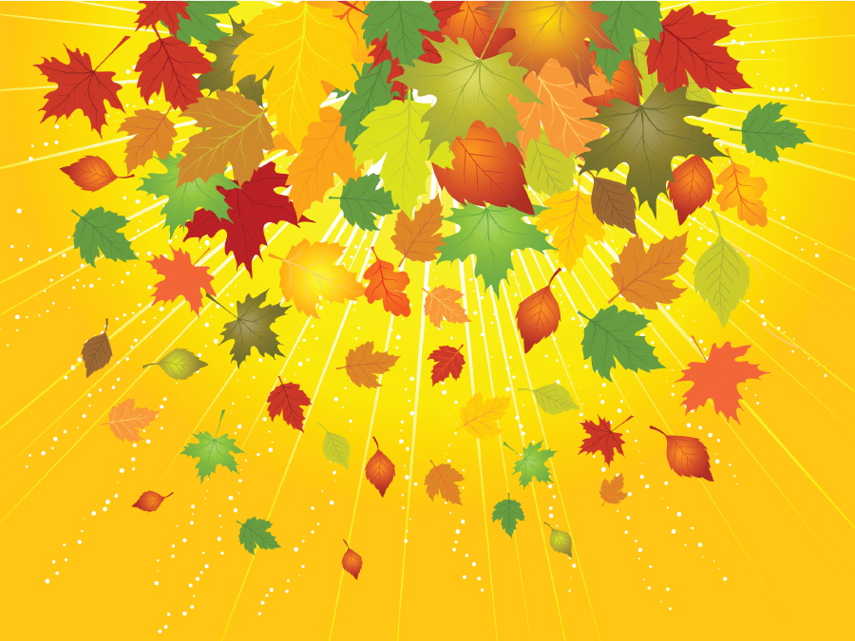
Introductory Lessons for
Buds, Leaves and Global Warming
JoAnn Mossman
Gr. 7 Life Science
Overlook Middle School
Ashburnham-Westminster Regional

Slide 2
Connect
to
prior knowledge

Slide 3
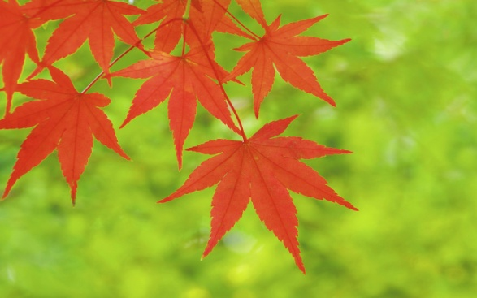
Getting Started
Brainstorm everything the students “know” about autumn and leaves changing colors and falling off of the trees. Keep on chart paper to revisit as the investigation proceeds.
Take the True/False quiz. Go over answers but keep them to revisit as well.

Slide 4
True and False Questions
Chlorophyll give leaves their basic green color.
Carotenoids produce the yellow, oranges and brown colors in corn, carrots and bananas.
The length of the night is a main reason in telling the leaves when to change color.
Leaf out is when the leaves fall off of their branches.
It does not matter the species of tree, the leaves on the trees can turn any color they want.
Stems, twigs and buds are made to survive freezing cold and can reawaken in the Spring.

Slide 5
Read
An
article

Slide 6
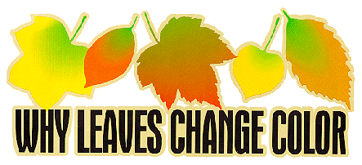
By the: U.S. Department of Agriculture
How does autumn color happen?
Where do autumn colors come from?
How does weather affect autumn color?
What triggers leaf fall?
What does all this do for the tree?
What happens to all those fallen leaves?
Where can I see autumn color in the United States?

Slide 7
How does autumn color happen? | 3 factors that influence autumn leaf color: ______________________________ ______________________________ ______________________________ ________________________________ Regulated by: ______________________________ ________________________________ ________________________________
Where do autumn colors come from? | 3 Types of Pigments: Chlorophyll – ____________________ Carotenoids –____________________ Anthocyanins - ___________________

Slide 8
Introduce
vocabulary

Slide 9
Name: Block:
Mrs. Mossman/Life Science
http://harvardforest.fas.harvard.edu/museum/phenology.html
Harvard Forest Schoolyard Ecology
Harvard University
Buds, Leaves, and Global Warming
Sept. 2013-May 2014
We will be assisting Forest Ecologist Dr. John O’Keefe in his research on deciduous trees. His research has been going on since 1990. We will help gather data to answer the following questions:
When does the growing season for trees in our schoolyard end this autumn, and when does the new growing season begin in the spring?
How might the length of the growing season relate to climate?
Vocabulary:
phenology:
deciduous:
coniferous:
chlorophyll:

Slide 10
Practice
Observation
Protocol
indoors

Slide 11
Lab Group Rubric
Skill | 4 | 3 | 2 | 1
Following Directions | I followed all directions including stopping when the lights went out. | I followed most of the directions and stopped when I realized the lights were out. | I needed a reminder from Mrs. M. about directions and quieting down when the lights went out. | I needed many reminders from Mrs. M. about directions and quieting down.
Focus | I stayed on task throughout the entire lab. | I stayed on task through most of the lab. | I needed a reminder from Mrs. M. to stay on task. | I needed many reminders from Mrs. M.
Equipment Use & Safety | I used the equipment carefully and correctly. | I used the equipment carefully. | I need to be more careful with the equipment. | I needed many reminders on how to use the equipment correctly.
Cooperation | I cooperated with all of the members of my group. | I did my best to cooperate with the others in the group. | Mrs. M. had to come over to discuss my cooperation. | The group did not run smoothly because I was frequently off task.
Clean-up | I worked hard helping with clean-up. | I helped with clean-up. | I didn’t help very much with clean-up. | I left the group before clean-up was done.

Slide 12
How to measure
On the board, show students how to measure length and width of a leaf.
On the “Key to Trees” worksheet, have them practice measuring and go over it together since all of the leaves are the same.
“Key to Trees” is also an introduction to a dichotomous key.

Slide 13
Now move to stations
At each station have 6 leaves taped down.
Using the Autumn Student Data Sheet have students measure each leaf and estimate % color changed.
Leave data sheets at stations so other classes can compare.
Also have branches with blue flagging marking where to start counting the 6 leaves to practice.

Slide 14
Leave the Data sheets
If you have multiple classes, have each class leave the data sheets face down next to the leaves they observed.
Future groups will do their own observations then check with the completed data sheets from other classes or groups.
Measurements and percentages that don’t match up will give you a heads up which students will need more practice.

Slide 15
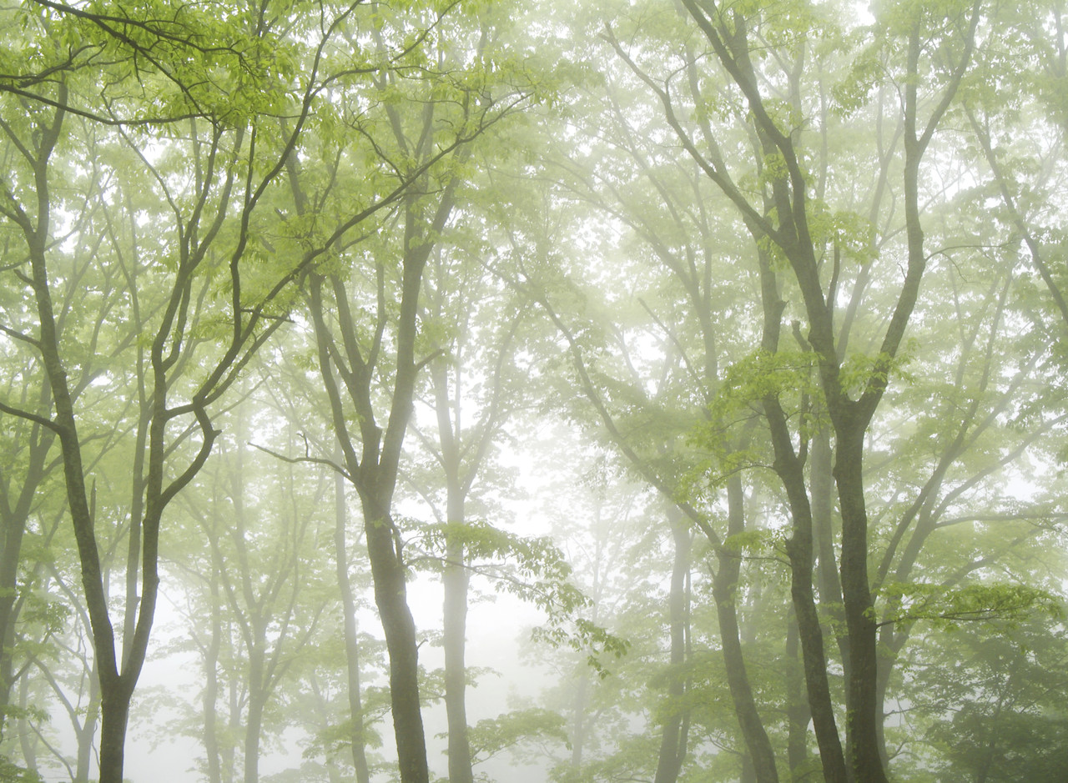
Now head outdoors
Practice using the Outdoor Classroom Rubric with the “Unnatural Walk” activity.

Slide 16
Outdoor Classroom Rubric
Skill | 4 | 3 | 2 | 1
Following Directions | I followed all of the directions for the observation or activity. | I followed most of the directions. | I needed a reminder from Mrs. M. about directions. | I needed many reminders from Mrs. M. about directions.
Safety | I followed all safety instructions. | I followed most safety instructions. | I needed a reminder from Mrs. M. to stay safe. | I needed many reminders from Mrs. M. about the safety behaviors.
Activity | I worked very hard on the observation or activity. | I did pretty well on the observation or activity. | I need to work harder on the observation or activity. | I had a lot of difficulty on the observation or activity because I just wasn’t trying.
Listening | I stopped and listened every time it was signaled. | I stopped and listened most times it was signaled. | Mrs. M. had to remind me to stop and listen when it was time. | I needed many reminders to stop and listen.

Slide 17
Now head outdoors
Once you are comfortable with the outdoor portion of your classroom management, head out to meet your trees!

