Slide 1
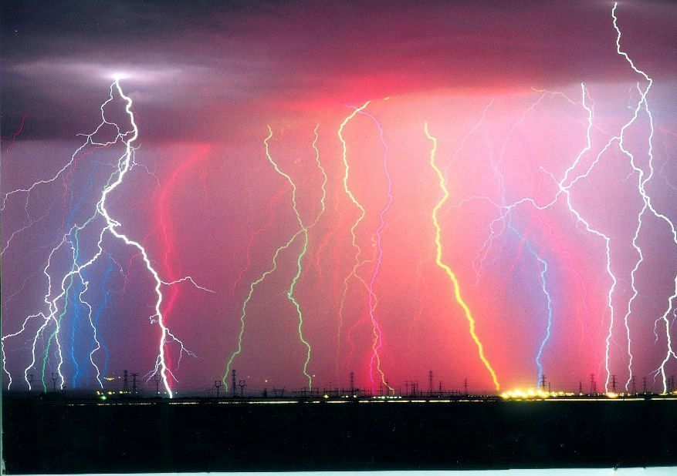
Harvard Forest Schoolyard Ecology Lightning Round
Each project leader shares 1-3 slides in 3 Minutes
March 30, 2017

Slide 2
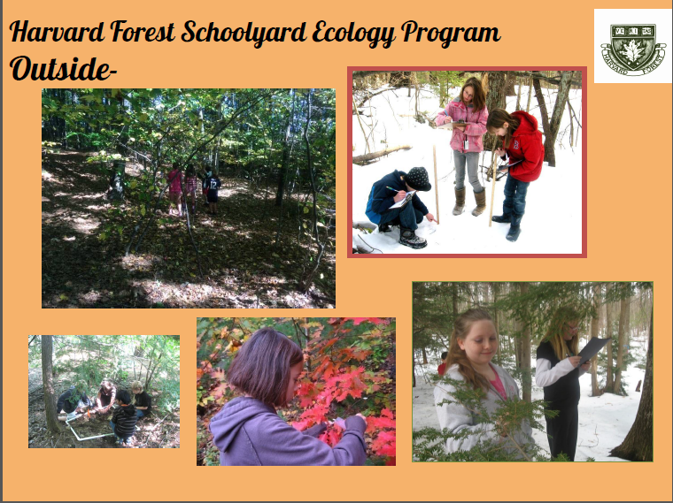
Kate Bennett – J.R. Briggs Elementary School

Slide 3
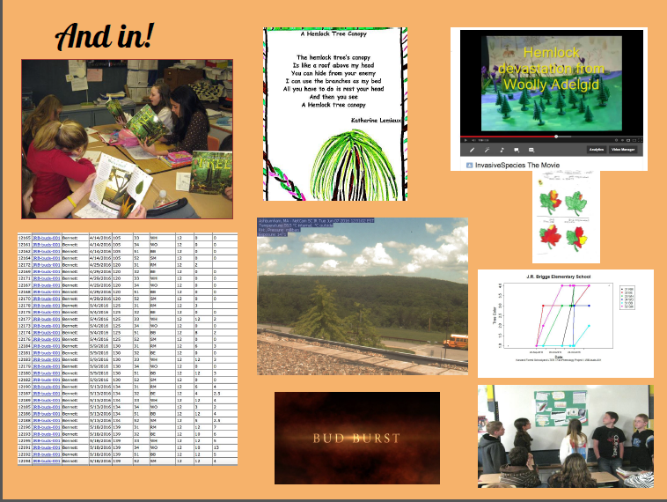

Slide 4
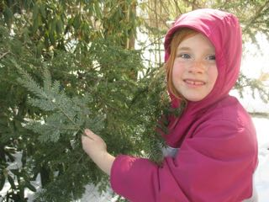
Helen James Elementary School
Robin Gurdak Foley
The discovery of wooly adelgids on Branch E of Mrs. Warner’s hemlock tree.

Slide 5
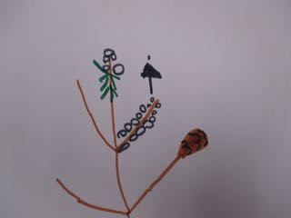
Student drawing of life stages of a woolly
adelgid on a hemlock branch.

Slide 6
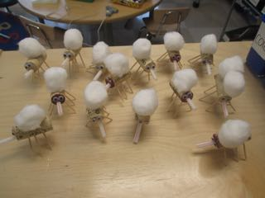
Model adelgids emerging from the wool.

Slide 7
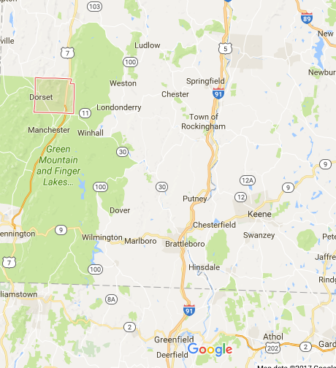
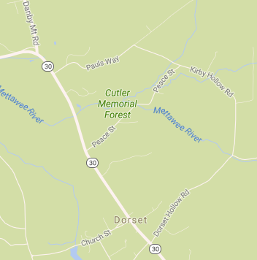
Amy Newbold: Long Trail School
Where is Dorset?
Our study site it the Cutler Memorial Forest
Long Trail School

Slide 8
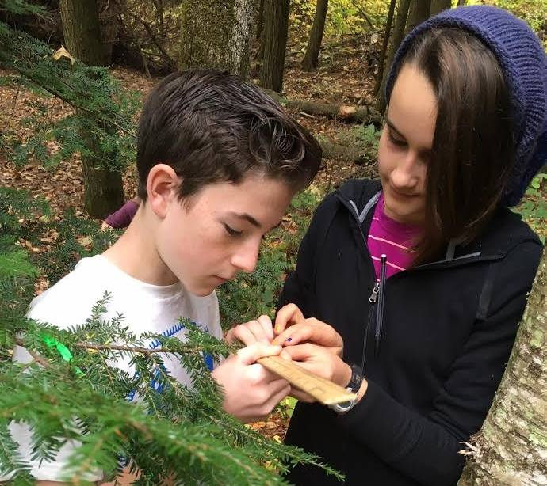
We were brand new to this project in the Fall….
….So that means next year I will have much more to say!
Working with 7th grade students
Part of a unit on The process of doing science (we stress why citizen science is important and doable!)
The Mettawee river runs through our site. I am hoping (fingers crossed) to have a biologist come and electroshock for native trout as part of our spring site visits
Expecting to do more with the data next year to teach essential skills (graphing, spreadsheets, etc.).
Glad to be here to get more ideas

Slide 9
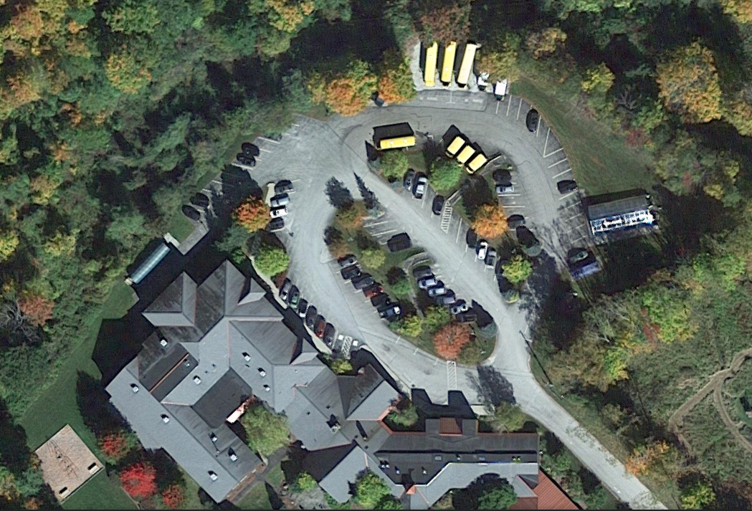
Jen Rosenthal: Long Trail School
This is our 1st year of the Buds study.
Completed Fall Data Collection.
We have 5 trees that we have been studying (4 sugar maples & 1 white ash).
Location- perimeter of the parking lot
Tree Selection- various reasons

Slide 10
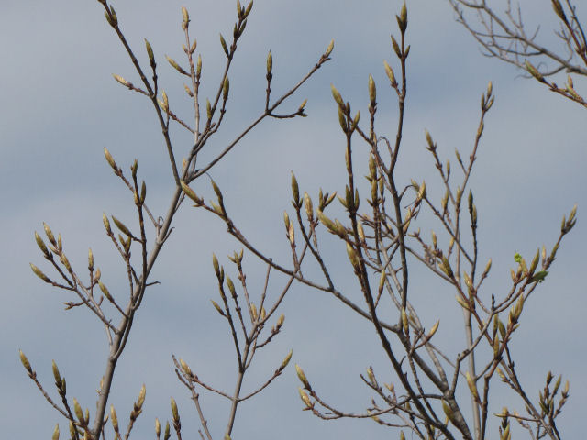
My plans for the future…….
Spring 2017 - Bud Collection
Continue collections with future 9th Grade Integrated Science classes
Have students begin to analyze data & present their findings at our STEAM Fairs that are held every other year.
Have advanced students complete meta analysis of data sets for independent projects.

Slide 11
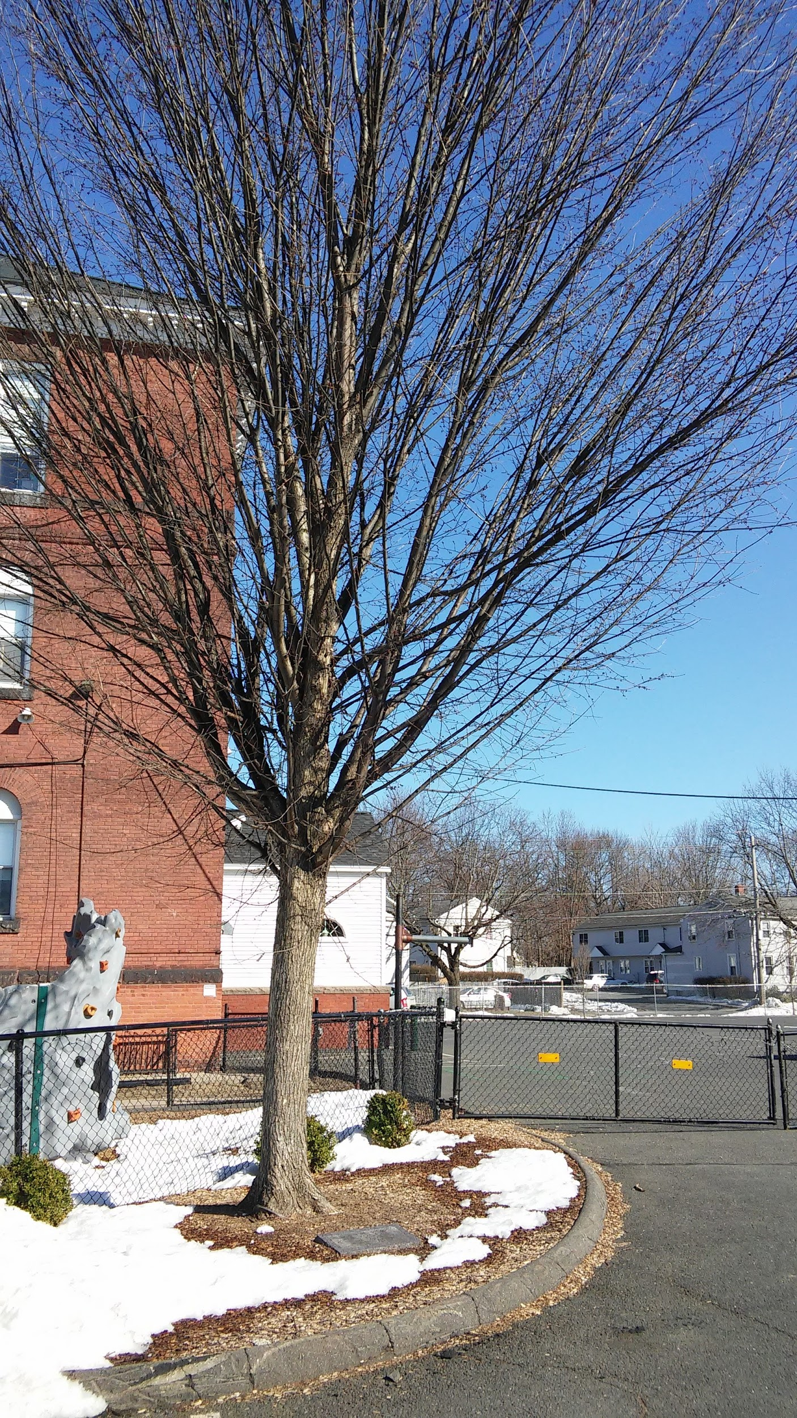
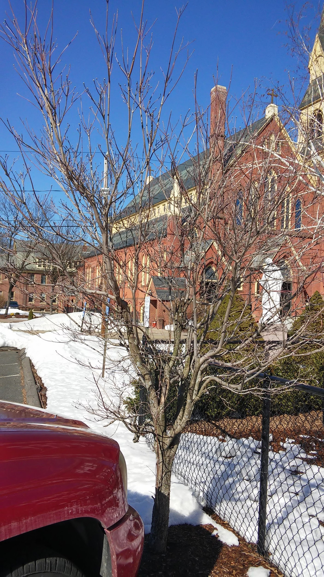
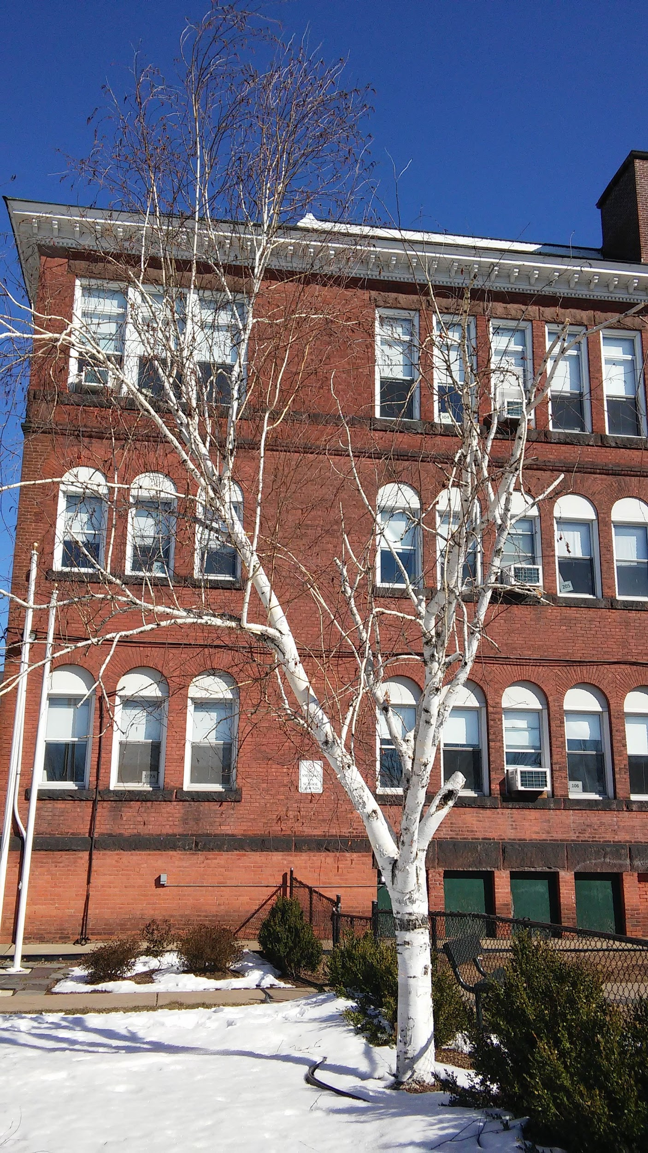
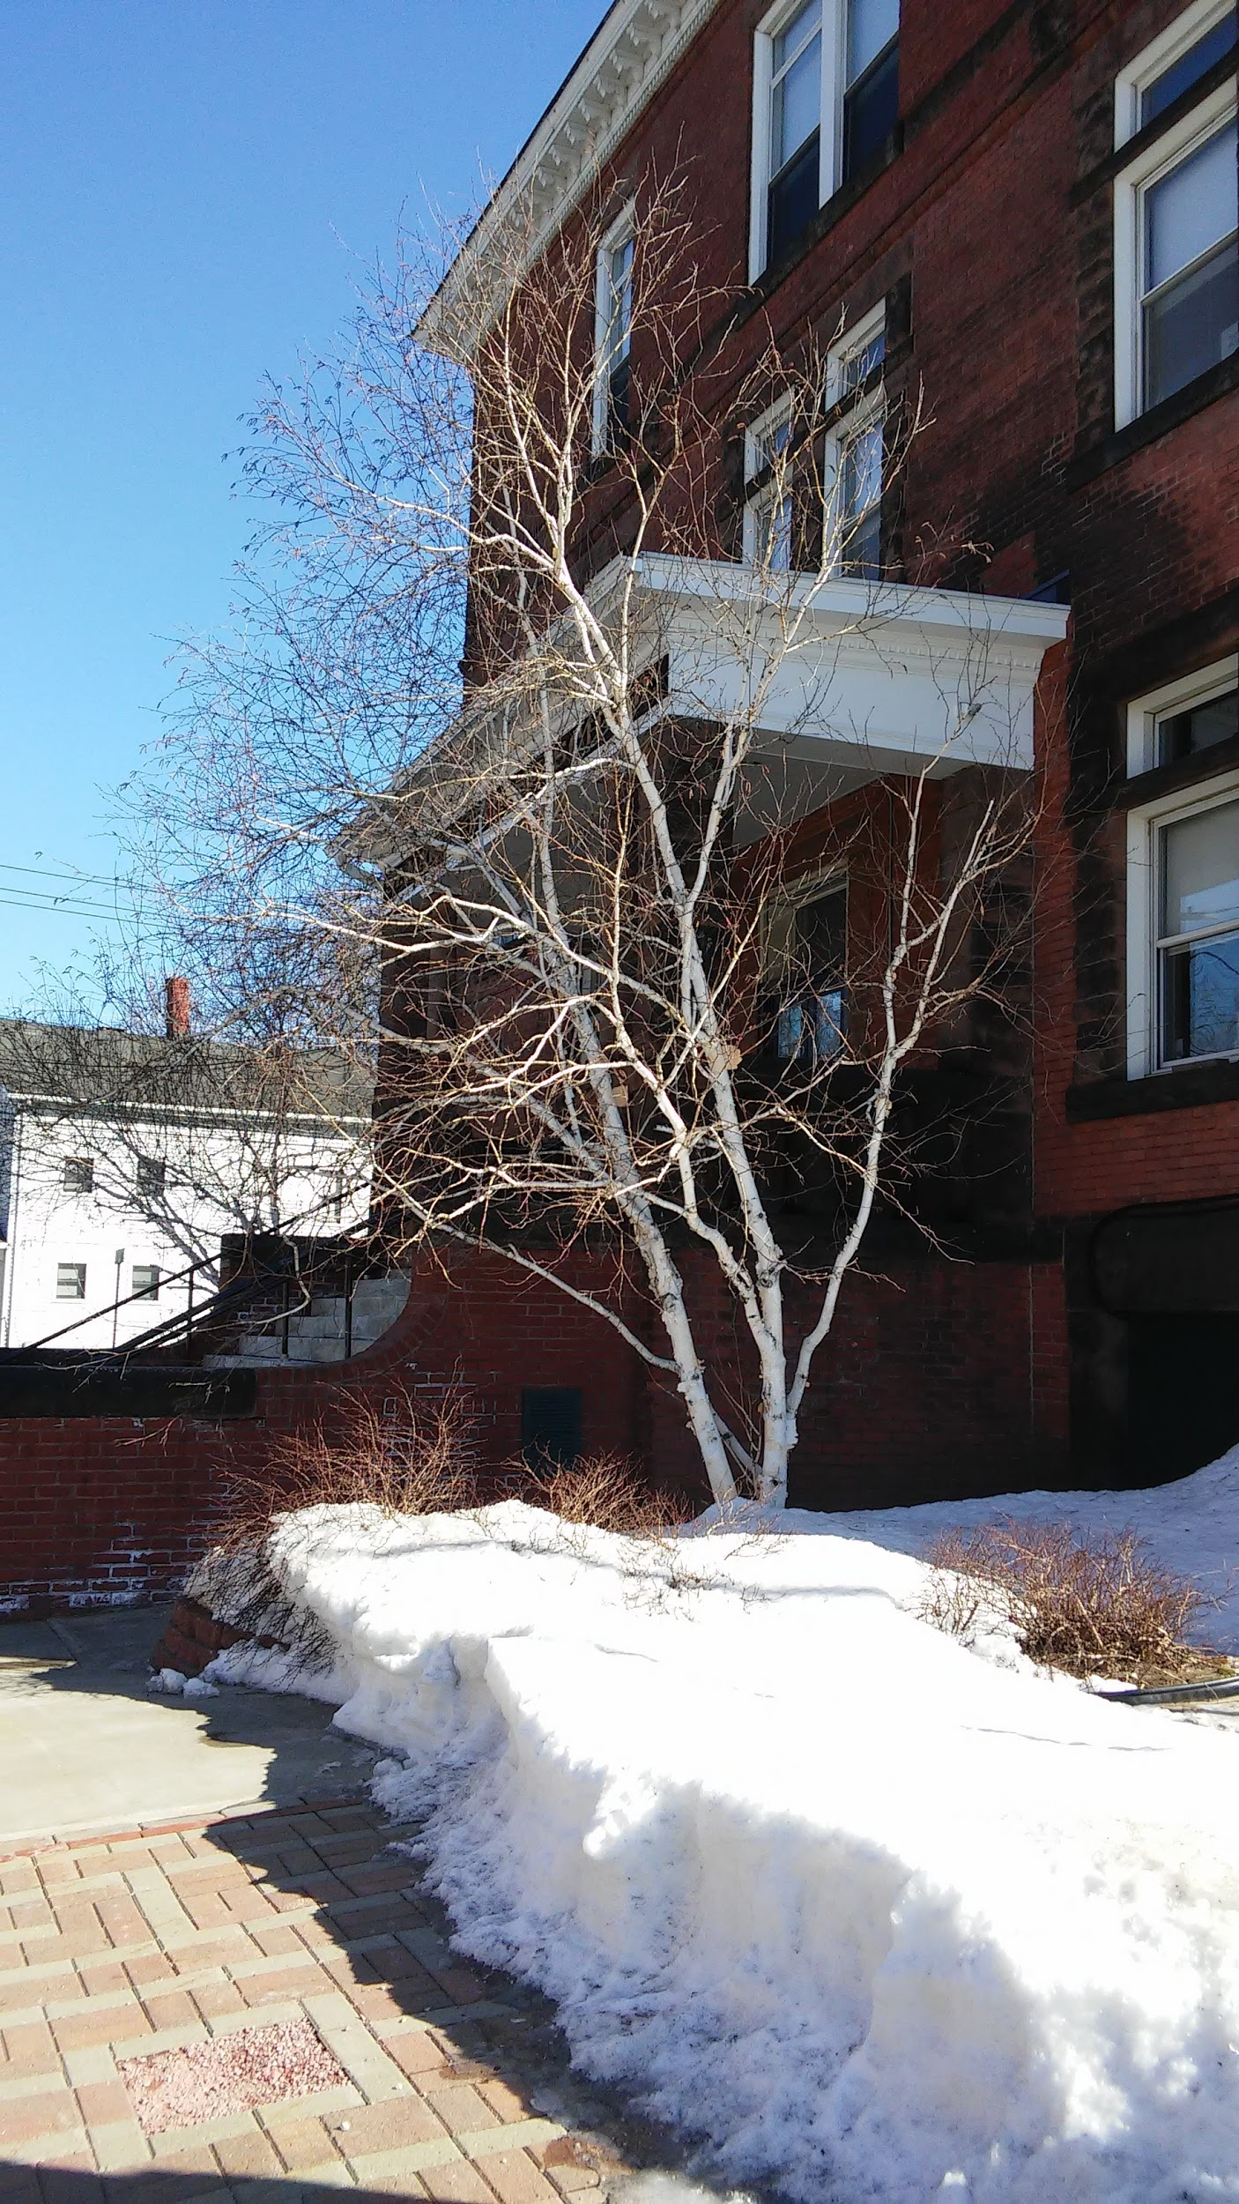
St. Mary’s Parish School Grade 5
Mary Reed

Slide 12
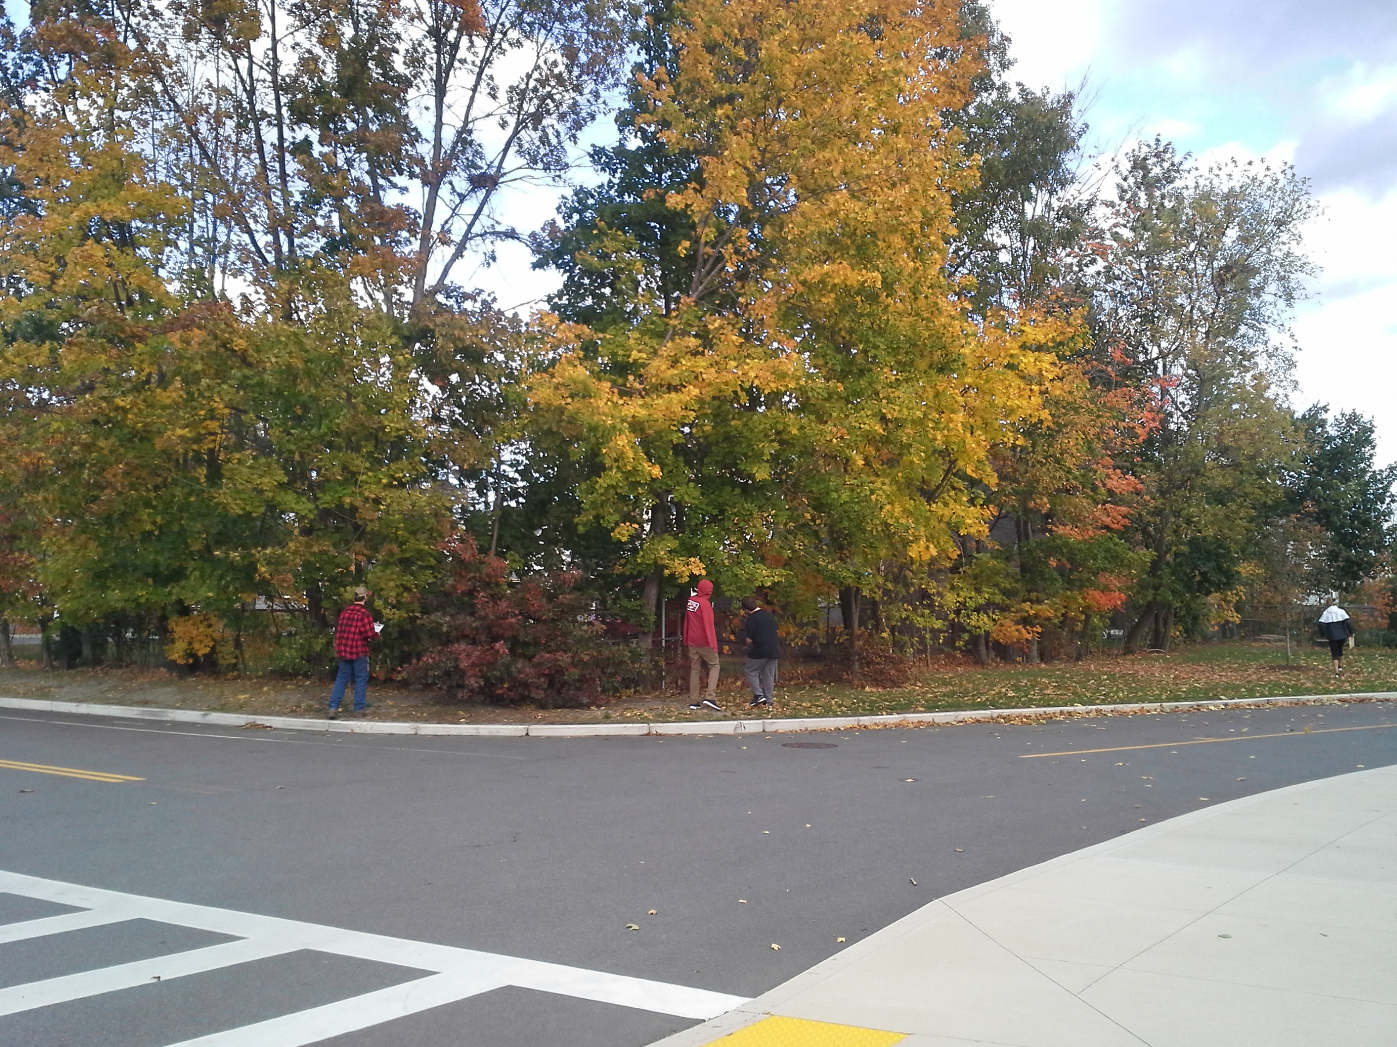
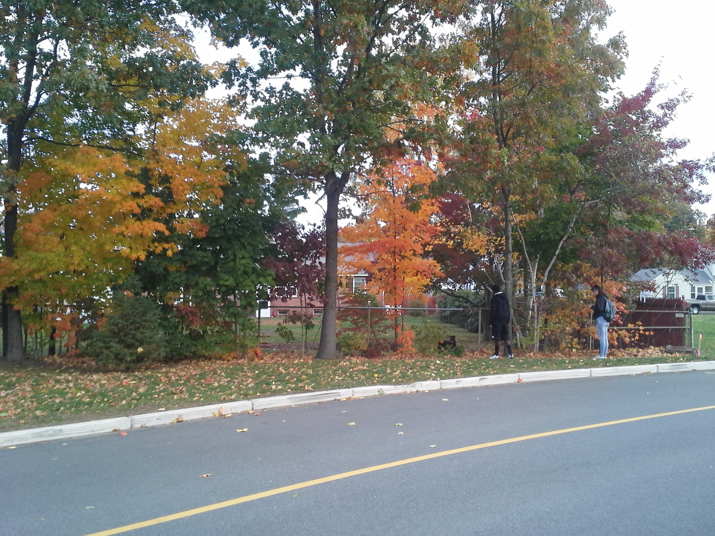
Greenfield High School
4 trees
16 branches total
3 biology classes

Slide 13
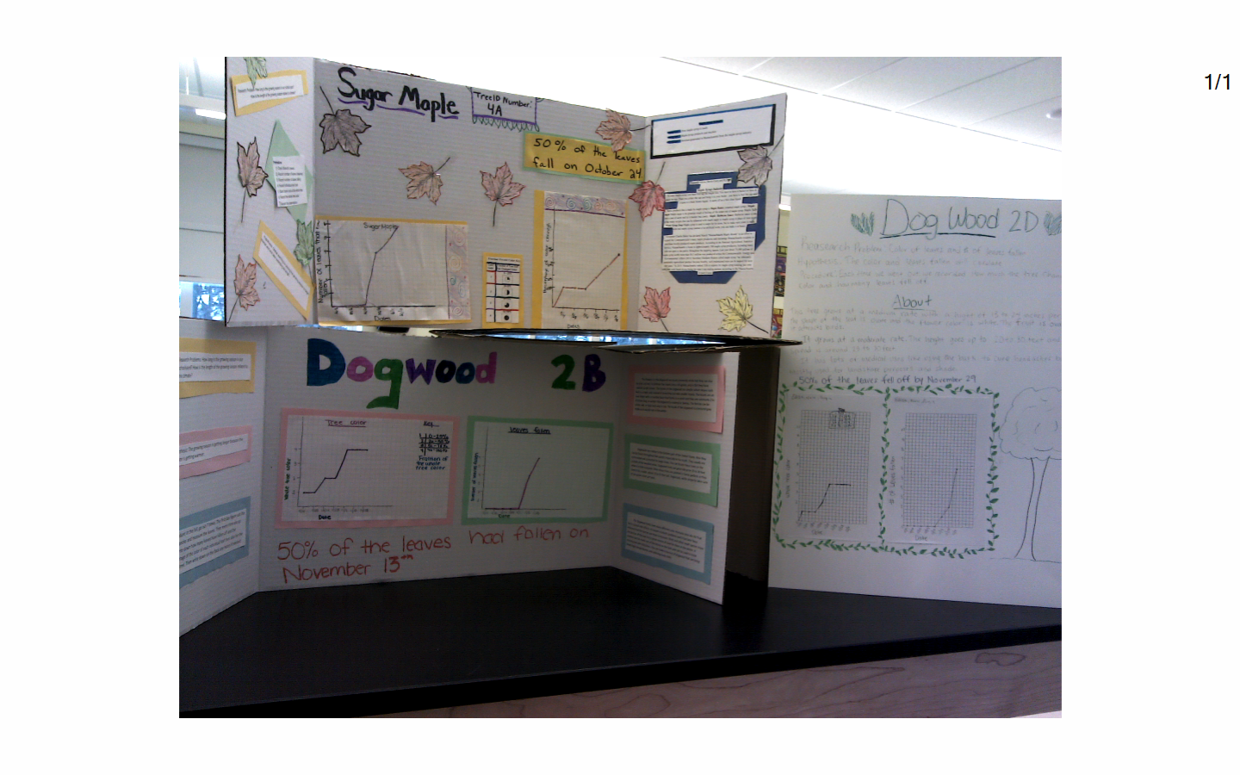
Displaying the Data

Slide 14
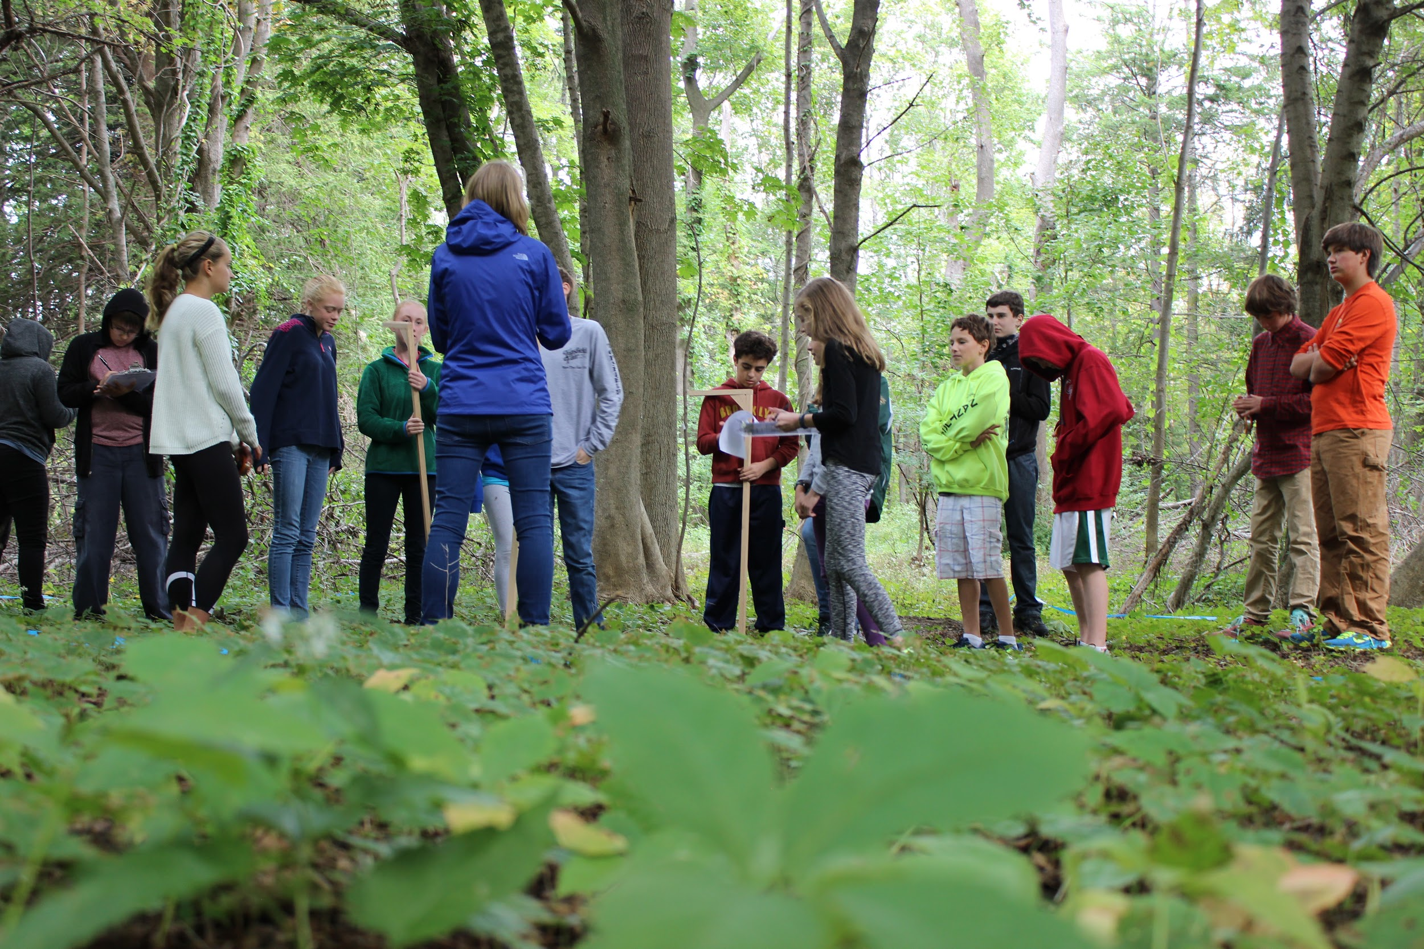
Our Changing Forests At Glen Urquhart School
Total of 31 7th graders
Work in groups of 3 or 4
Practice measuring DBH of cardboard cylinders, poles in classroom
Each group of 4 measures every tree in plot
Identify leaves indoors first, using field guides (Leaf Snap App)
Identify trees in plot

Slide 15
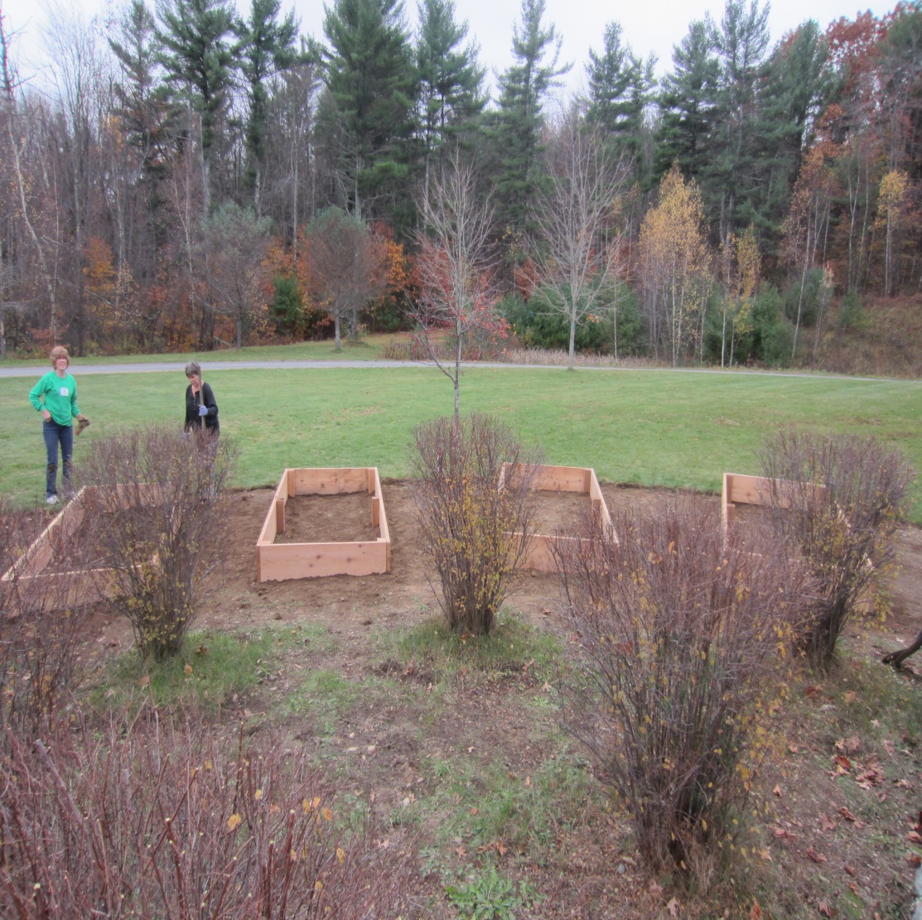
Overlook Middle School JoAnn Mossman

Slide 16
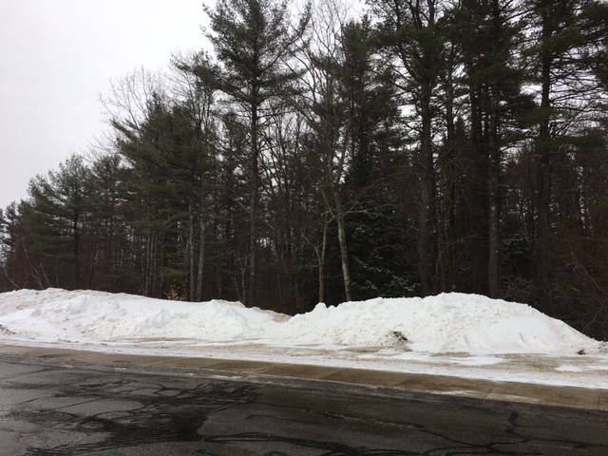

Slide 17
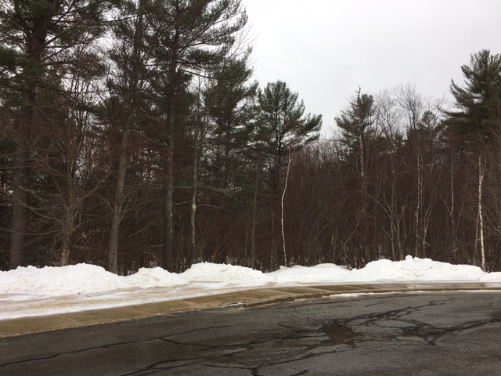

Slide 18
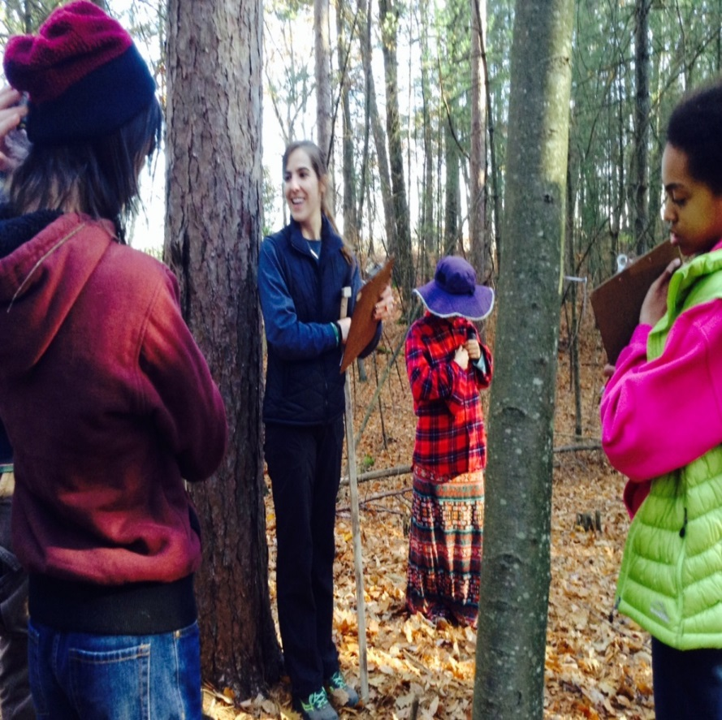
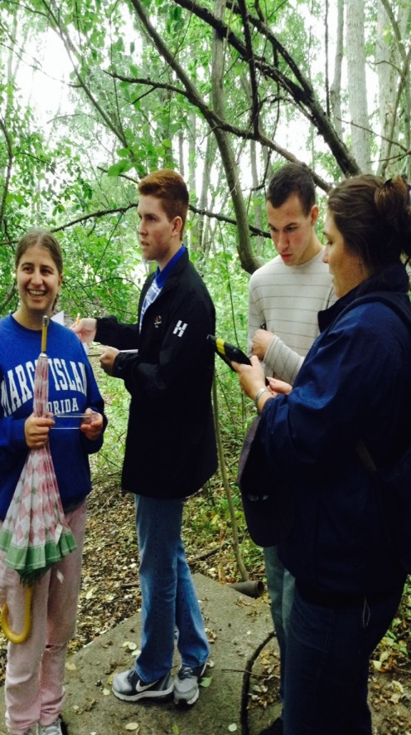
Harvard Forest Programs at
Mass Audubon’s Drumlin Farm
Wildlife Sanctuary
Changing Forest Study with Carey Lang and Wildlife Biologists
Concord-Carlisle Pathways Team Eco-monitors at pond # 2

Slide 19
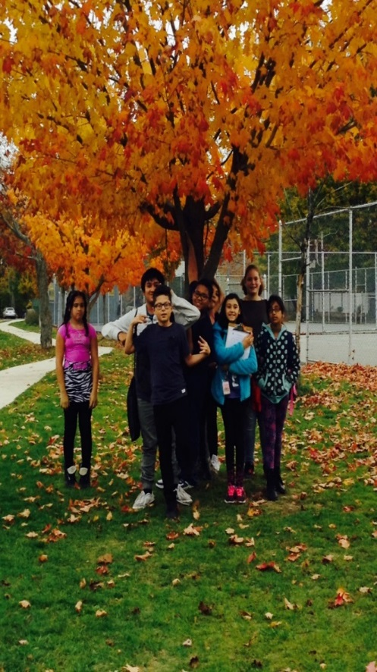
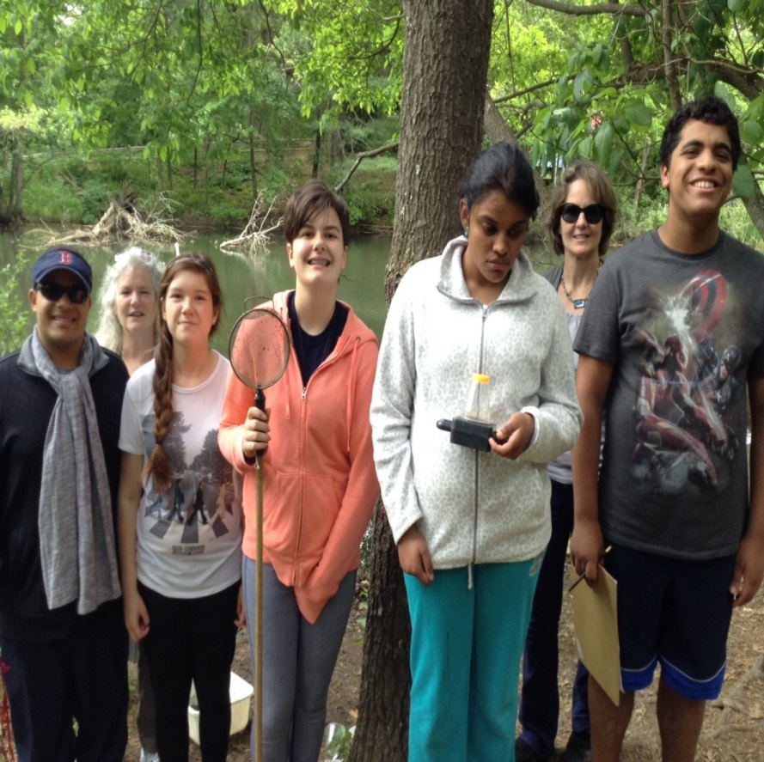
Harvard Forest Phenology and Hydrology Studies
Phenology Study in Lowell at Robinson Middle School Sugar Maple
Hydrology Studies at Drumlin Farm Pond #4 with AB Eco-Monitors

Slide 20
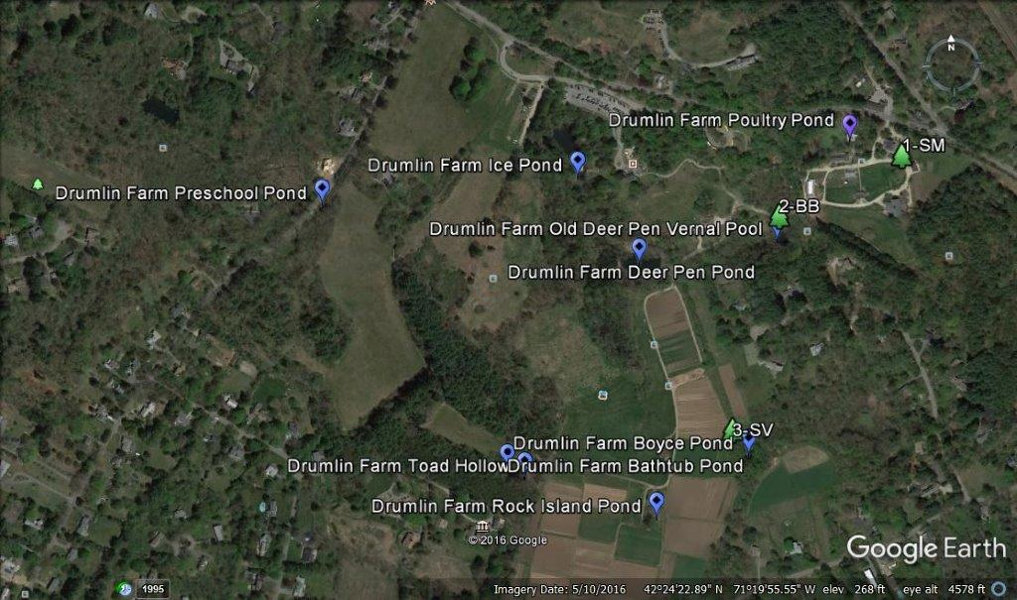
Vernal Pools, Ponds and Study Trees at Mass Audubon’s Drumlin Farm Wildlife Sanctuary

Slide 21
Belchertown schoolyard ecology
Exploring cross-grade partnerships
Clark - SRE grade 2
&
Levy - Woodland/Honors Ecology

Slide 22
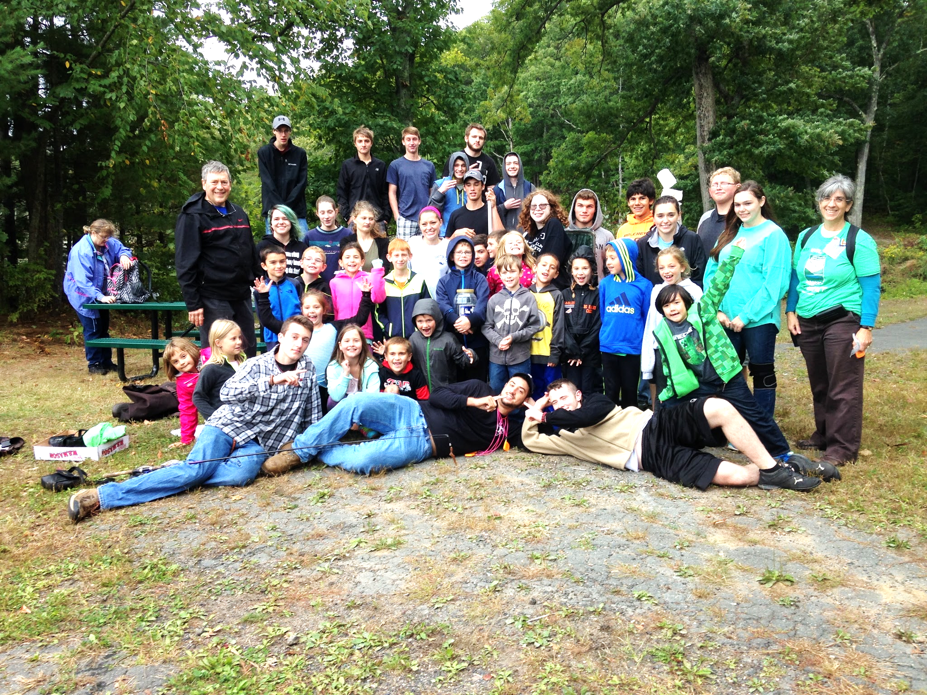
WEco and Clark explore Lake Wallace together

Slide 23
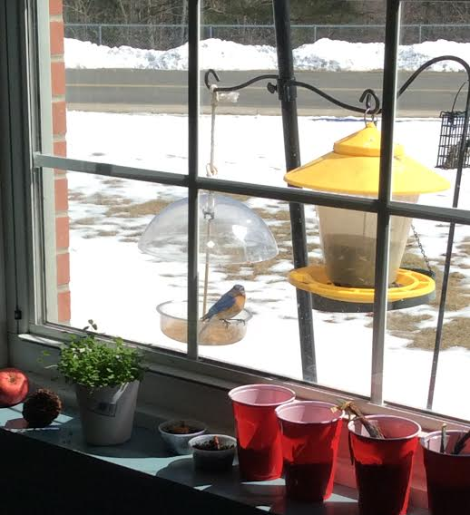
Check out the view out Clark’s window!

Slide 24
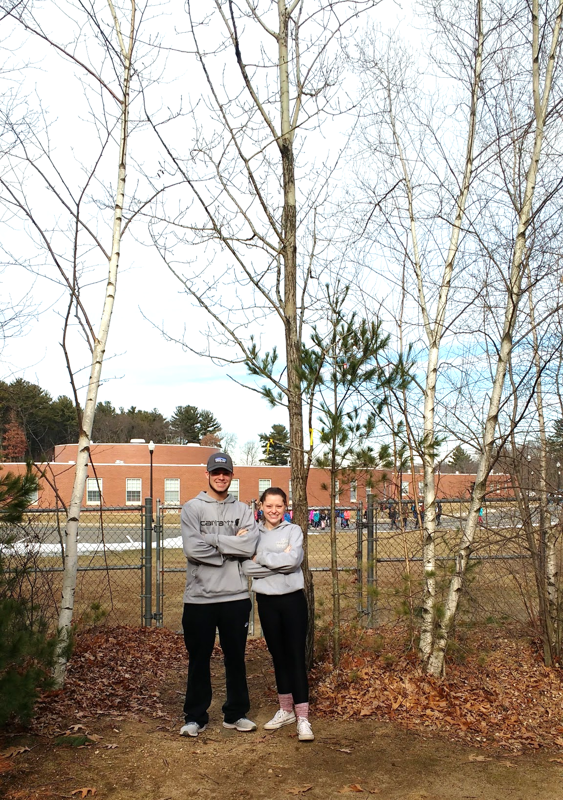
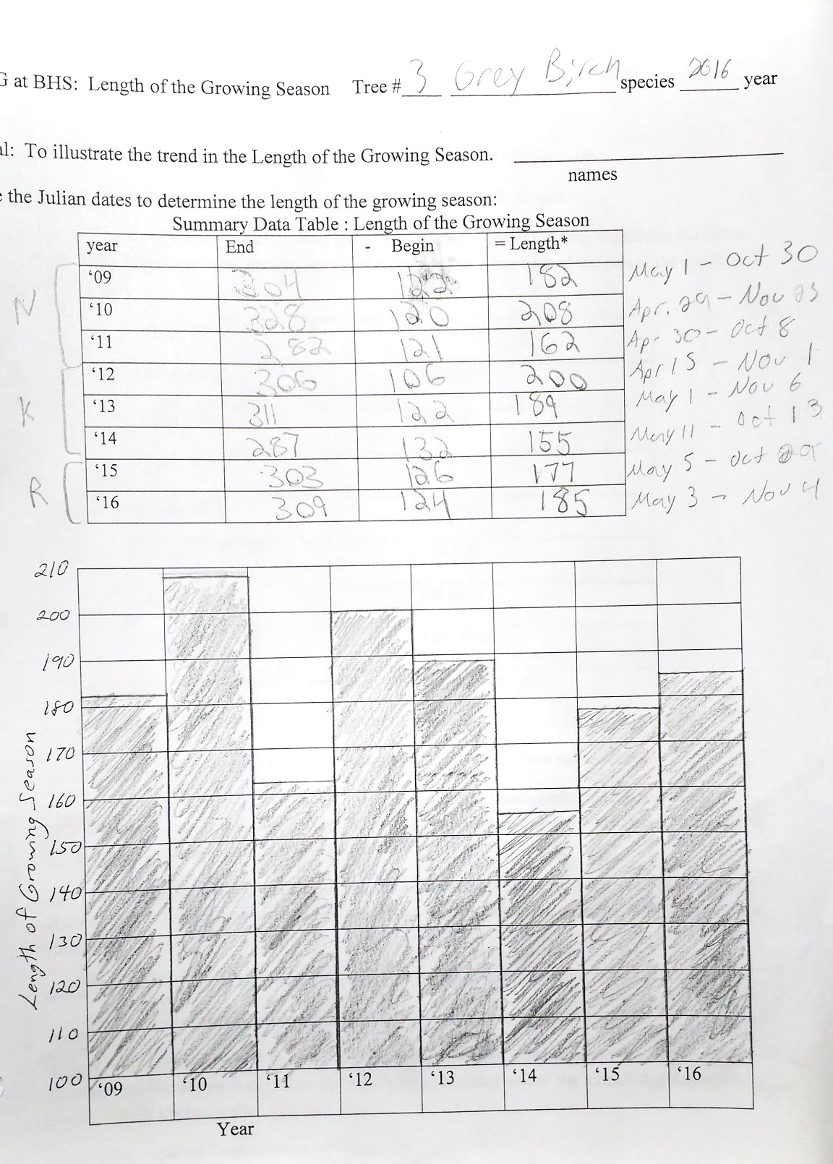
Knowing your Tree

Slide 25
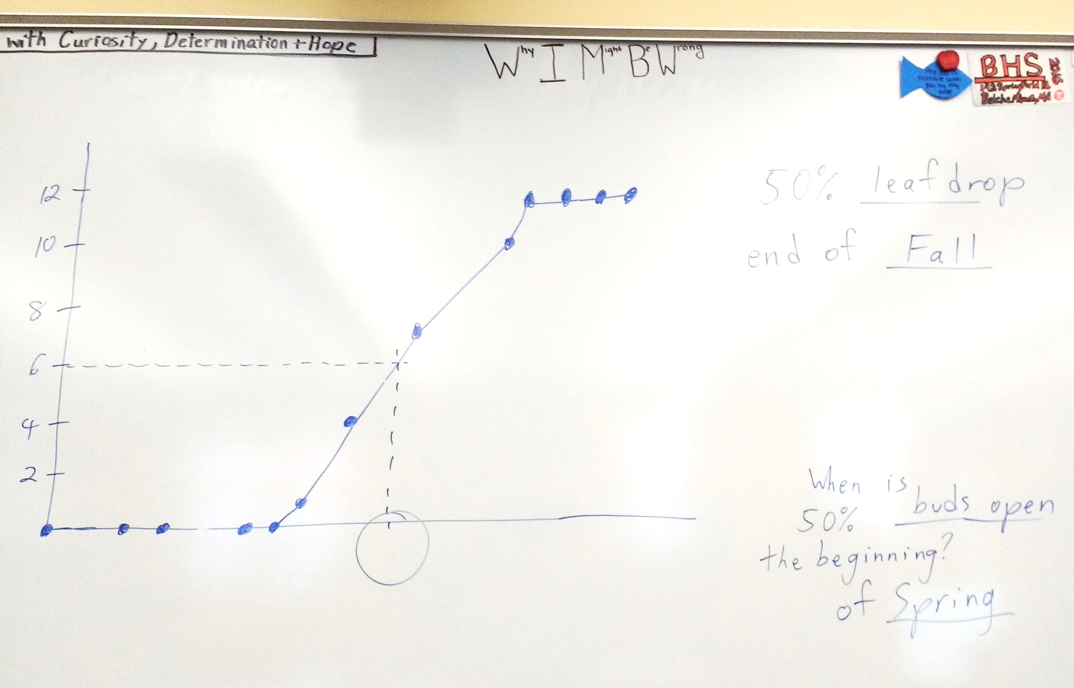

Slide 26
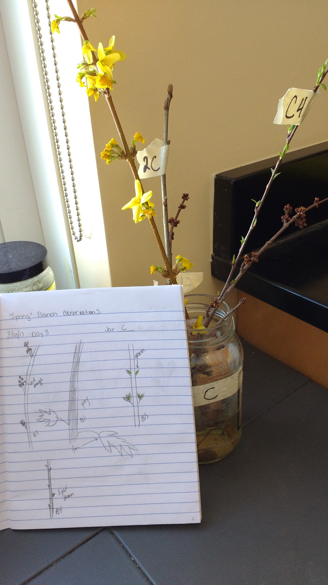
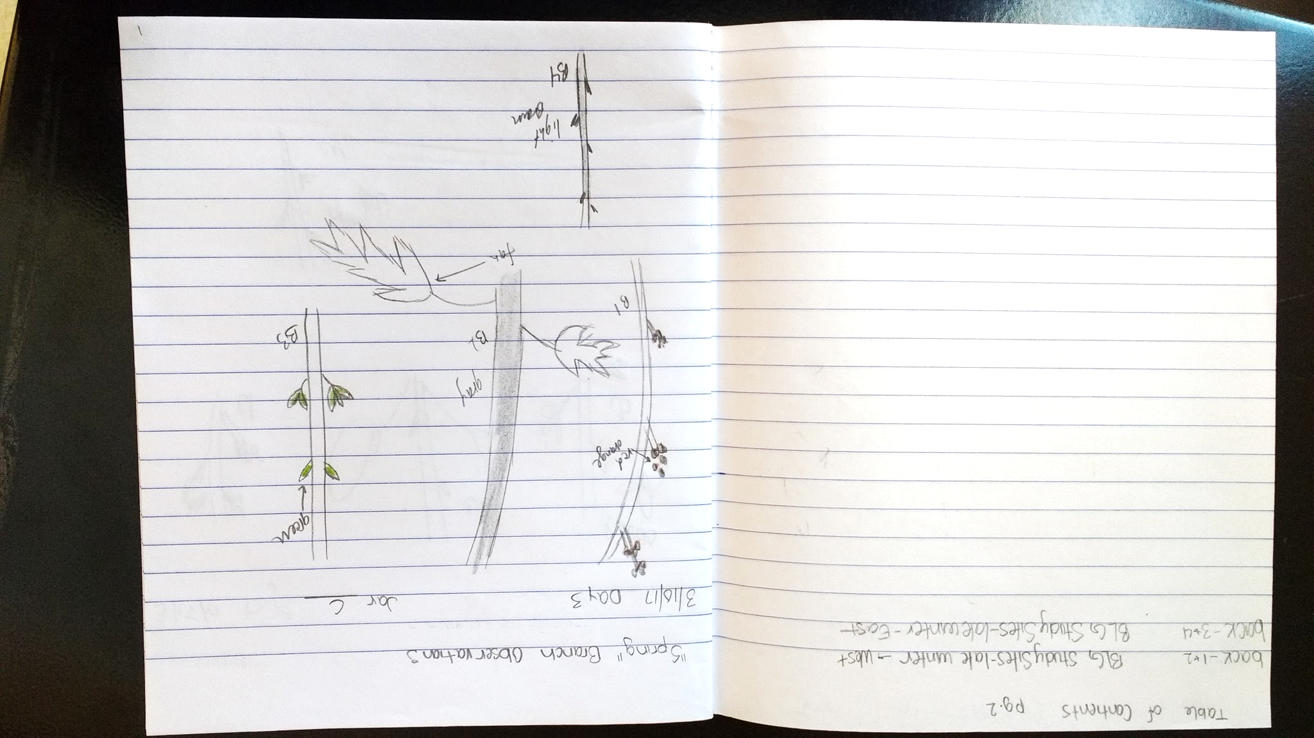

Slide 27
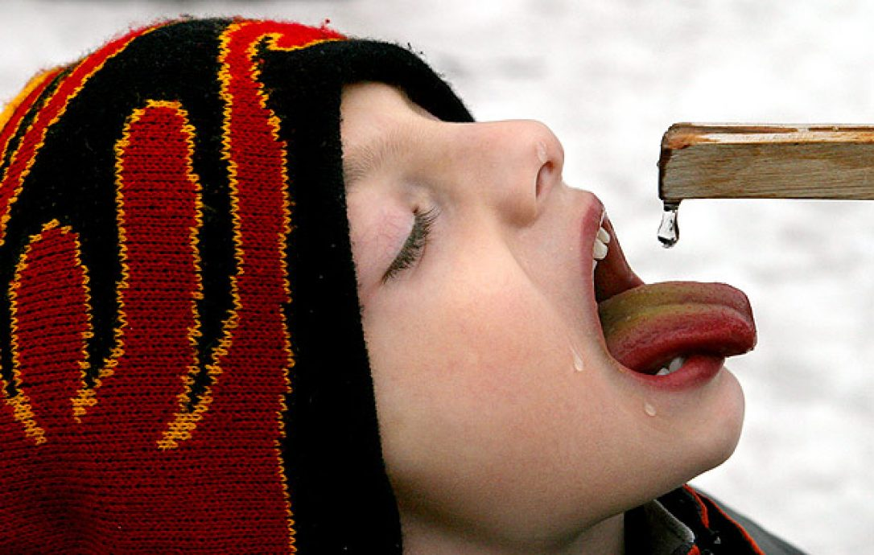

Slide 28
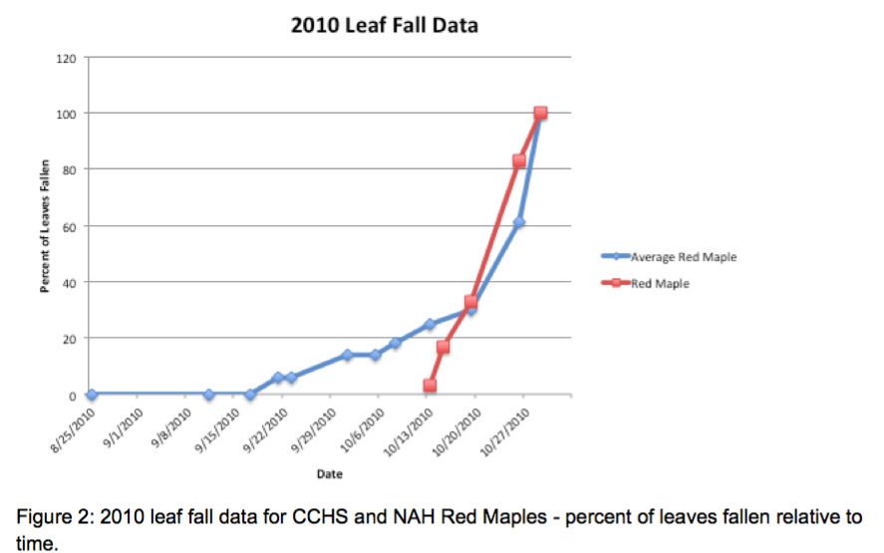
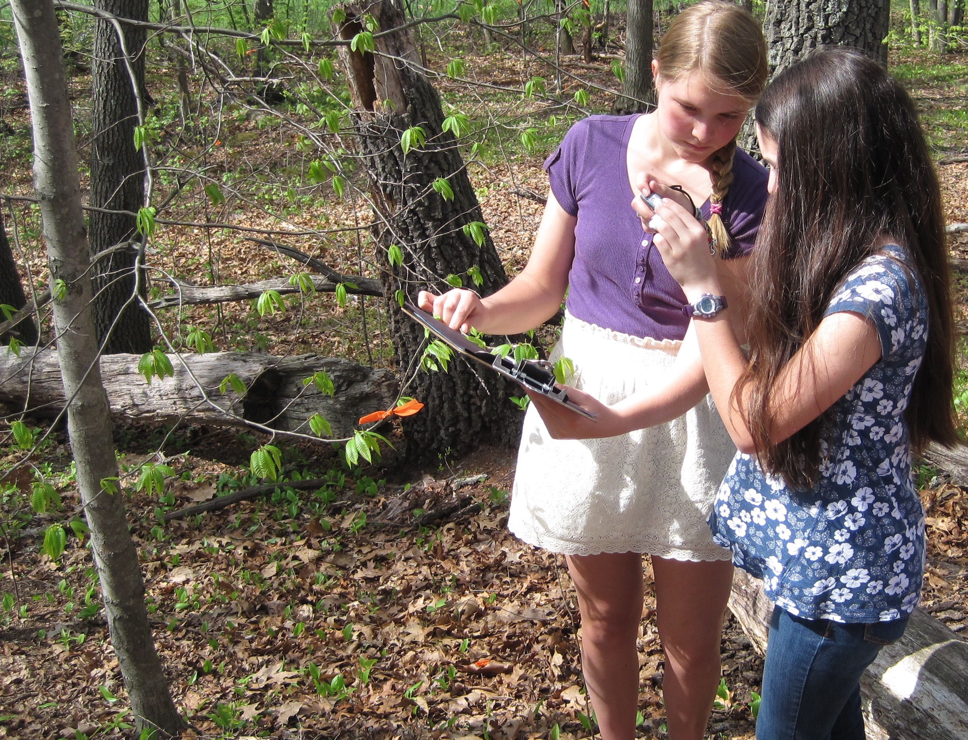
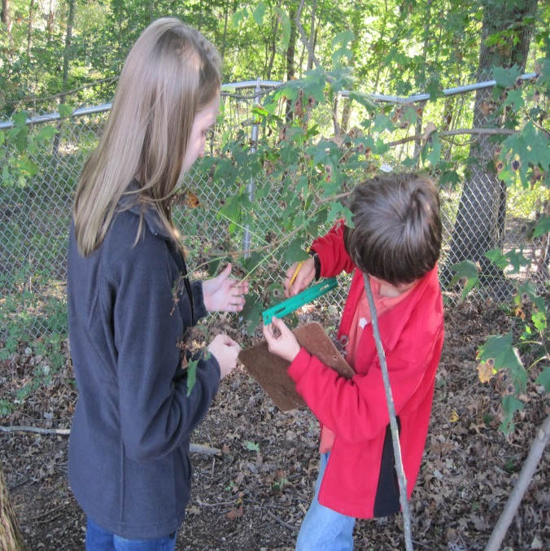
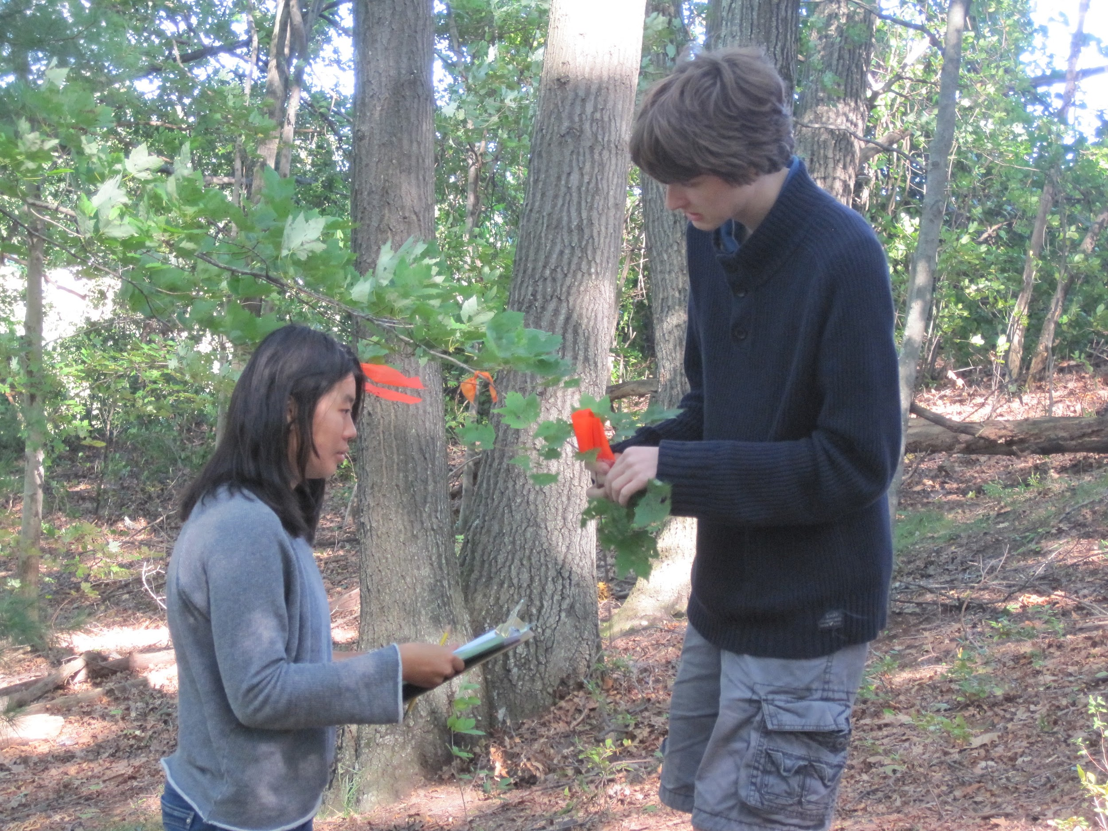
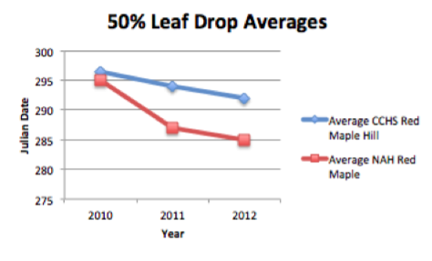
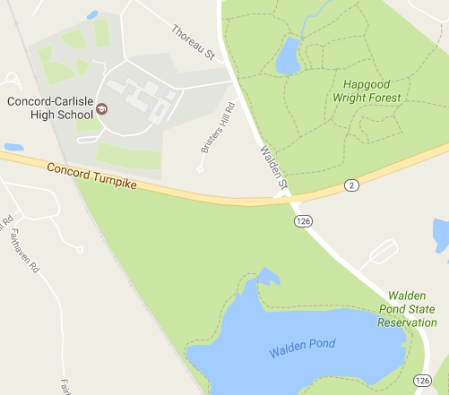
Phenology at Concord-Carlisle High School (MA)
Nora Murphy (and Priscilla Guiney, Peter Nichol, Jennifer Benson, and Jim Truncer)
CCHS student teaching data collection to 5th grader
Members of the Environmental Field Studies Group
Graphs by E. Zeng, AP Bio CCHS 2013
Notes:
For seven years, we have been tracking and recording data from leaf falling and leaf budding.
EFSG first, then also AP Bio (Fall 2012 →)
North Attleboro High School
AP Bio analyses – geographic or weather patterns

Slide 29
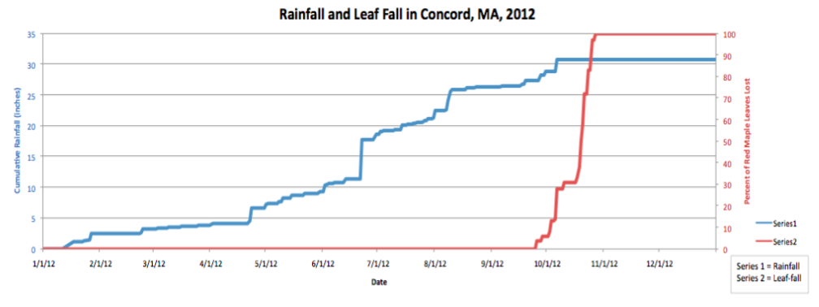
Tree Phenology and Annual Weather
Graph by R. Walton, AP Bio, CCHS 2013
Notes:
2012-13 AP Bio students were able to meet Carolyn Polger (from Richard Primack’s group) who studied tree phenology in Concord for her doctoral research
Shift from Excel to Google Sheets for graphing

Slide 30
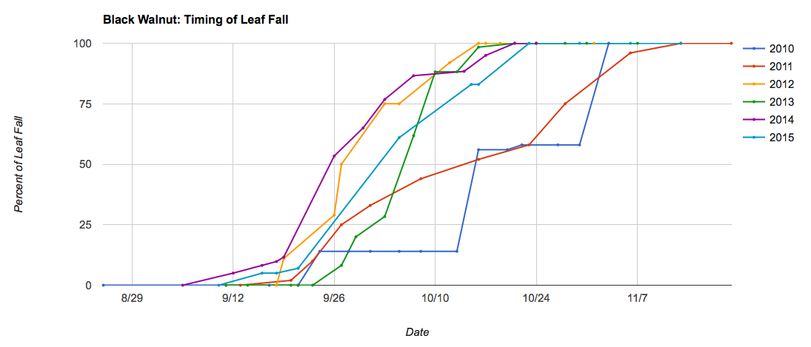
Leaf Fall Data Over Six Years (Black Walnut)
Notes:
Data collected over 7 years (and counting) so we are really interested to see how global warming and associated weather changes will affect tree phenology
Goal for 2017-18: create set of graphs for Introductory Biology students to analyze

Slide 31
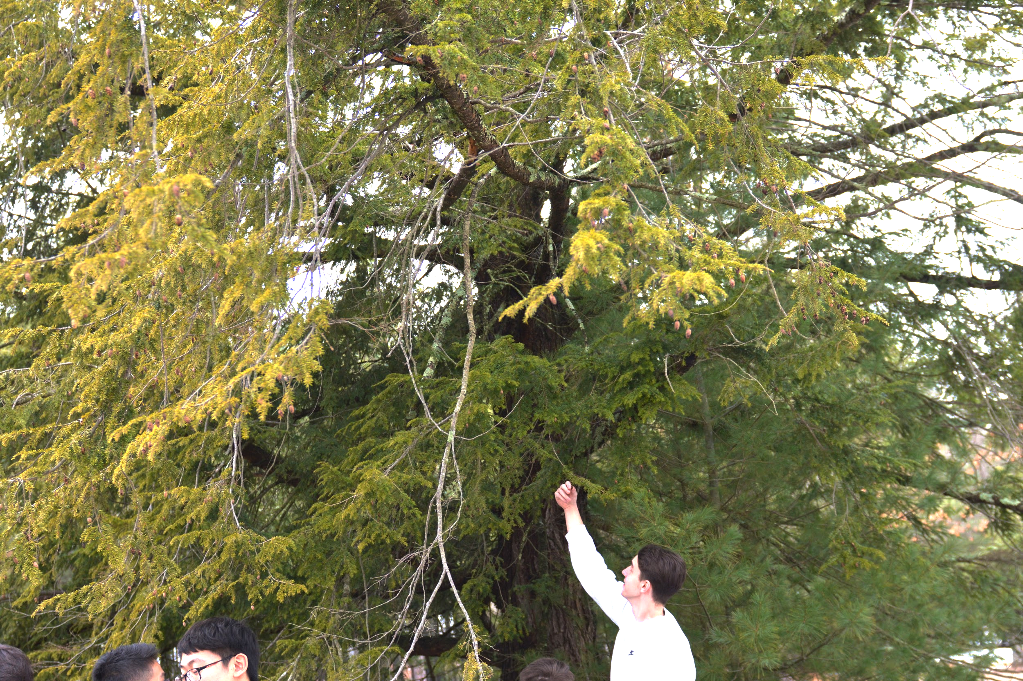

Students checking for hemlock pests
Notes:
Students checking for hemlock pests

Slide 32
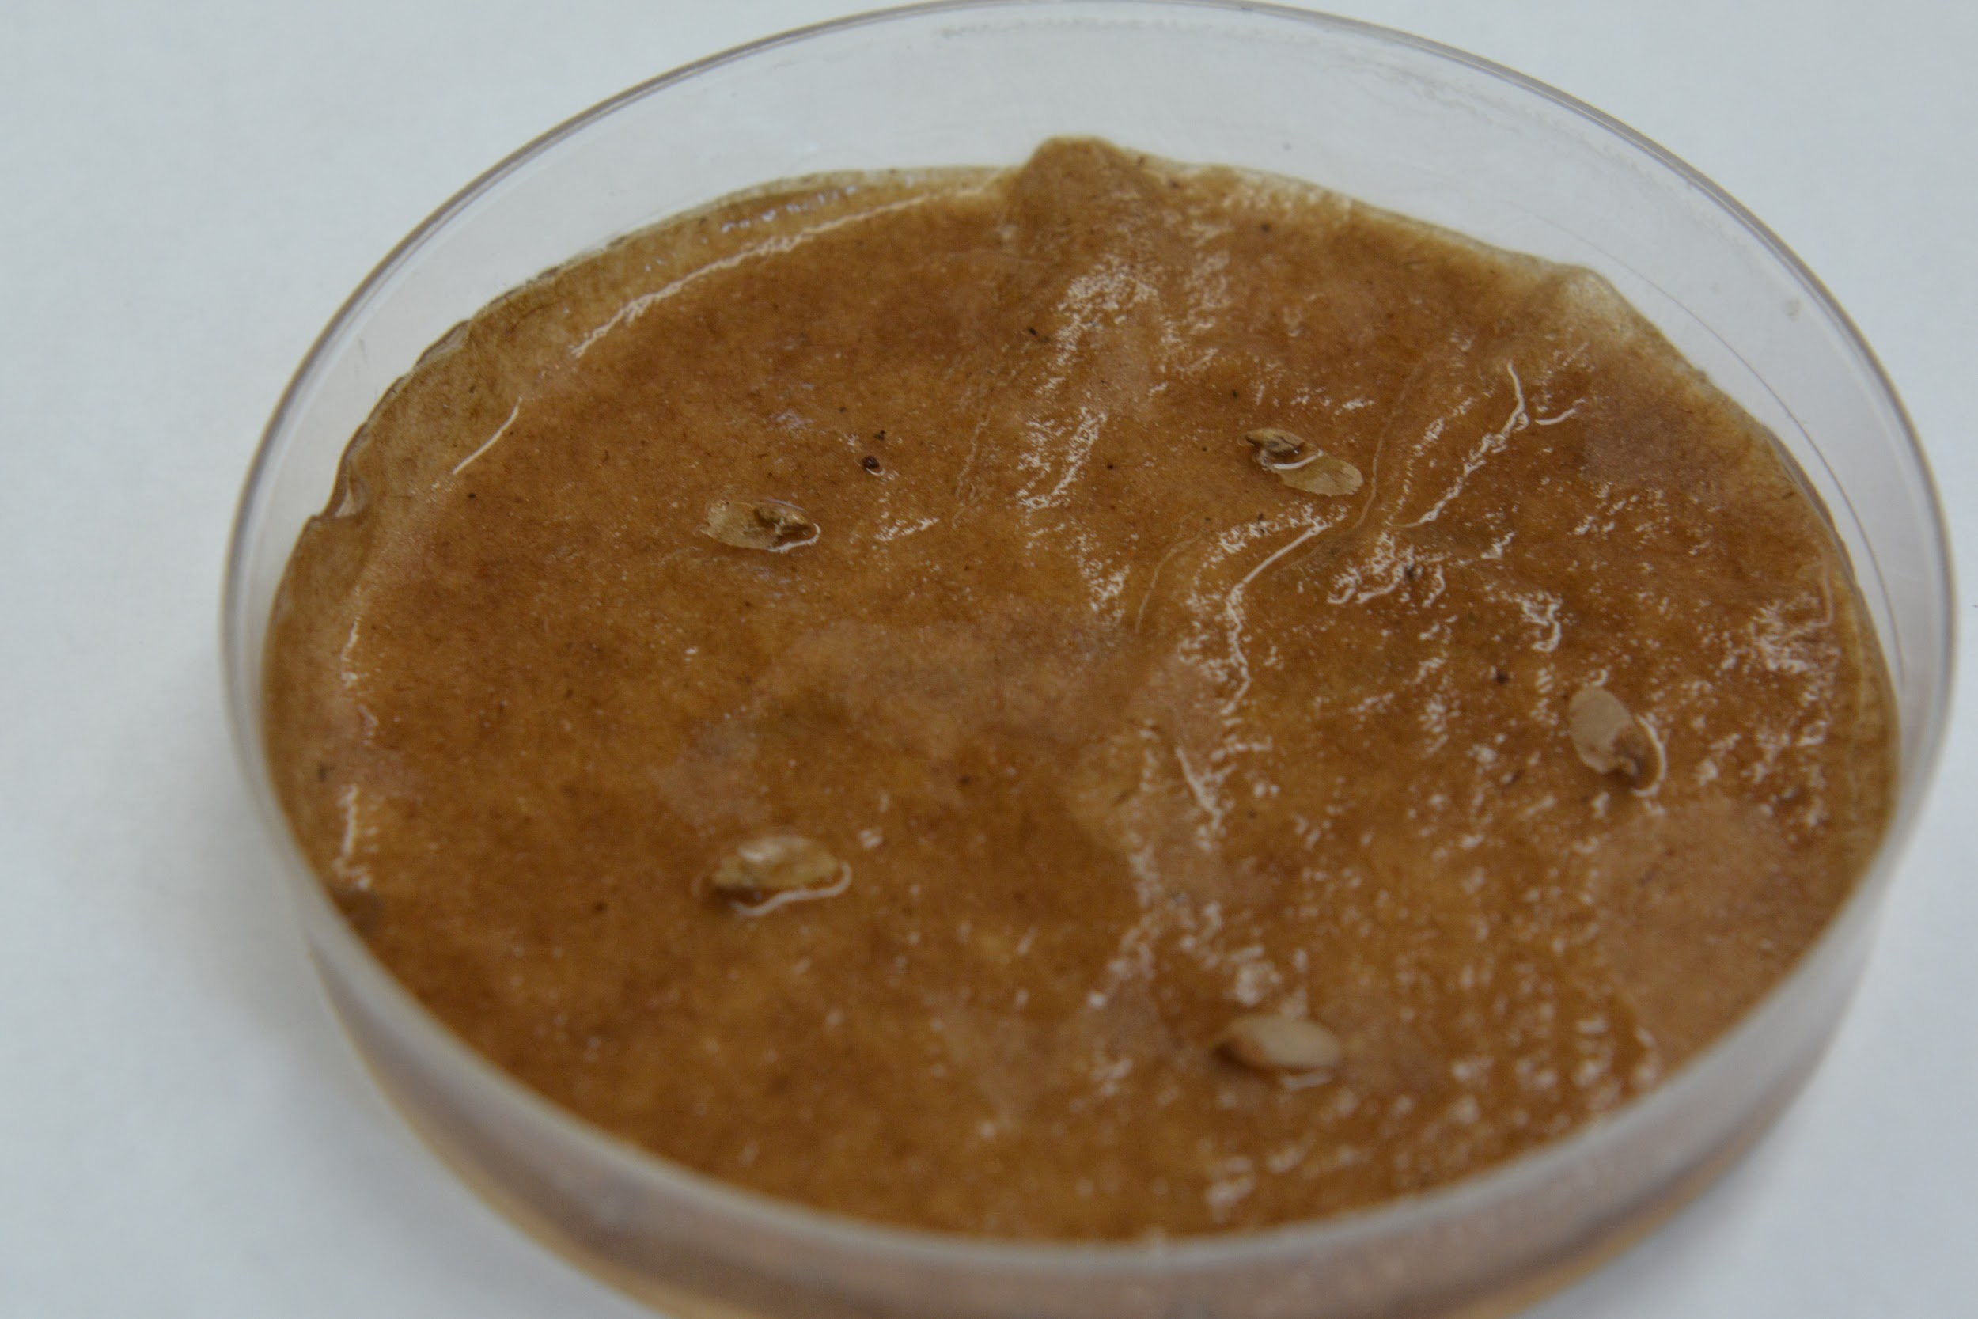
Hemlock seeds in culture dish
Notes:
Hemlock seeds in culture dish

Slide 33
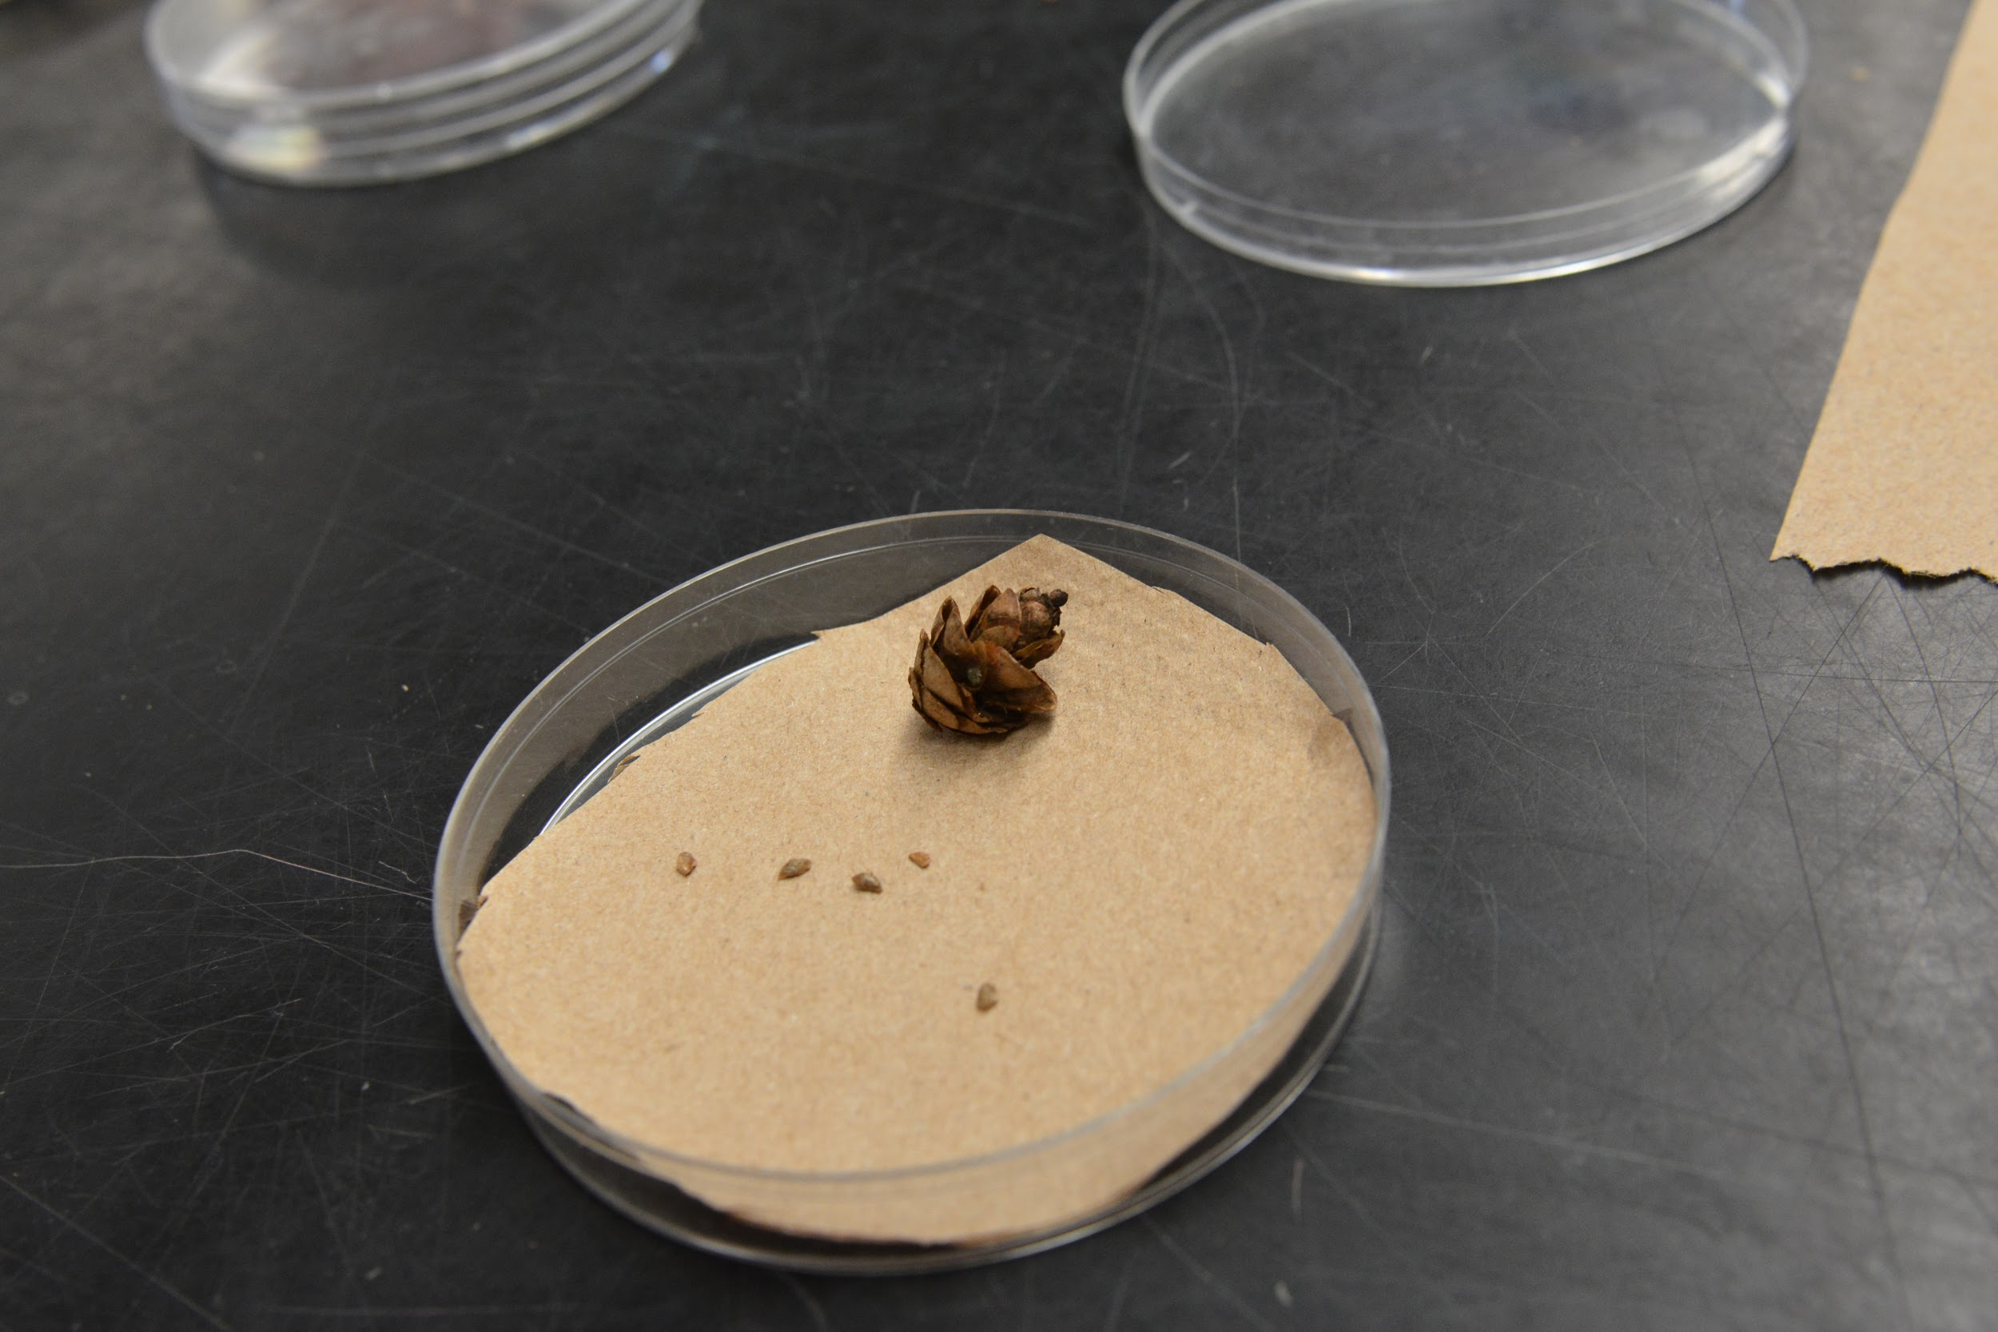
Hemlock cone with seeds
Notes:
Hemlock cone with seeds

Slide 34
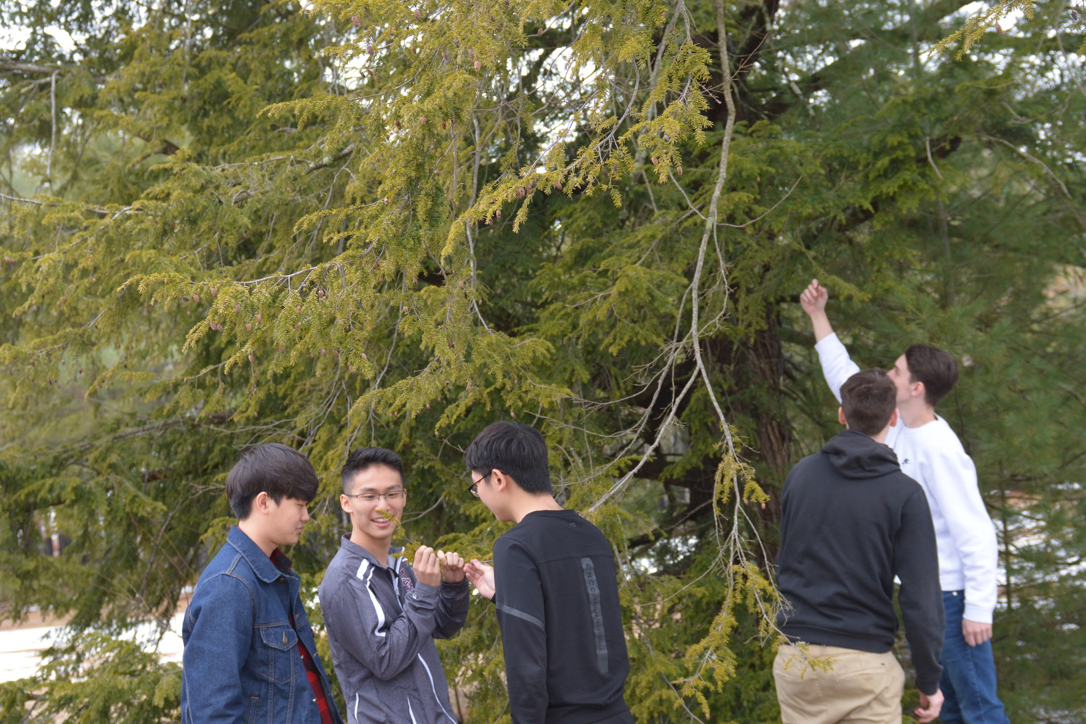
Environmental Science students looking for hemlock cones
Notes:
Environmental Science students looking for hemlock cones

Slide 35
Melanie McCracken- Groton Dunstable H.S.
Forest Measurement Lab
An in class exercise to complete after doing the plot survey for “Changing Forests” CP1 Environmental Science high school class

Slide 38
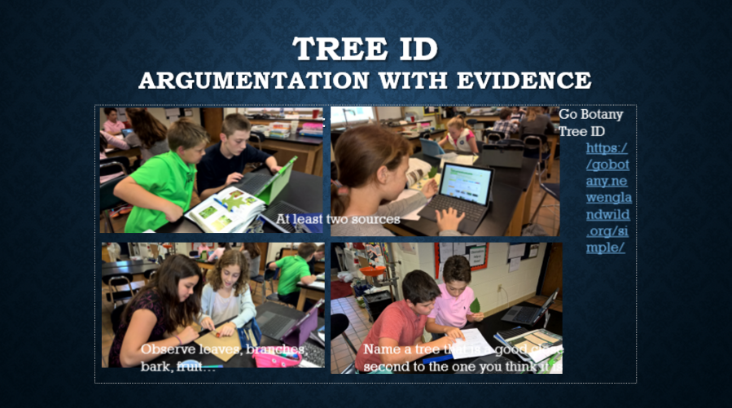
Williston School – Jane Lucia

Slide 39
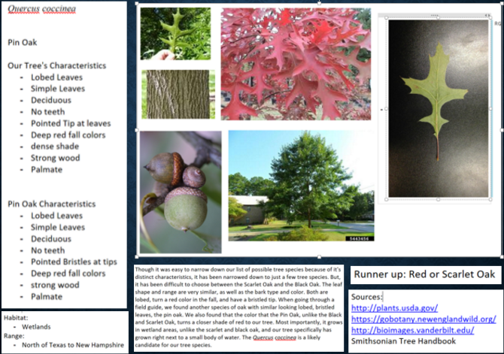

Slide 40
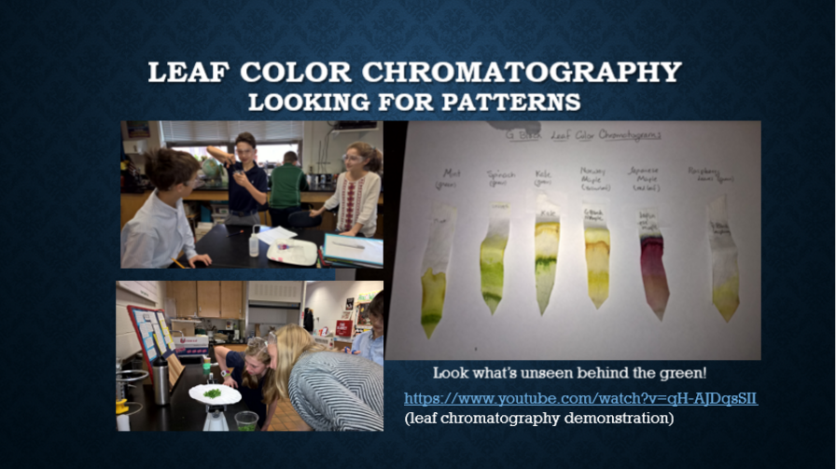

Slide 41

Bartlett Community Partnership School, Lowell, MA
What trees in my neighborhood?
Using Project to Encourage Curiosity of Local Ecosystem

Slide 42


BCPS, Lowell, MA
Where do trees get their mass?
Using Project to Practice
Measuring Skills, Precision and Recording Data

Slide 43


BCPS, Lowell, MA
Identifying Species

Slide 44



Vanessa Bergmann
Shutesbury Elementary School
SUCCESSES
Schoolyard set-up (Big thanks to Louise Levy!)
Student engagement
Knowledge of citizen science
Ecosystem science standards: (interactions, energy, dynamics)
Student ownership of data collection
Time outside!

Slide 45



CHALLENGES
Consistent data collection
Outside time student management
Communication & plan for data
interpretation
Winter check-ins
Incomplete dataset (1st year)

Slide 46

NEXT STEPS
Analyze Fall data
Conclusion paragraphs
Let data drive new questions
Spring data collection for 2017-18 students
Advice for maternity leave sub (setting up Fall ‘17 protocol?!)

Slide 47



New Demonstration Plot and Tree ID Field Guide for Field Trip Activity
Harvard Forest Schoolyard Ecology
Pamela Snow
Thanks to Carey Lang

Slide 48



Expansion of Our Changing Forests Project Capacity
Emery Boose and Joshua Plisinski, Harvard Forest
New Carbon Biomass Totals- cut and paste here.
Thanks to Clarisse Hart and Hightstead Foundation

Slide 49



Schoolyard Teacher Jana Matthei Shined as Teacher Leader at MAST and MITS
Jana introduced students to the Buds, Leaves and Global Warming Study and engaged participants in a tree identification activity
See Jana’s MAST Powerpoint presentation at: http://harvardforest.fas.harvard.edu/sites/harvardforest.fas.harvard.edu/files/MAST%20conference%20Presentation-Matthei-2016.pdf

