Slide 1
Know where you live
Skills to get to know 20 common tree species
… and then some

Slide 2
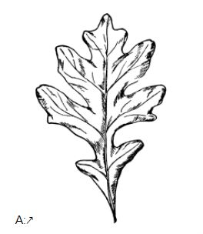
A:
Basic structure
Leaf is compound - - - - - - - - - - Hickory
Leaf is simple - - - - - - - - - - - - - go to 2
Edge
Edge is lobed - - - - - - - - - - - - - go to 3
Edge is entire - - - - - - - - - - - - - go to 4
Veins
Palmate veins - - - - - - - - - - - - - Maple
Pinnate veins - - - - - - - - - - - - - - Oak
Margin
Margin is smooth - - - - - - - - - - - a whole branch of those maddeningly oval leaves = MOL
(maybe an Osage Orange or just some generic leaves that an artist drew without really knowing)
Margin is wavy - - - - - - - - - - - - go to 5
Shape
Fan shaped, including the veins - - - Gingko

Slide 3
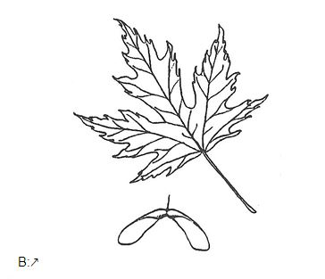
B:
Basic structure
Leaf is compound - - - - - - - - - - Hickory
Leaf is simple - - - - - - - - - - - - - go to 2
Edge
Edge is lobed - - - - - - - - - - - - - go to 3
Edge is entire - - - - - - - - - - - - - go to 4
Veins
Palmate veins - - - - - - - - - - - - - Maple
Pinnate veins - - - - - - - - - - - - - - Oak
Margin
Margin is smooth - - - - - - - - - - - a whole branch of those maddeningly oval leaves = MOL
(maybe an Osage Orange or just some generic leaves that an artist drew without really knowing)
Margin is wavy - - - - - - - - - - - - go to 5
Shape
Fan shaped, including the veins - - - Gingko

Slide 4
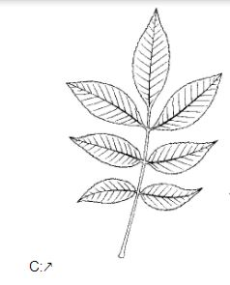
C:
Basic structure
Leaf is compound - - - - - - - - - - Hickory
Leaf is simple - - - - - - - - - - - - - go to 2
Edge
Edge is lobed - - - - - - - - - - - - - go to 3
Edge is entire - - - - - - - - - - - - - go to 4
Veins
Palmate veins - - - - - - - - - - - - - Maple
Pinnate veins - - - - - - - - - - - - - - Oak
Margin
Margin is smooth - - - - - - - - - - - a whole branch of those maddeningly oval leaves = MOL
(maybe an Osage Orange or just some generic leaves that an artist drew without really knowing)
Margin is wavy - - - - - - - - - - - - go to 5
Shape
Fan shaped, including the veins - - - Gingko

Slide 5
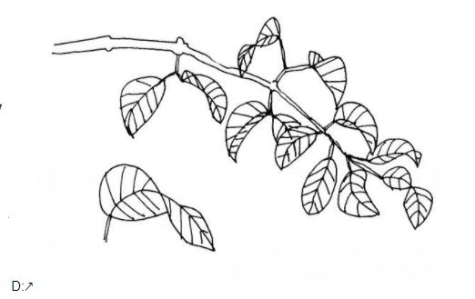
D:
Basic structure
Leaf is compound - - - - - - - - - - Hickory
Leaf is simple - - - - - - - - - - - - - go to 2
Edge
Edge is lobed - - - - - - - - - - - - - go to 3
Edge is entire - - - - - - - - - - - - - go to 4
Veins
Palmate veins - - - - - - - - - - - - - Maple
Pinnate veins - - - - - - - - - - - - - - Oak
Margin
Margin is smooth - - - - - - - - - - - a whole branch of those maddeningly oval leaves = MOL
(maybe an Osage Orange or just some generic leaves that an artist drew without really knowing)
Margin is wavy - - - - - - - - - - - - go to 5
Shape
Fan shaped, including the veins - - - Gingko

Slide 6
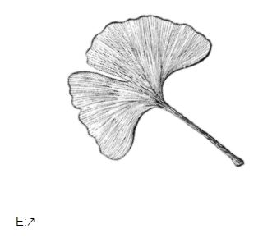
E:
Basic structure
Leaf is compound - - - - - - - - - - Hickory
Leaf is simple - - - - - - - - - - - - - go to 2
Edge
Edge is lobed - - - - - - - - - - - - - go to 3
Edge is entire - - - - - - - - - - - - - go to 4
Veins
Palmate veins - - - - - - - - - - - - - Maple
Pinnate veins - - - - - - - - - - - - - - Oak
Margin
Margin is smooth - - - - - - - - - - - a whole branch of those maddeningly oval leaves = MOL
(maybe an Osage Orange or just some generic leaves that an artist drew without really knowing)
Margin is wavy - - - - - - - - - - - - go to 5
Shape
Fan shaped, including the veins - - - Gingko

Slide 7
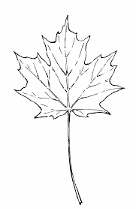
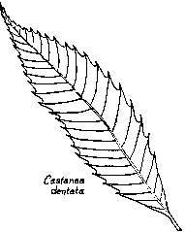
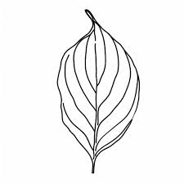
Vein patterns
Pinnate (most)
Palmate
like the vanes of a feather.
Parallel … super uncommon among trees

Slide 8
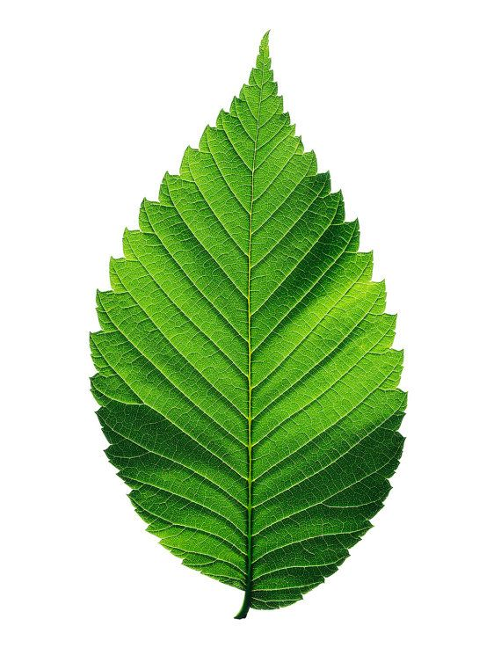
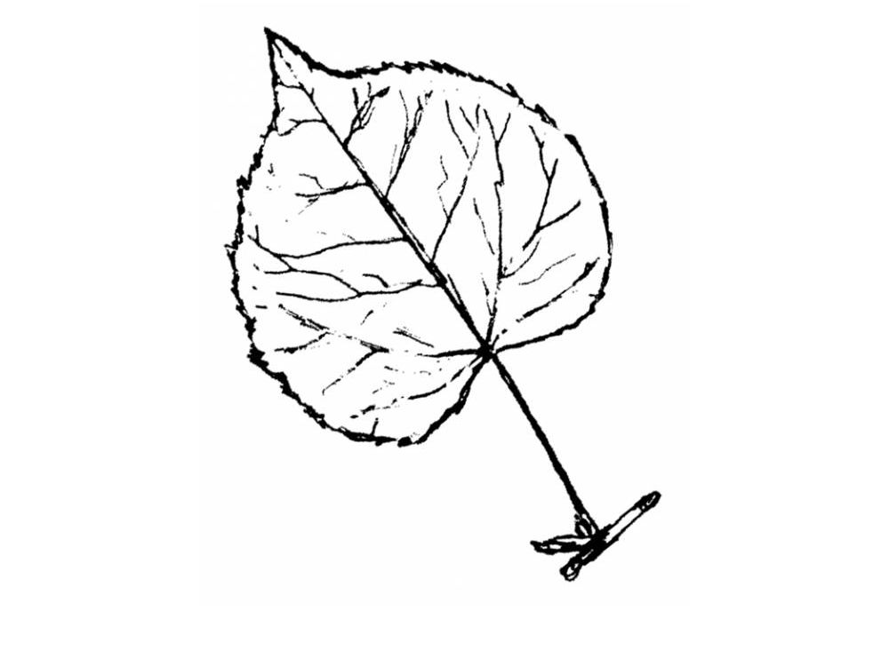
Truly distinctive features that leave no doubt about the ID
Aspen - Won’t spin
They have a flattened petiole, which catches the wind like the blades of a wind chime.
Oh, and weakly veined
Sandpaper texture = Elm
Also, asymmetrical base …
aka diagonal across the petiole

Slide 9
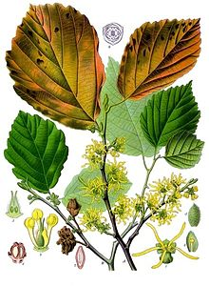
Asymmetrical across the base of the petiole? ...
Witchhazel … they’re blooming right now, too!
Or the leaf of a tree that had a hard time growing … truly, you need to look at several leaves on each tree to know which is “classic” or that represents the general shape of most leaves that you’d find on that tree

Slide 10
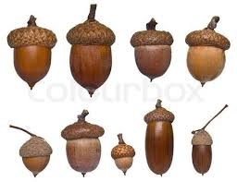
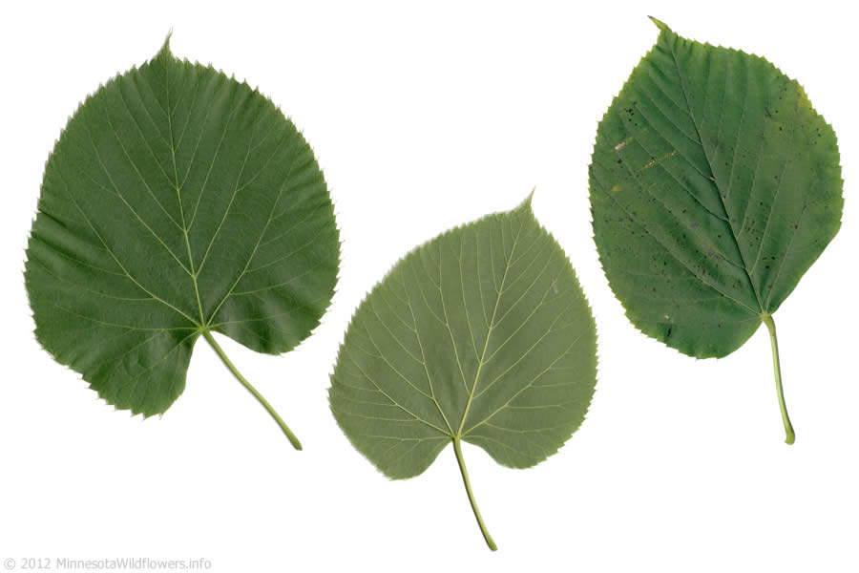
More distinctive
Another asymmetrical base?
= Basswood (aka Linden)
(note, the edge is toothed)
Acorns? = Oak
Wings (samara) = Maple

Slide 11
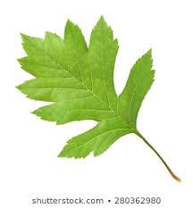
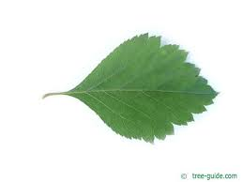
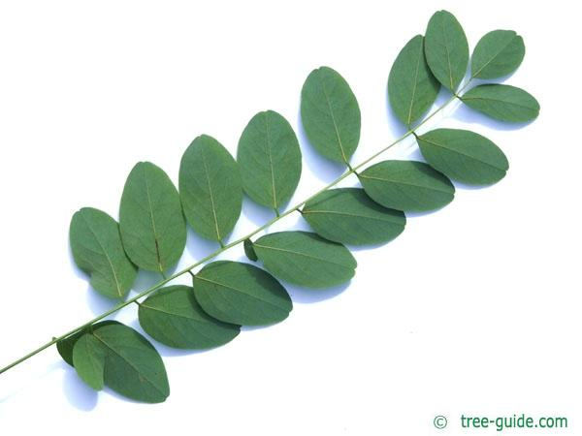
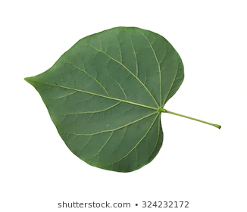
Distinctive shapes
Hawthorne have thorns … so do Black Locust
Redbud is heart-shaped, but
No teeth and symmetrical
Oooh, and Black Locust has tons of small oval leaflets,
btw, Honey Locust has many times more tiny long leaflets

Slide 12
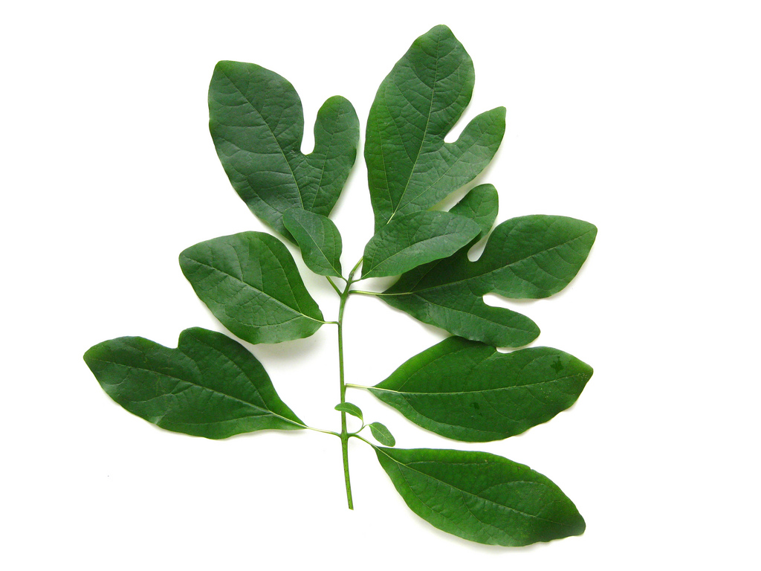
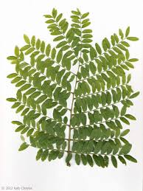
Speaking of distinctive ...
How about Sassafras?!
Ghost, Mitten, or MOL!!
Honey Locust - it’s bipinnate - a twice-cut compound leaf

Slide 13
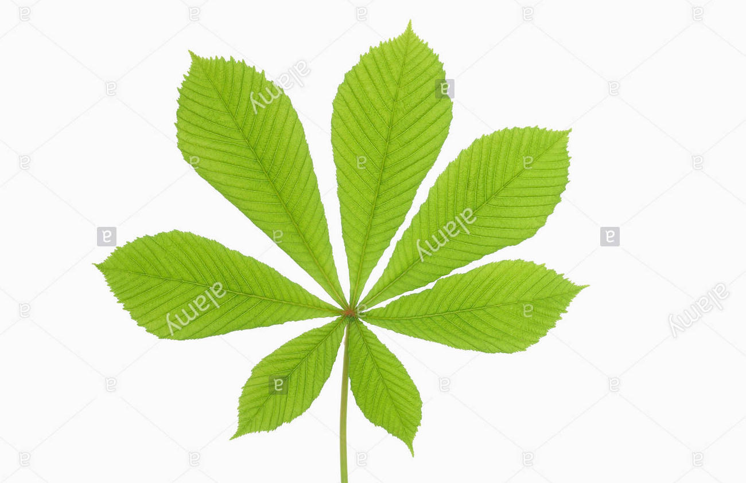
Even more distinctive - this one has opposite branching
All you really need is to spot that fruit!

Slide 14
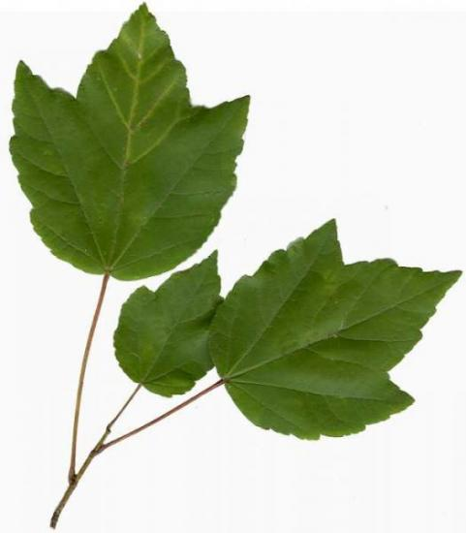
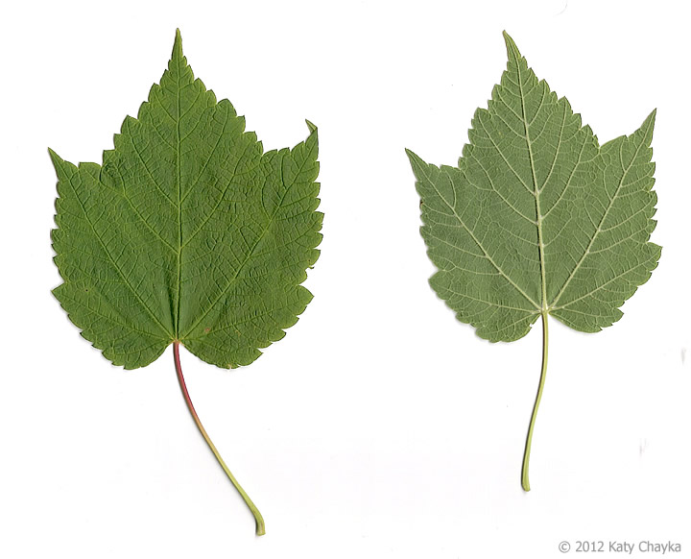
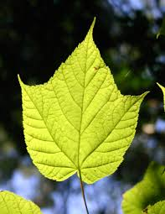
Red Maple, Striped Maple, Mountain Maple
common “goosefoot” at higher elevations

Slide 15
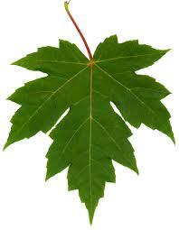
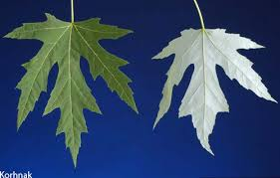
Silver Maple, Japanese Maple, Freeman Maple
The undersides look silvery when blowing in the wind
A hybrid cross between Red and Silver Maples

Slide 16
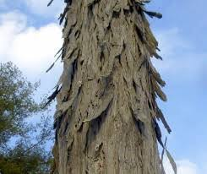
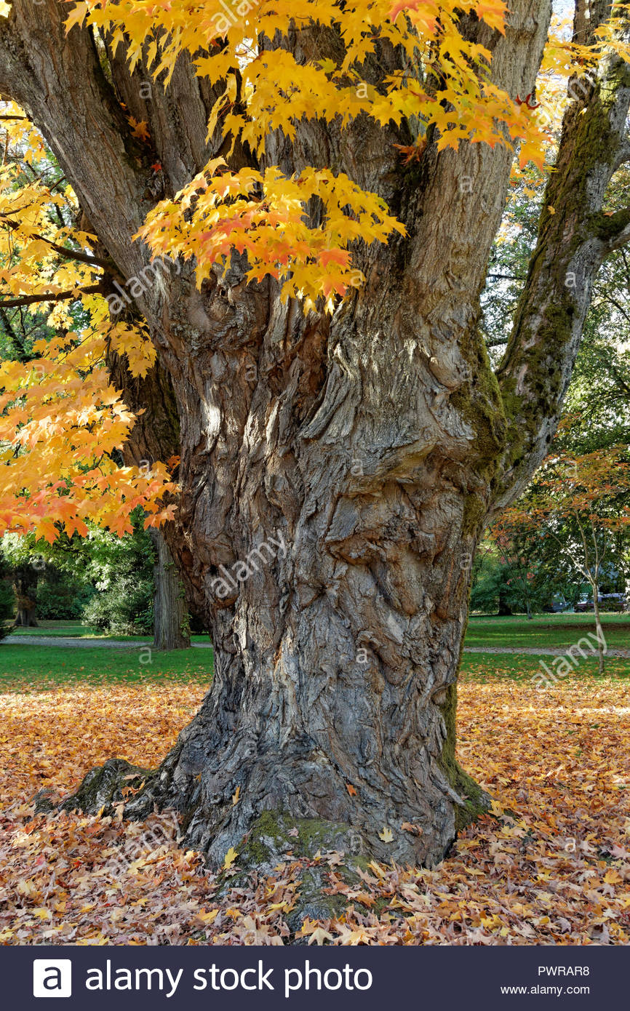
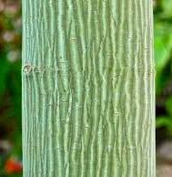
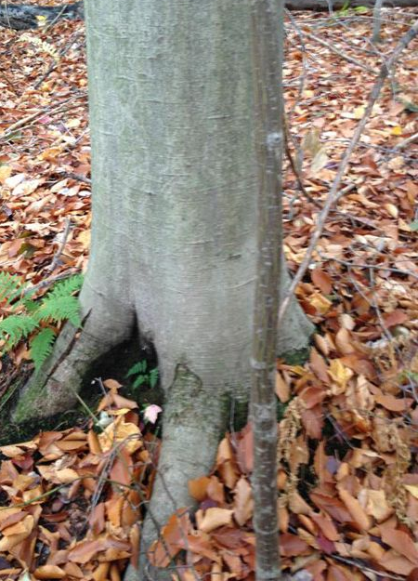
How about the bark?
The bark peels on Shagbark Hickory and Paper Birch and a really old Maple
Beech is smooth, so is Striped Maple
aka Goosefoot Maple

Slide 17
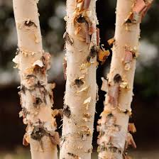
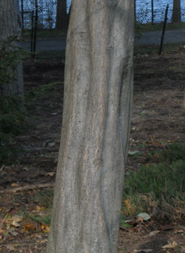
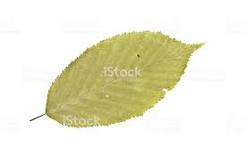
River Birch bark Musclewood, aka Bluebeech bark
reddish/golden like an
athlete’s limb

Slide 18
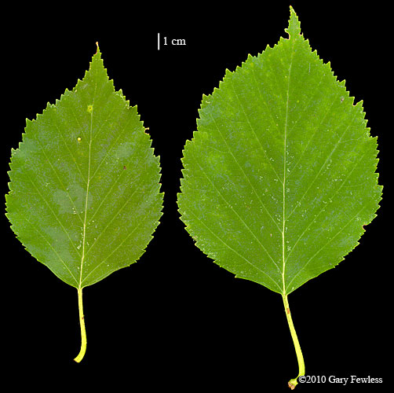
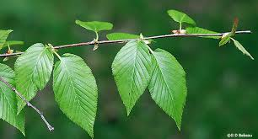
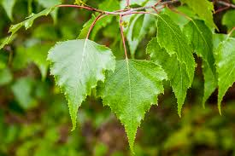
Birch leaves … toothed, with strong veins
Paper Birch
Gray Birch
Ooh, and Black and Yellow Birch bark are scratch-&-sniff sensations!
Does it smell like Wintergreen or Root beer to you?

Slide 19
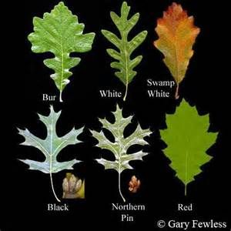
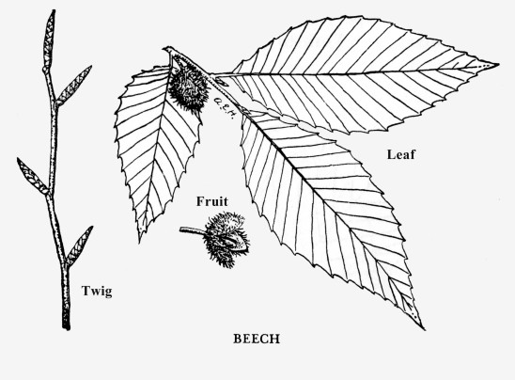
Strongly veined also include
Oaks and Chestnut and Beech

Slide 20
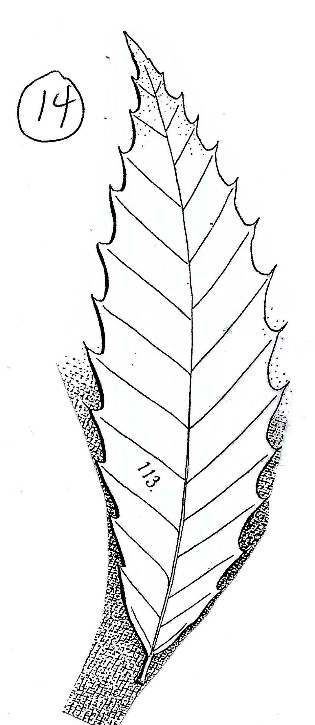
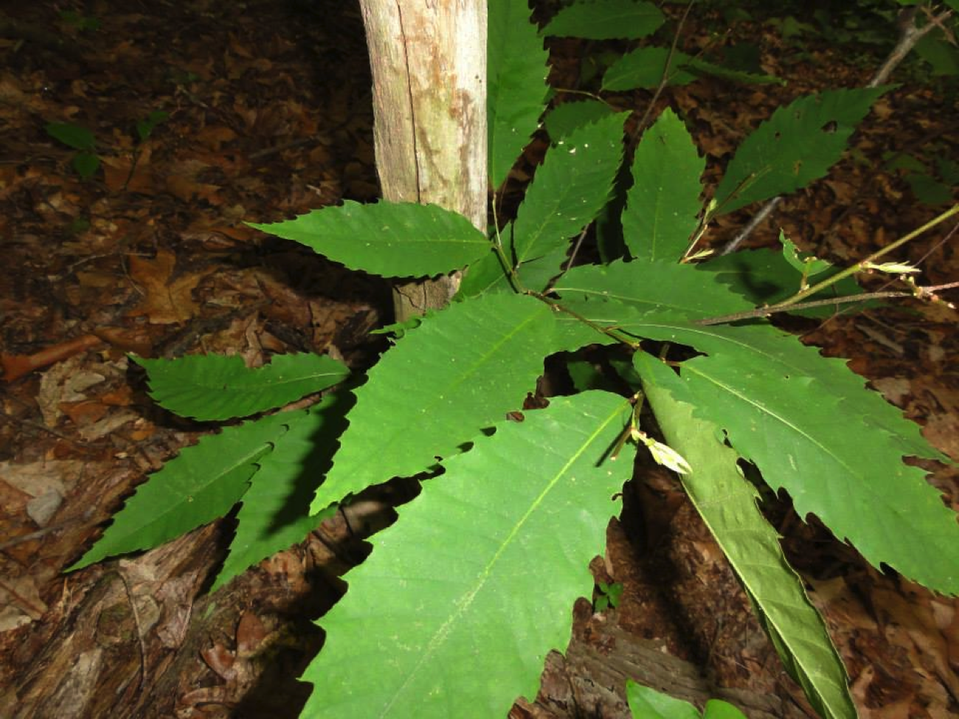
Talk about distinctive … and quite the history, too
Used to be more common than oaks, but an introduced
fungus kills off the trees, once their trunks reach dbh 4”+
Now we just find
tiny whips
around a dead
snag,
never reaching
more than
15 feet before
they die
The leaf is almost canoe-shaped, a solid 8-12 inches, with a super-short petiole
(round, it spins)

Slide 21
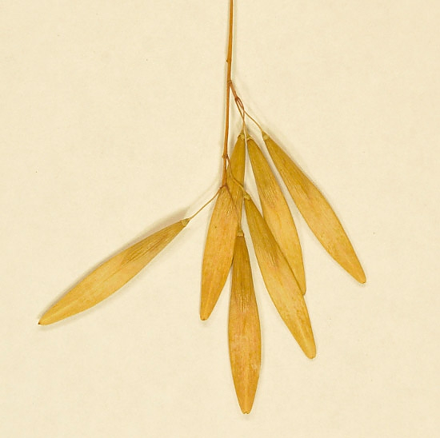
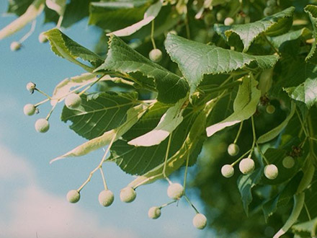
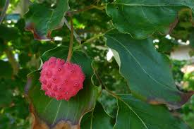
How about fruits?
Little Leaf Linden
White Ash
Kousa Dogwood
Maple

Slide 22
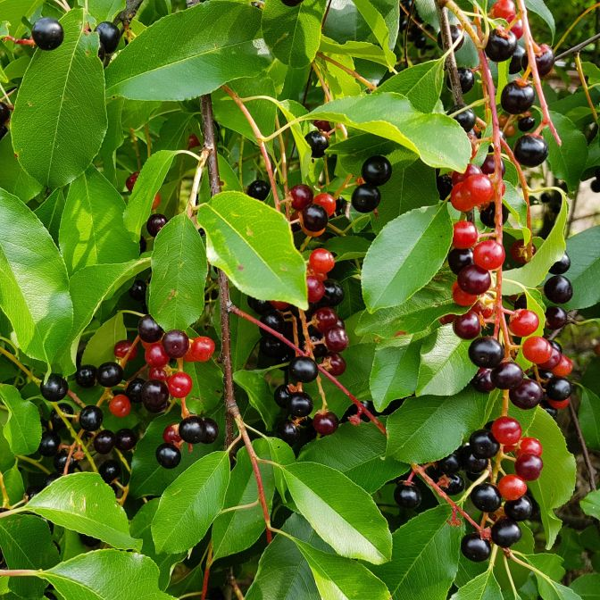
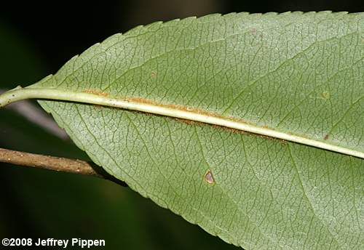
Black Cherry (native) added bonuses for IDing ...
Oh, and fruit … cherries!
Fuzz, on the underside, along the mid-rib

Slide 23
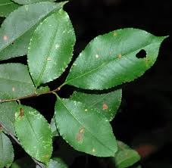
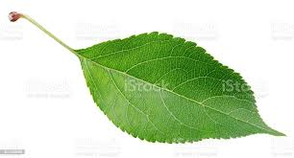
Weakly veined: fruits and other MOL’s
Flip it over to see weakly netted veins, they taper at the tip … classic for a fruit
Apple: lots of tiny teeth, with a tapered tip that twists

Slide 24
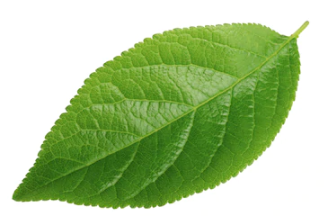
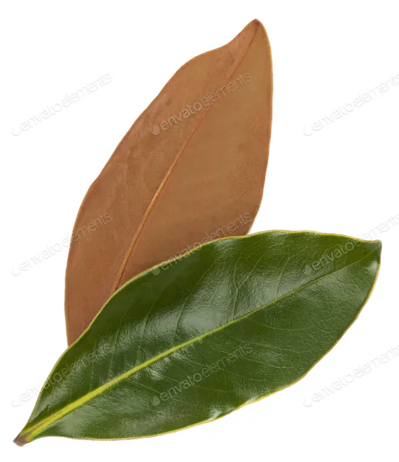
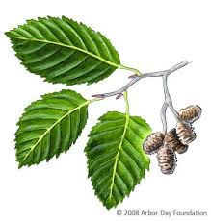
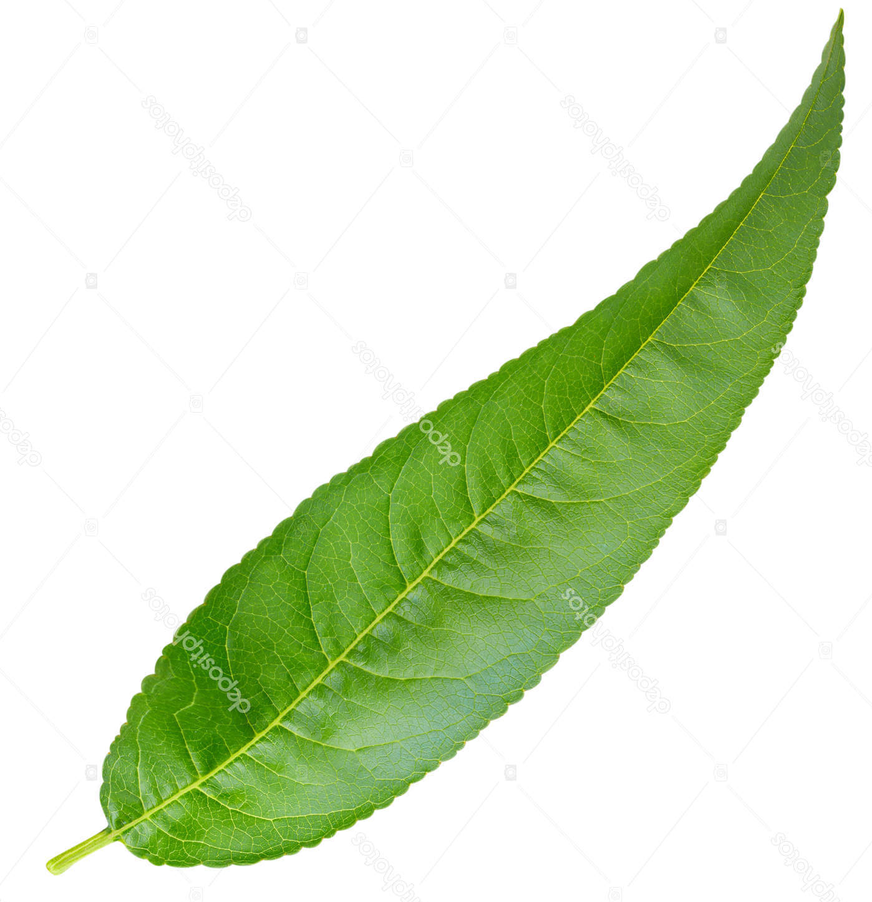
More MOL’s
Plum and Pear
Magnolia - weakly veined, shiny, smooth margin
Alder - strongly veined, distinctive fruit

Slide 25
I’ve always called this a pear, Trinity Pear?
Notice that those are not just teeth, but appear to be bristles

Slide 26
Around the other Schools:
CHCS
Black Walnut
Norway Maples with maroon leaves (looks like Sugar Maple)
Amelanchier
Little Leaf Linden
JBMS
Tuliptree
Japanese Maple
SRE
Honey Locust
Bradford Pear
Chinese Chestnut
Freeman Maple

Slide 27
Am. Beech and Horse Chestnut

Slide 28
Tuliptree and Catalpa
Tuliptree - two different leaf shapes
Northern Catalpa - no teeth

Slide 29
Compare Sugar Maple and Sycamore

Slide 30
Sycamore

Slide 31
American Beech and European Beech
American Beech
Check out the teeth at the end of each vein
Copper Beech
You don’t see a tooth at the end of each vein, and the leaves turn coppery-red in the fall

Slide 32
Still working on the ID of this one
Leaf has rounded teeth
… Ack!! I forgot to look at the branching!!
(I’ll have to send my dh out to check for me, since it’s on the path right next to where he works
Will the bark help?

Slide 33
Phew!
I took a pic of the tree, looking up the trunk, looks like the branching is alternate

