Slide 1
Why Do Teachers Engage in Citizen Science?
a presentation by
Emilie Cushing, Glen Urquhart School, Beverly, MA
and Maria Blewitt, Austin Preparatory School, Reading MA
Harvard Forest Schoolyard LTER Spring Teacher’s Workshop
March 30, 2017

Slide 2
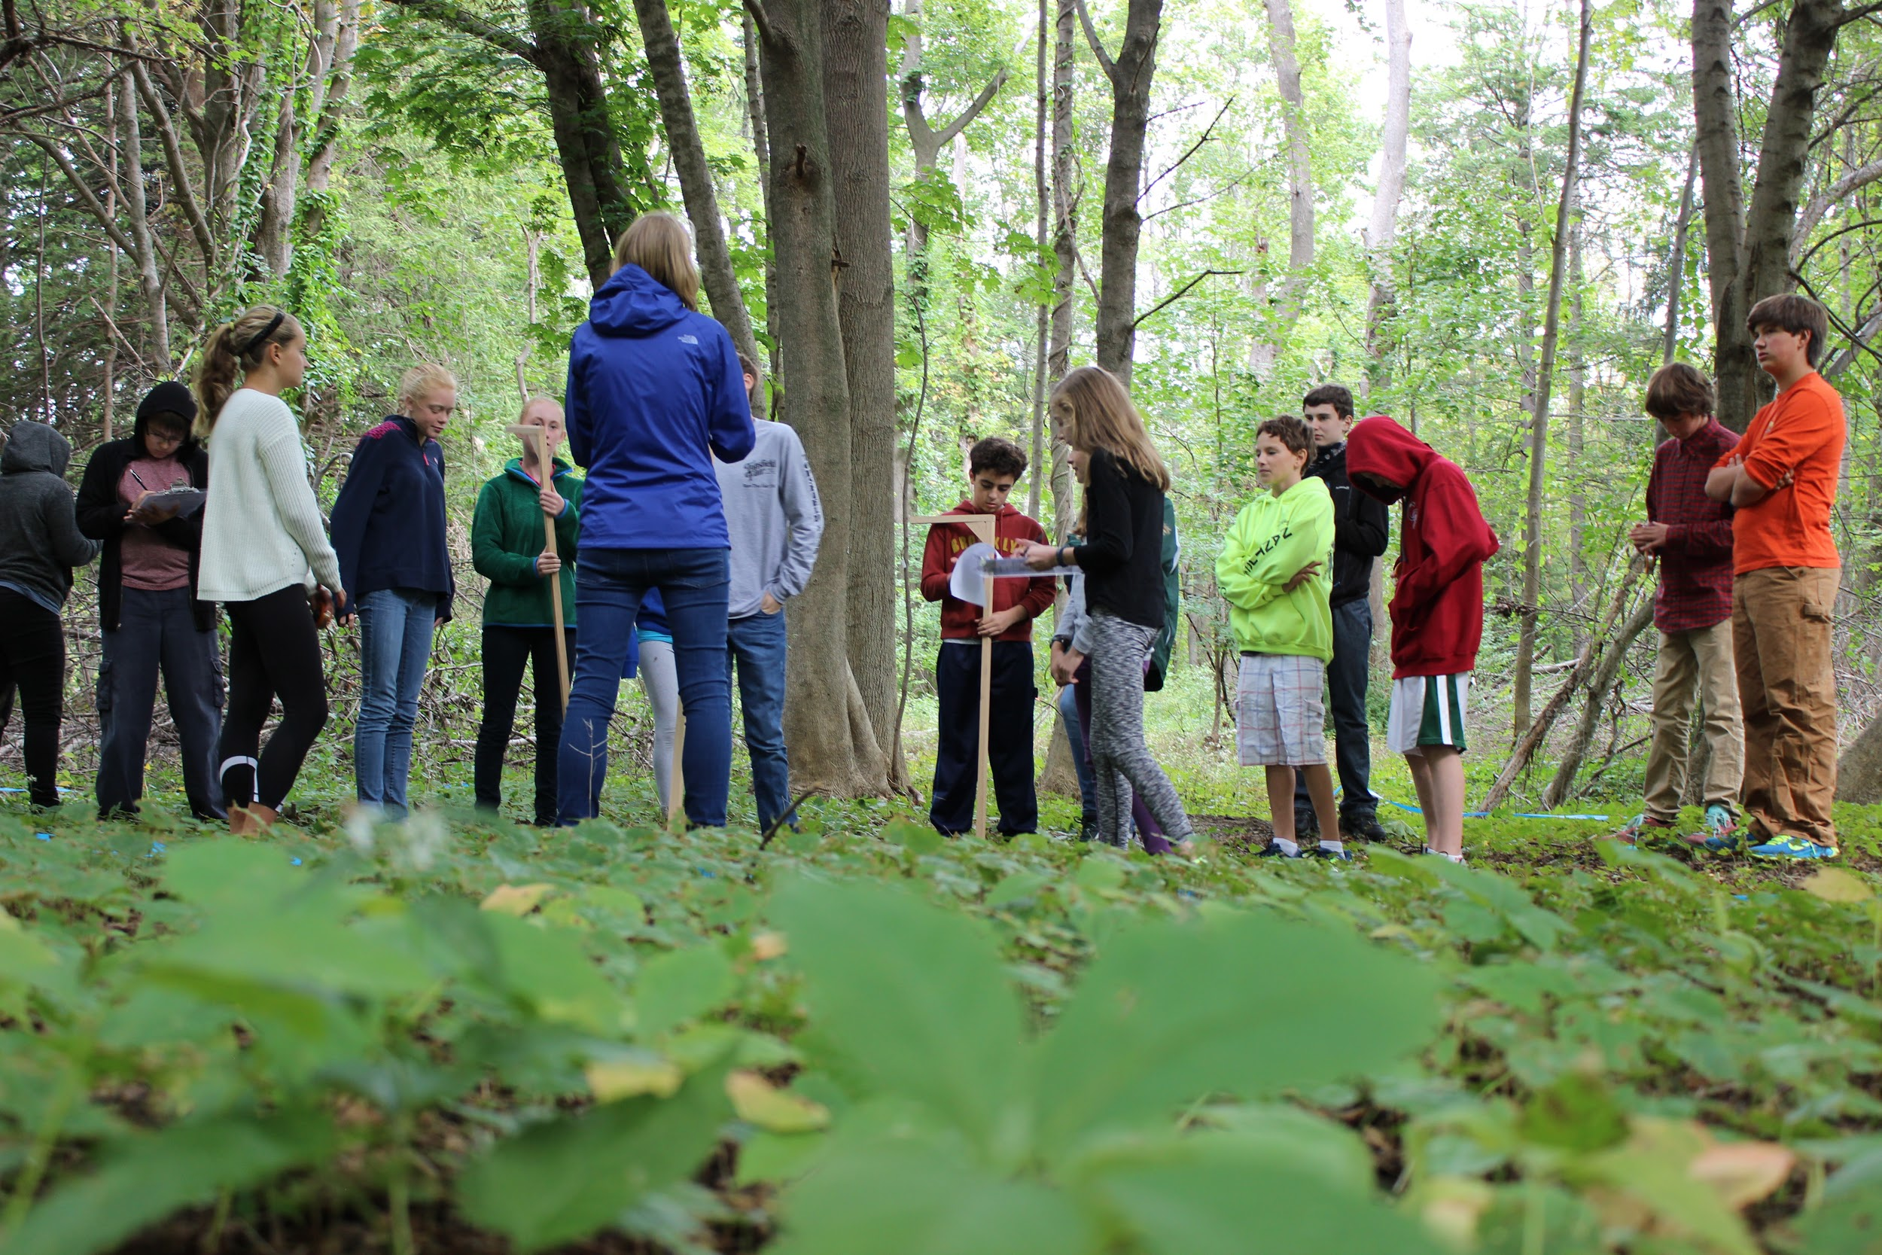
What is Citizen Science?
Scientific research that is carried out by the
general public (not professional scientists)
Often is in collaboration with professional
scientists affiliated with a university or organization
Often do not need prior science knowledge to participate

Slide 3
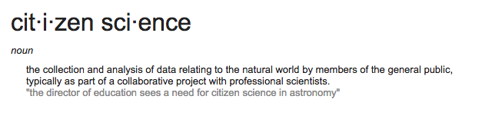

What is Citizen Science?
Can be an individual or a group
(a whole class can be involved)
Citizen Scientists provide the scientific
community with data, and may raise
novel ideas
Citizen Scientists acquire new skills
and knowledge

Slide 4
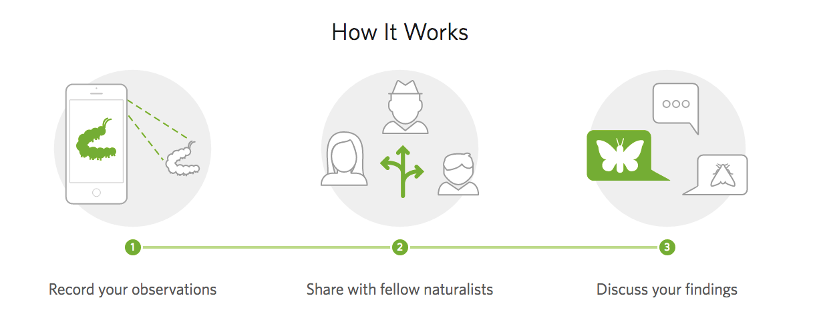
iNaturalist: How to use within your Schoolyard Project
Take photos of species in your plot (trees (!), insects, invasive species, etc.)
Upload photos with a description (species type, date, location)
Other naturalists can help with species identification
Possible project: Create a Project on iNaturalist for Schoolyard Ecology to help each other identify species
Website: https://www.inaturalist.org/

Slide 5
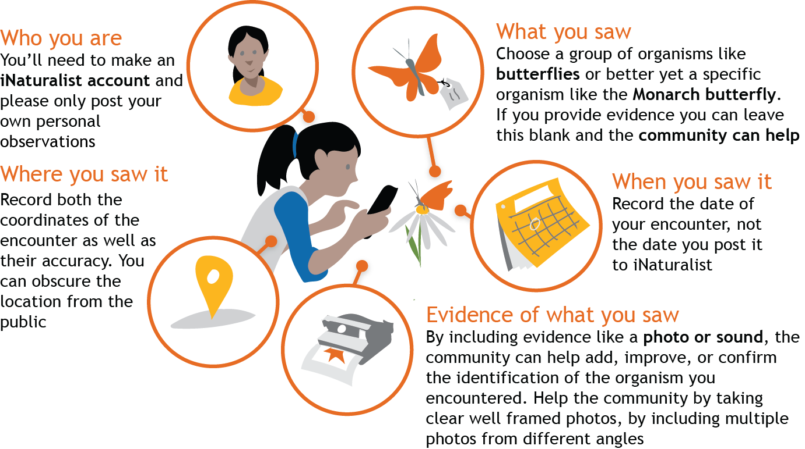
iNaturalist: How to make a data entry

Slide 6
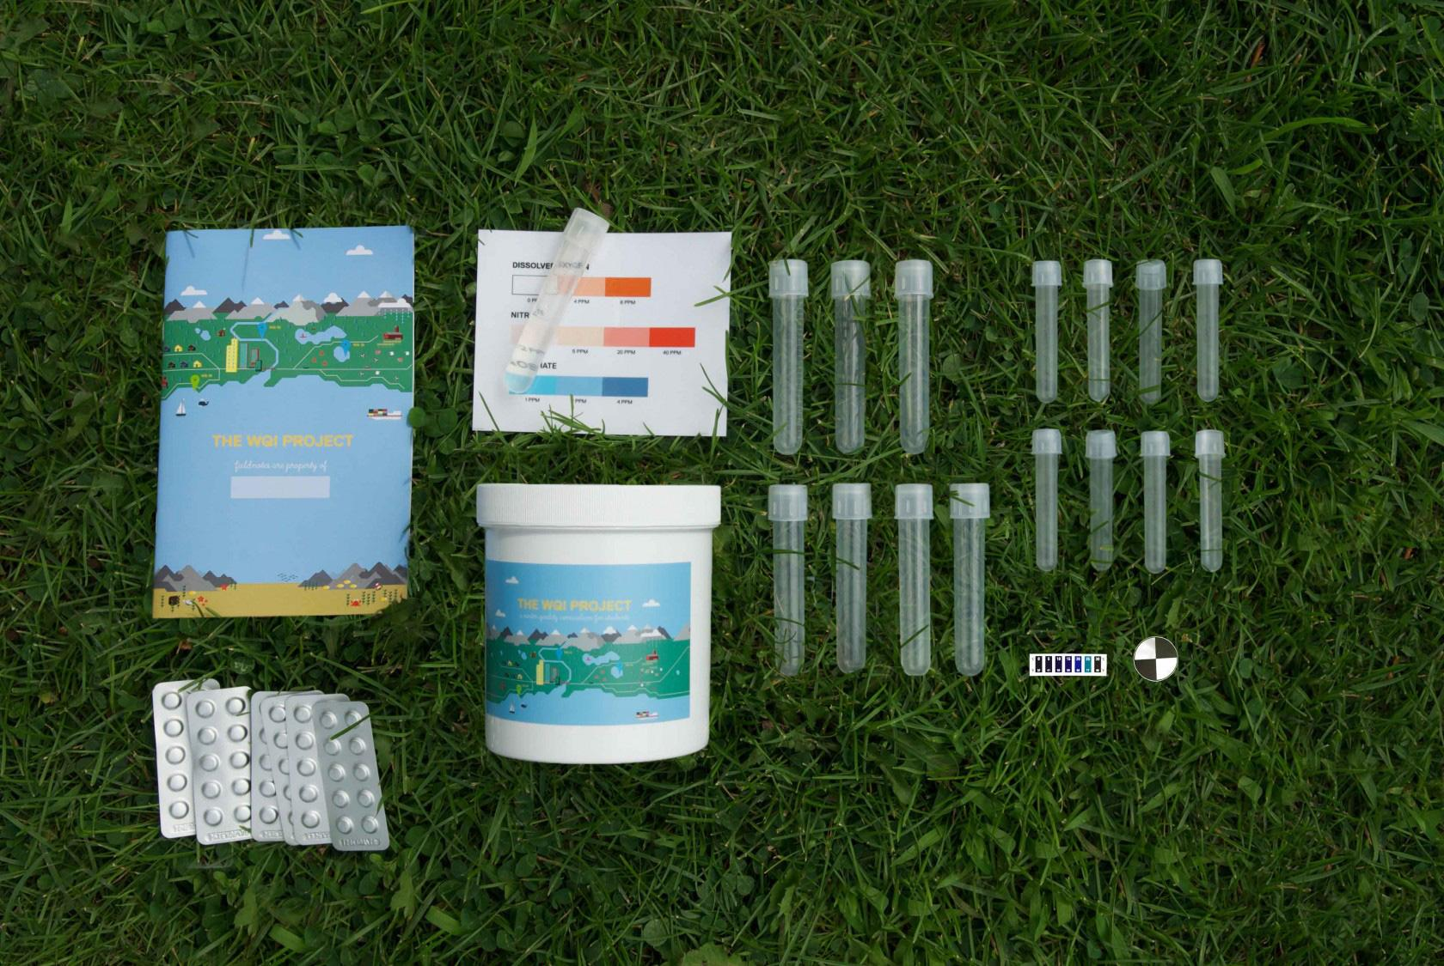
The WQI Project: How to use within your Schoolyard Project
Collect water quality data from a water source at or near your plot
Enter data into the database
Quick, easy, simple, fun!
Can follow the whole curriculum, or just do part of it
Website: https://thewqiproject.org/
Materials included in a project kit

Slide 7
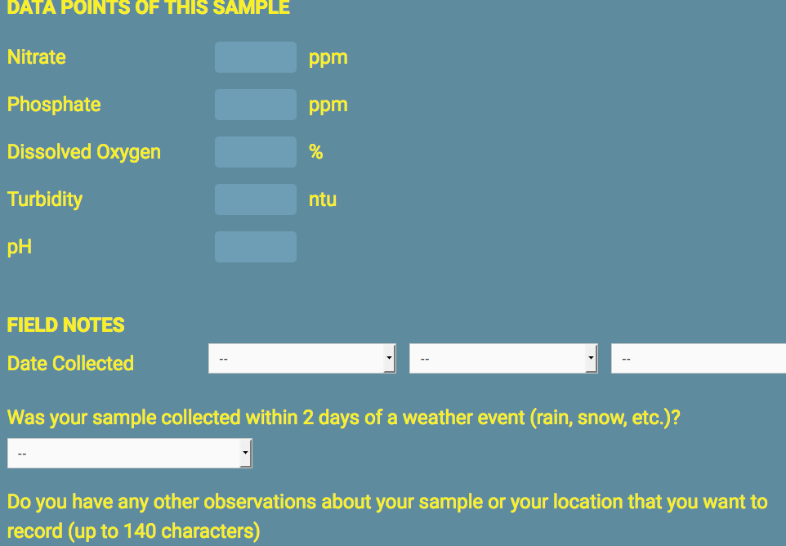
The WQI Project: How Students publish data

Slide 8
Who uses citizen science in the classroom?
What did we find?
In 2015, Blewitt and Lustick did a survey of science teacher organizations in New England and asked the teachers about their participation in citizen science projects in the classroom

Slide 9
Of 286 respondents...
about ⅔ had heard of the term “citizen science’
about ¼ actually had their students participate in a citizen science project

Slide 10
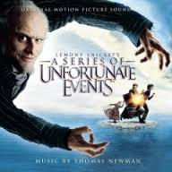
A Series of Unfortunate (Unsupported) Hypotheses

Slide 11

Hypothesis 1 - Charter and private school teachers will be more likely to put citizen science in their classrooms because they are less constrained by standards and accountability testing

Slide 12
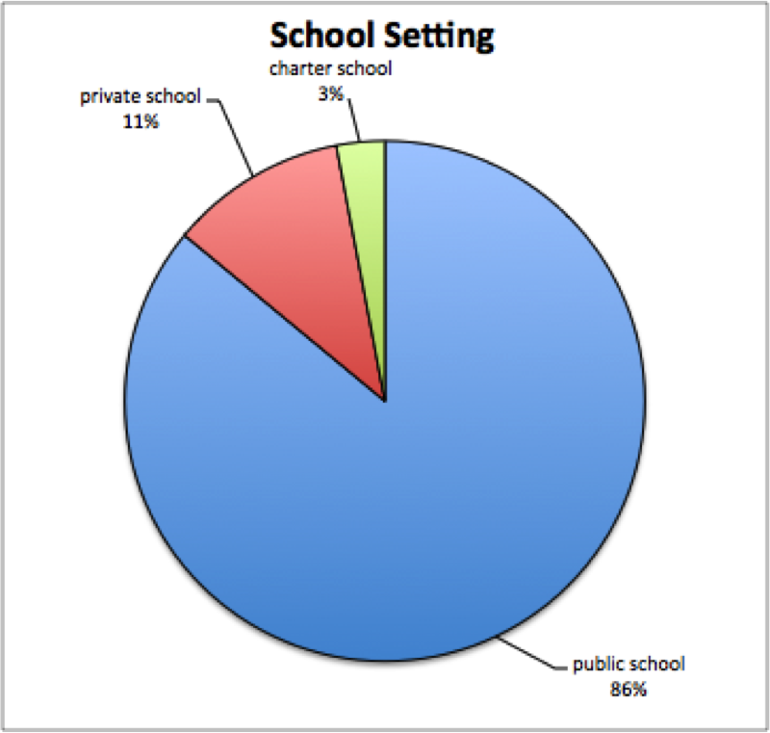
Nope!
School Setting | % of sub group that participated in a citizen science project
Public School | 26%
Private School | 26%
Charter School | 13%

Slide 13
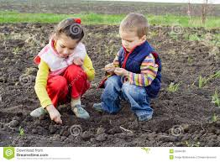
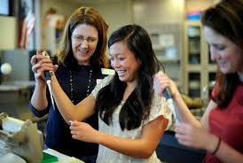
Hypothesis 2 - High school teachers are more likely to use citizen science projects because their courses are more specialized.

Slide 14
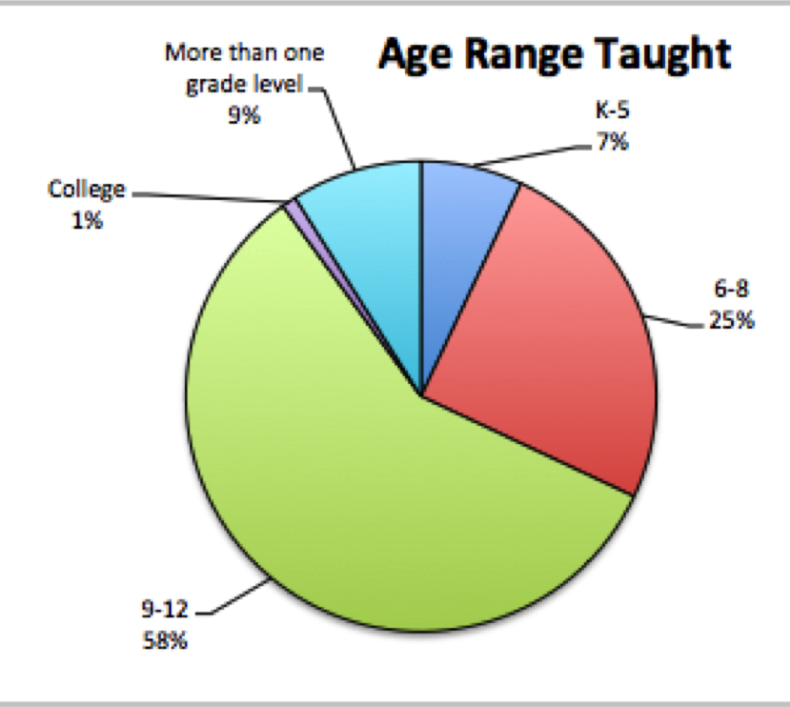
Nope!
Age Range Taught | % of sub group that participated in a citizen science project
K-5 | 24%
6-8 | 23%
9-12 | 25%
more than one age range taught | 42%

Slide 15


Hypothesis 3 - More experienced teachers are more likely to use citizen science projects because they are more comfortable with science content.

Slide 16
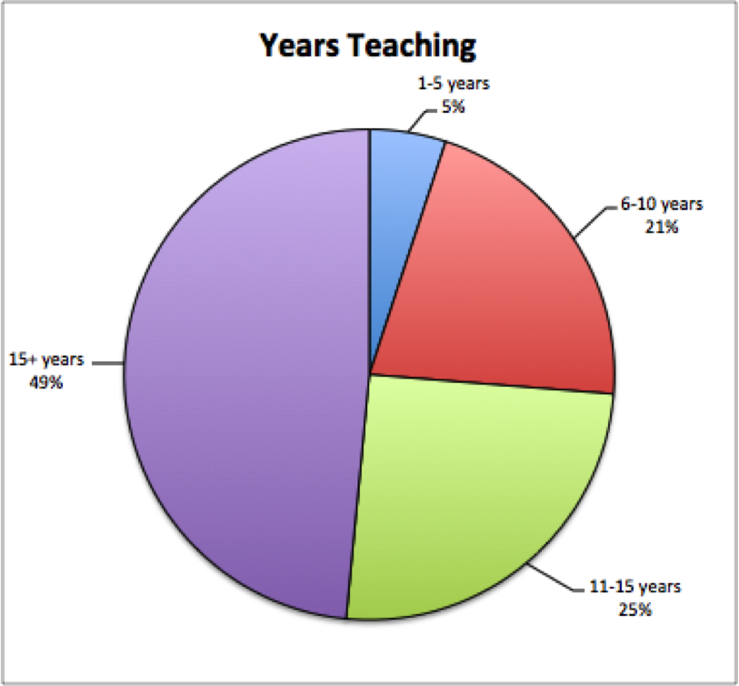
Nope!
Years Teaching | % of sub group that participated in a citizen science project
1-5 years | 8%
6-10 years | 23%
11-15 years | 25%
15 + years | 30%

Slide 17
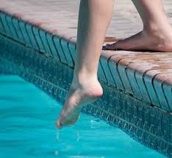
The Three Possibilities for Participation in Citizen Science
(based upon Wiggins and Crowston, 2011)
Contributory - collecting data or doing prescribed analysis for the project
aka - getting your feet wet!

Slide 18
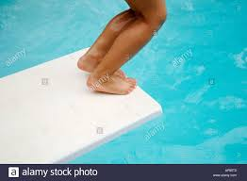
The Three Possibilities for Participation in Citizen Science
Collaborative - working with the research scientist to develop the project
aka - diving in!

Slide 19
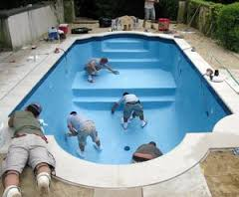
The Three Possibilities for Participation in Citizen Science
Co-Created - you come up with the idea for the project, and enlist scientific help to complete it
aka - designing the pool

Slide 20
Harvard Forest Schoolyard LTER...
offers opportunities to participate at your comfort level!

Slide 21
Harvard Forest Schoolyard LTER...
offers opportunities to participate at your comfort level!
1. Contributory - use data collection protocols and online lesson plans that exist on Harvard Forest’s website
2. Collaborative - use data collection protocols, but come up with your own lesson plans
3. Co-created - use data collection protocols, but come up with creative ways of analyzing the data with input from your friendly project scientist

Slide 22
Any Questions?

