Slide 1
Introducing BLG
to Woodland Ecology
Louise Levy
Belchertown HS

Slide 2
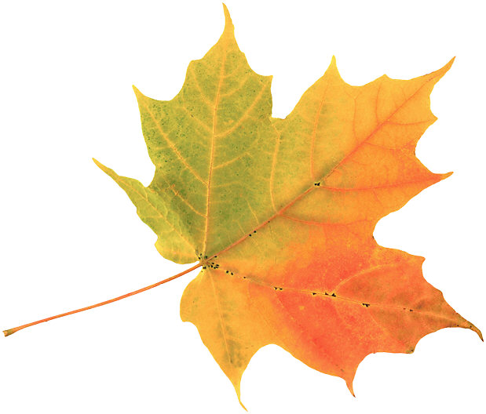
Buds, Leaves and Global Warming
you track leaf color change and leaf drop for your tree
We map the progress of your tree over time
We analyze our data to tell a story

Slide 3
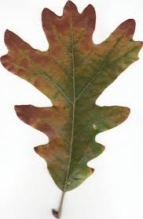
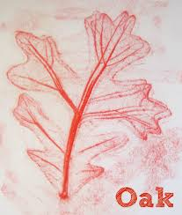
Careful observation and documentation

Slide 4
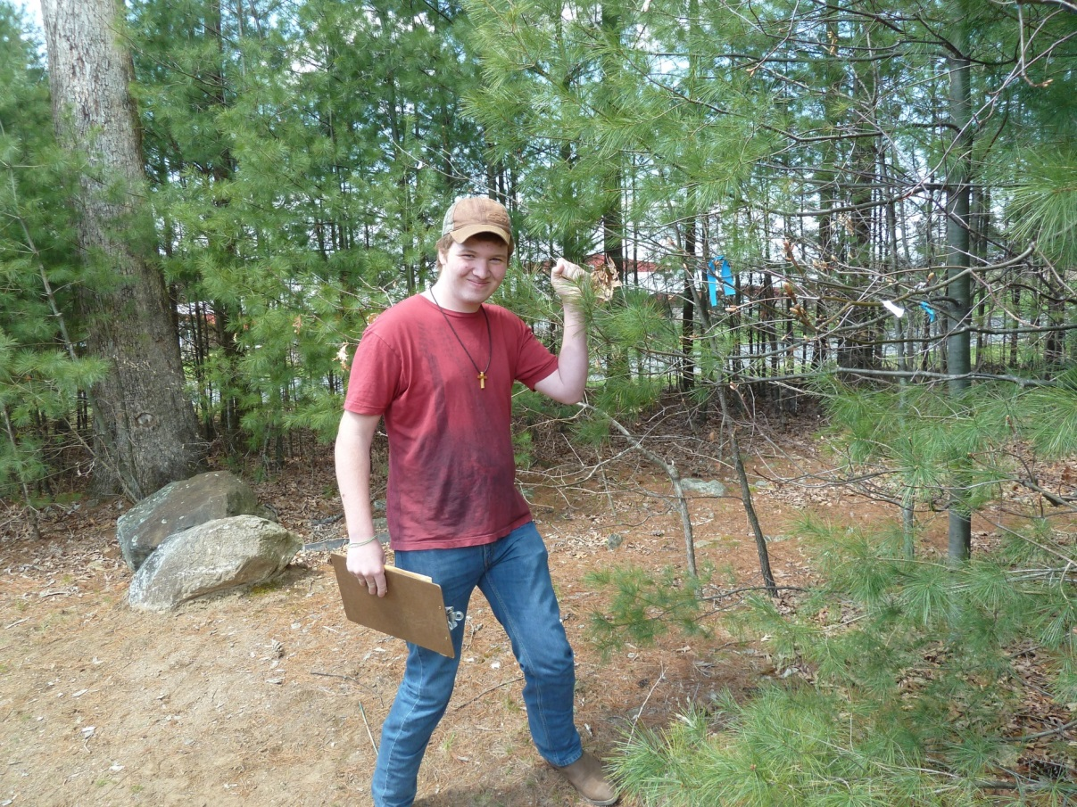
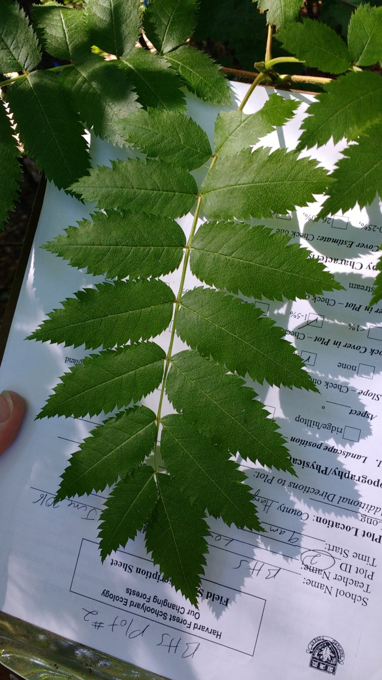
We collect data
in lovely weather …

Slide 5
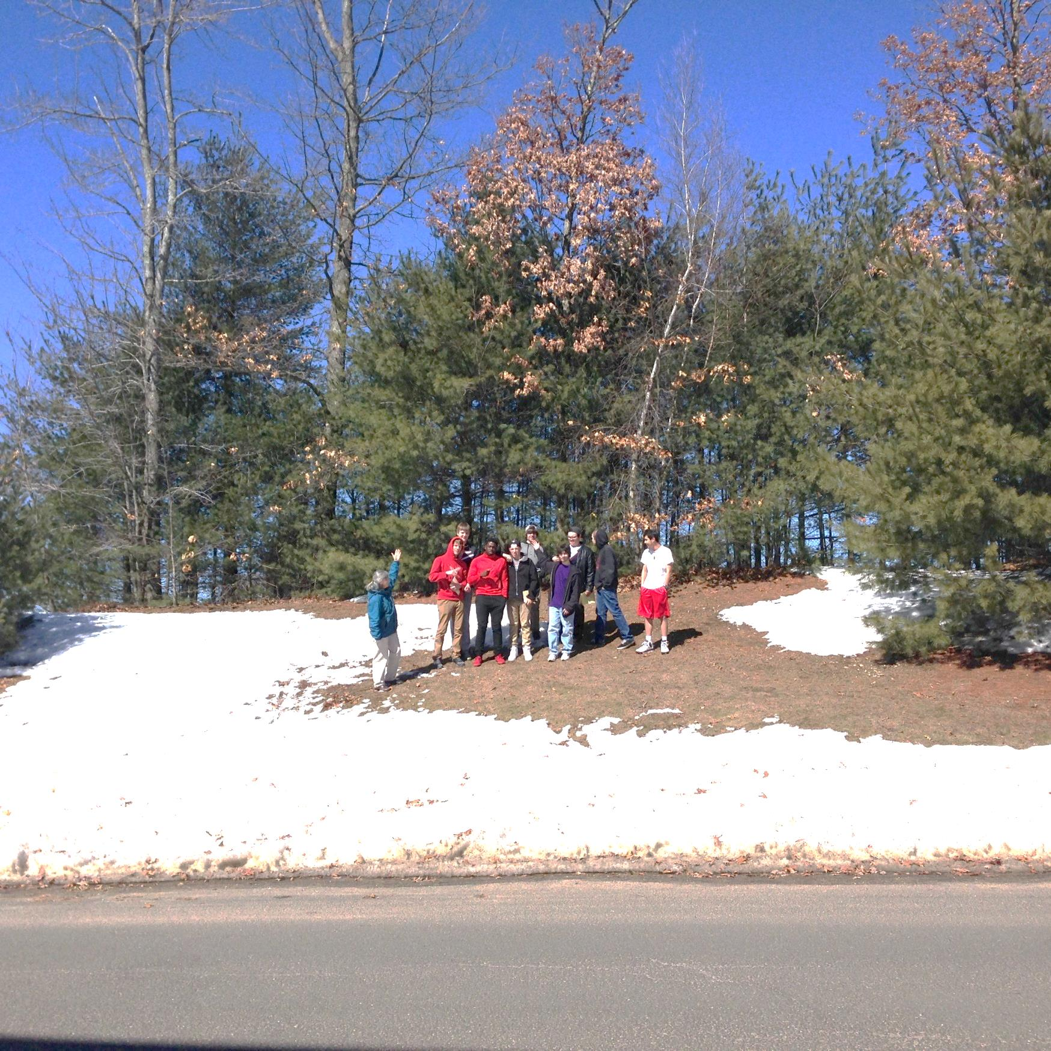

Slide 6
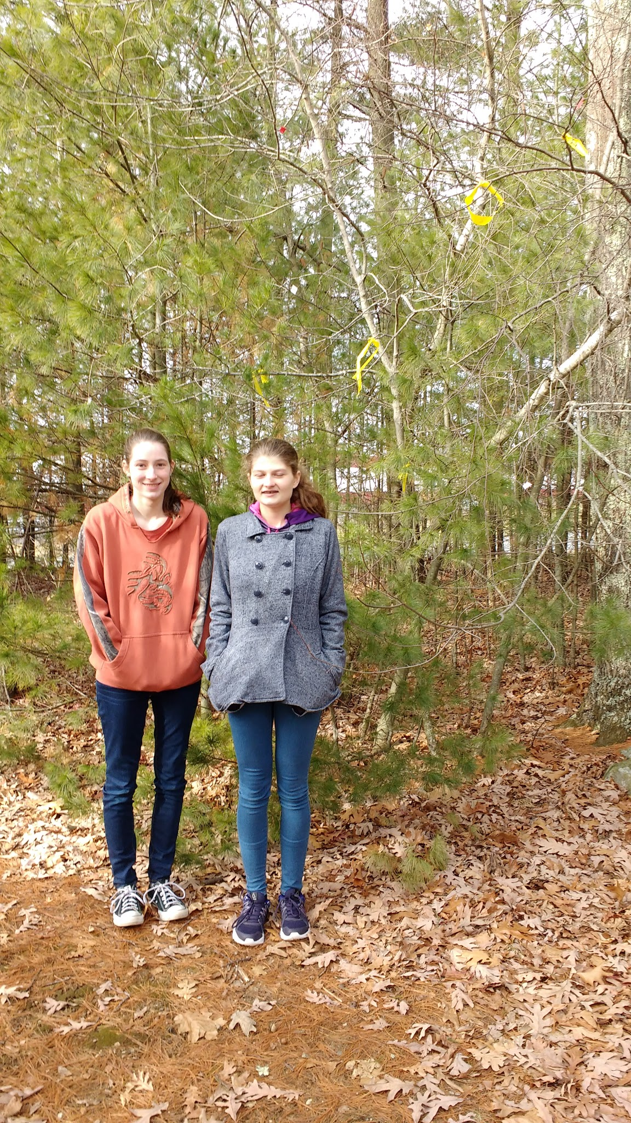
Instill a
sense of
Stewardship
and pride in
leaving a
legacy

Slide 7
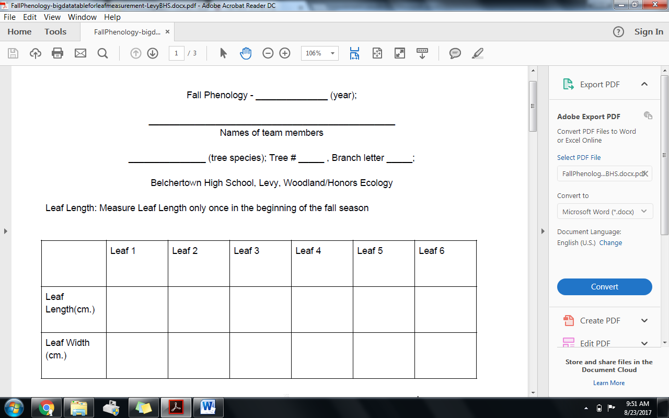

Slide 8
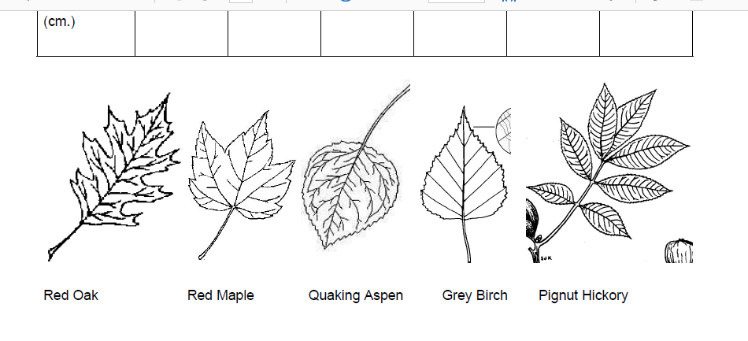

Slide 9
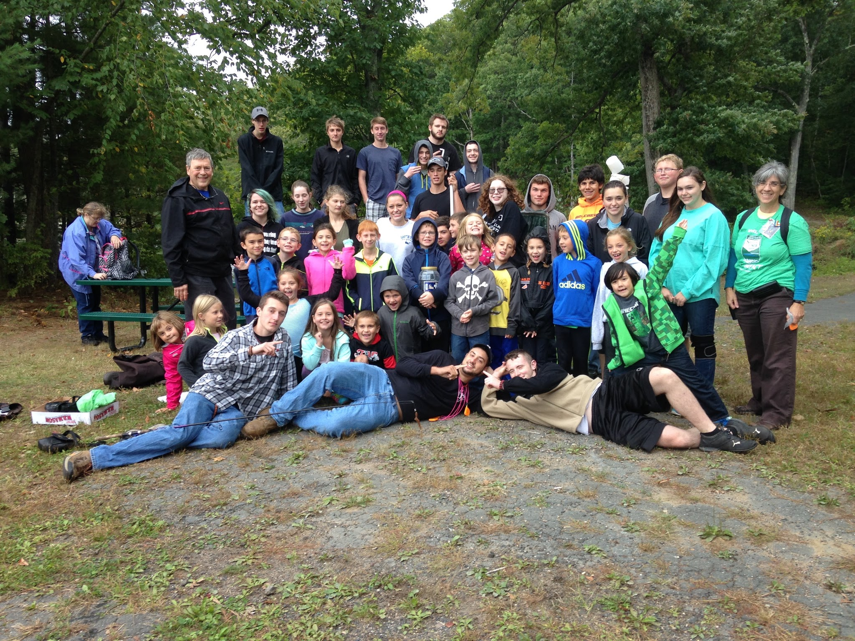

Slide 10
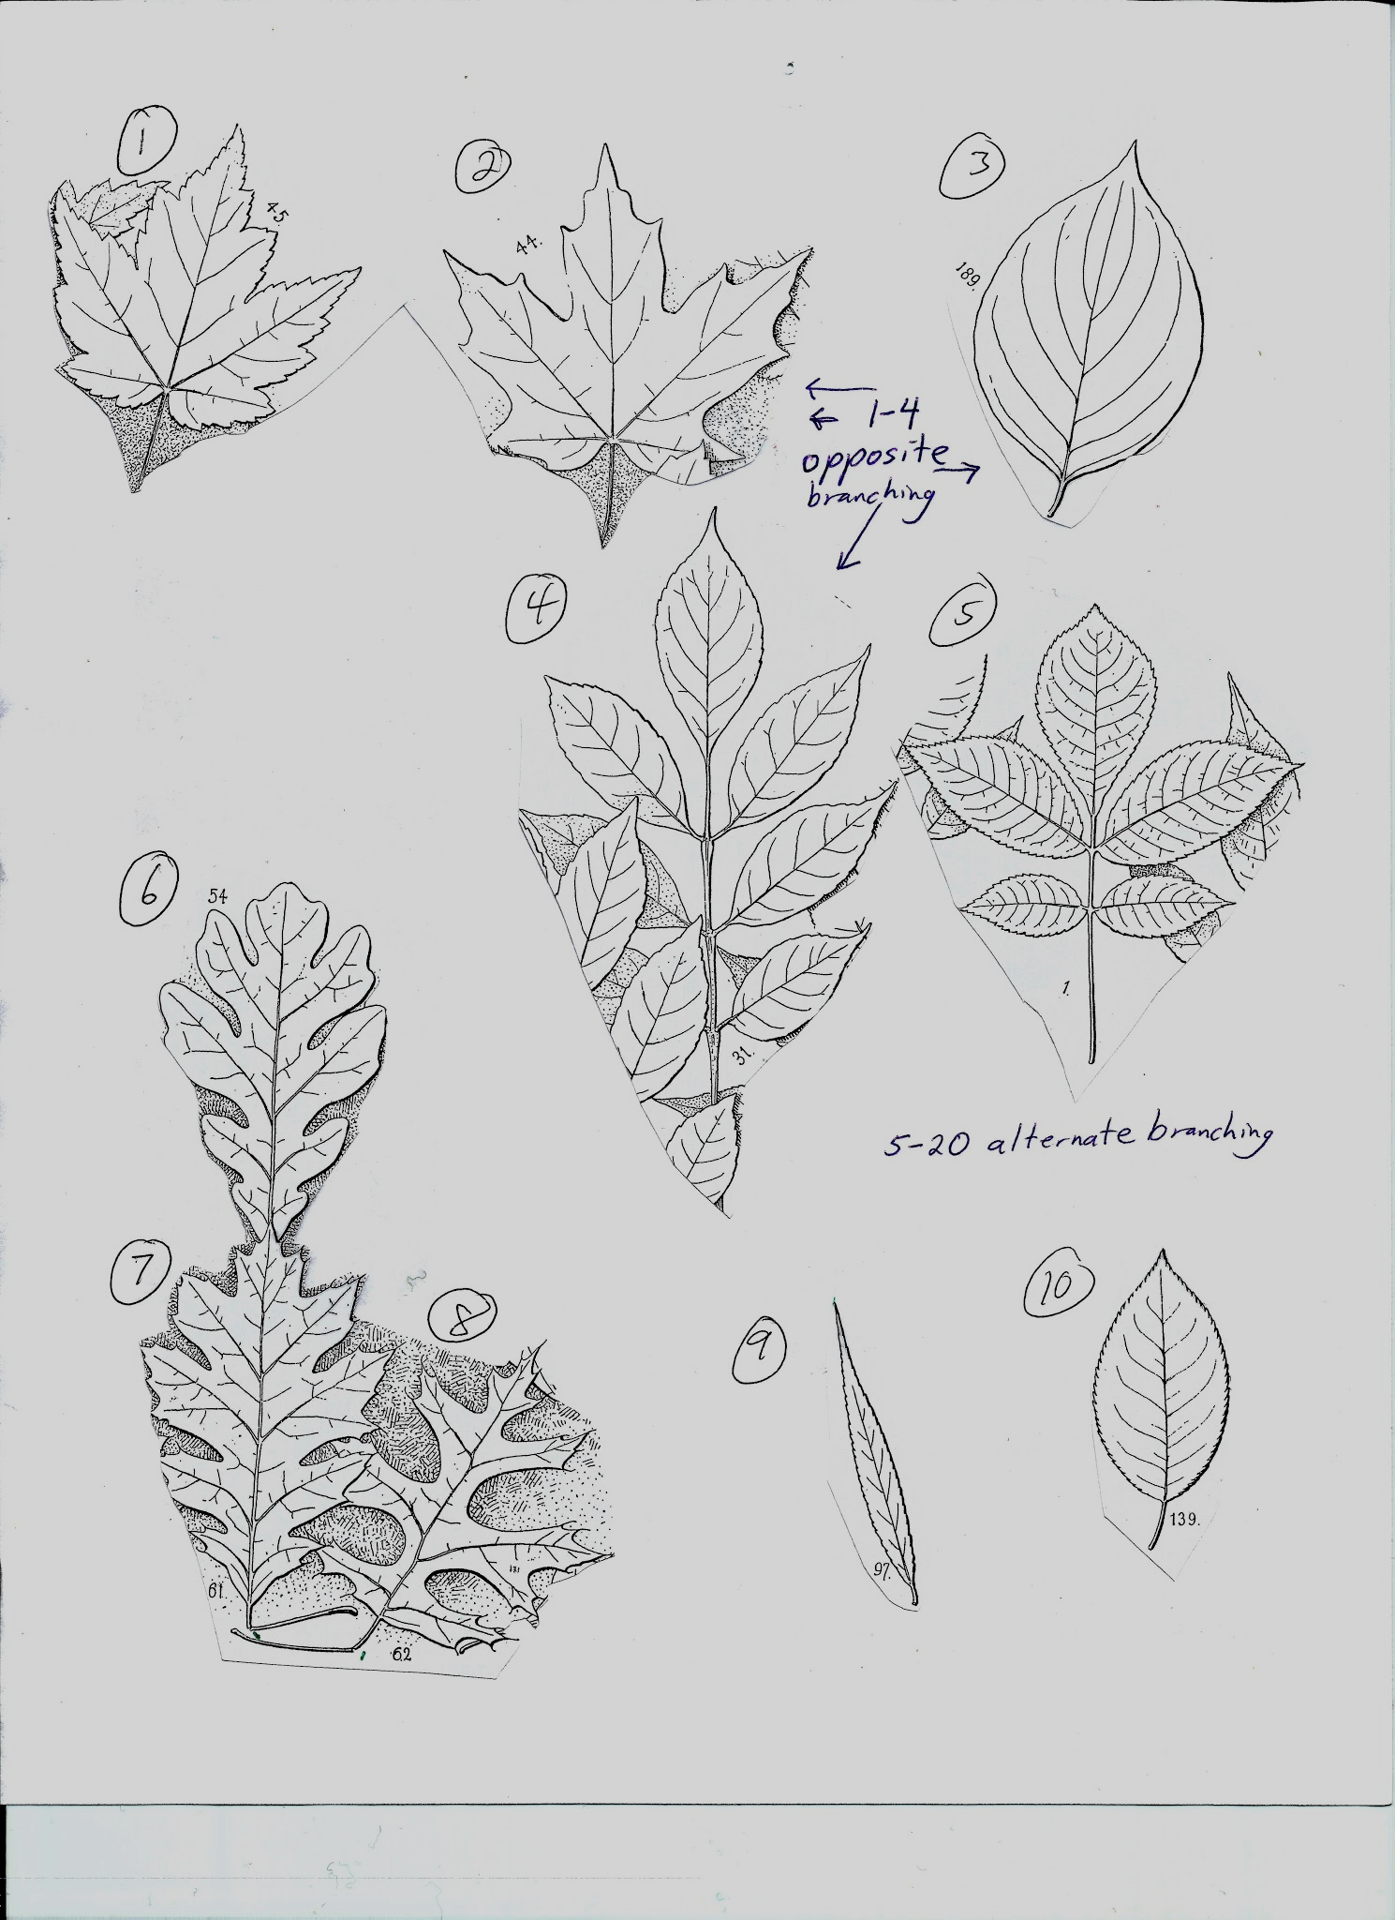
Learning
Leaves

Slide 11
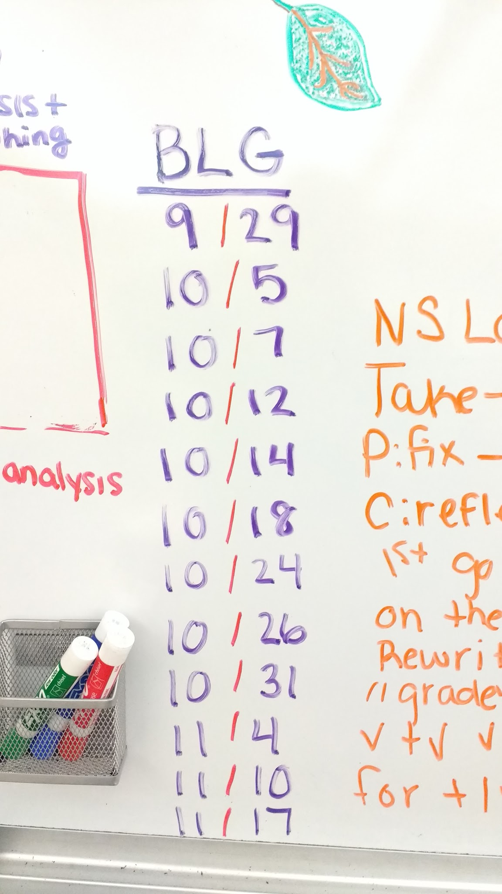

Slide 12
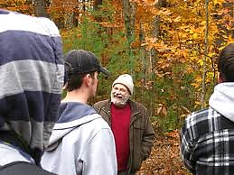
Dr O’Keefe is counting on us!

