Slide 1
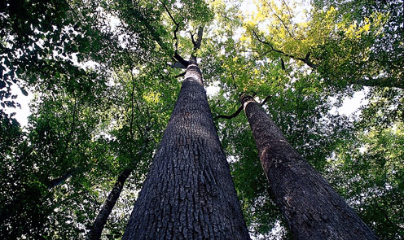
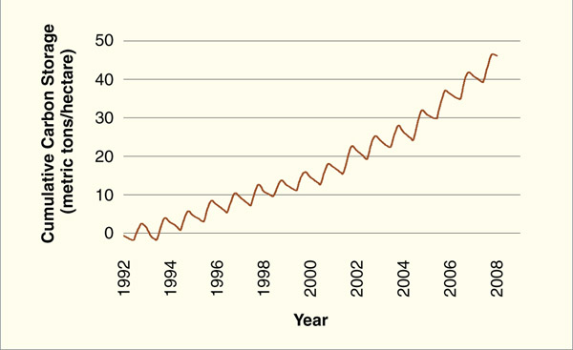
Our Changing Forests Harvard Forest Schoolyard Project August 23, 2017

Slide 2
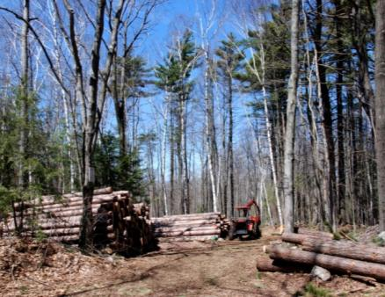
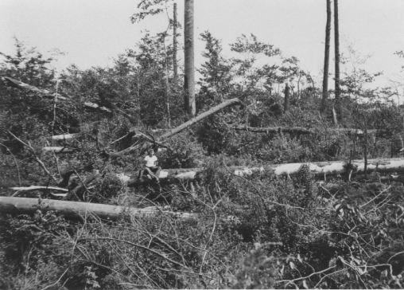
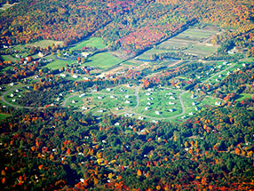
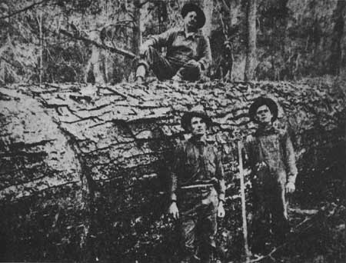
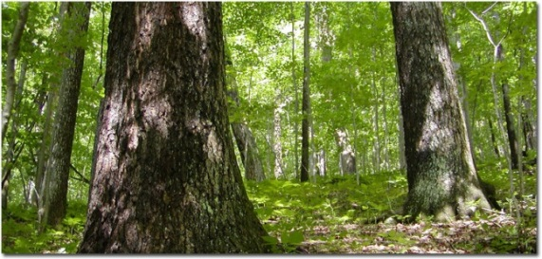
How do forests change?
What are the implications of forest change?
How do we measure forest change?

Slide 3
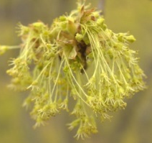
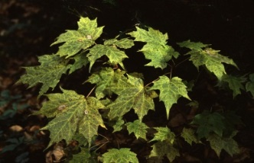
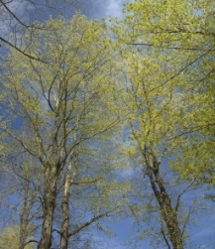
How do forests change?
New trees get established
Trees grow
Trees die
Seed
reproduction
survival
germination
Seedling
survival
growth
Tree

Slide 4
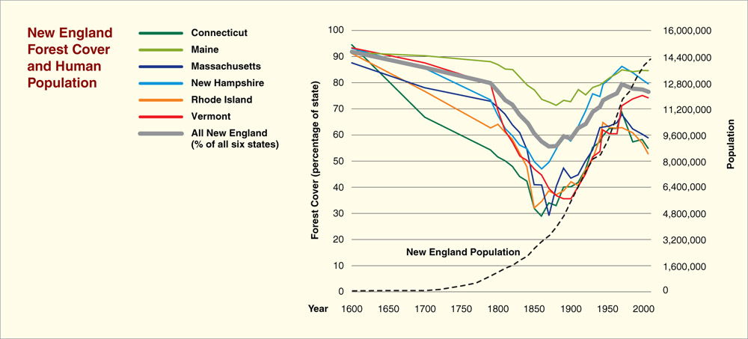
Disturbance
Background
Weather – ice, snow, wind, hurricanes
Pre-colonial
Fire, in some places
Colonial – Early Industrial
Forest clearance (lumber, farming, cities)
Fire
Modern
Forest regrowth
Forest fragmentation
Atmospheric pollution
Pest outbreaks
Future
Climate change
Development
Pollution
Notes:
Forest history graph

Slide 5
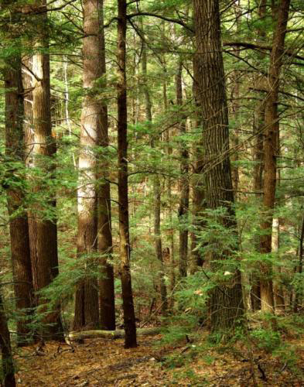
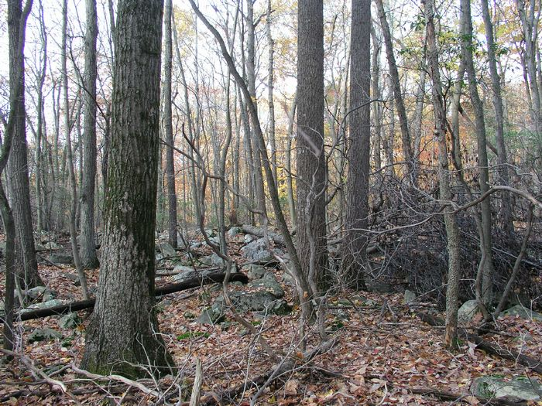
Implications of forest change
Species composition

Slide 6
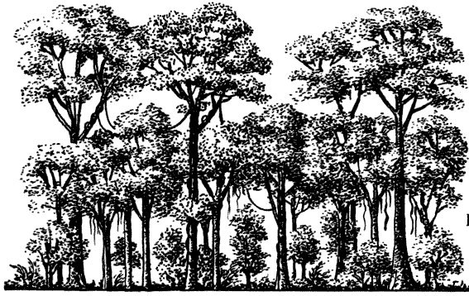
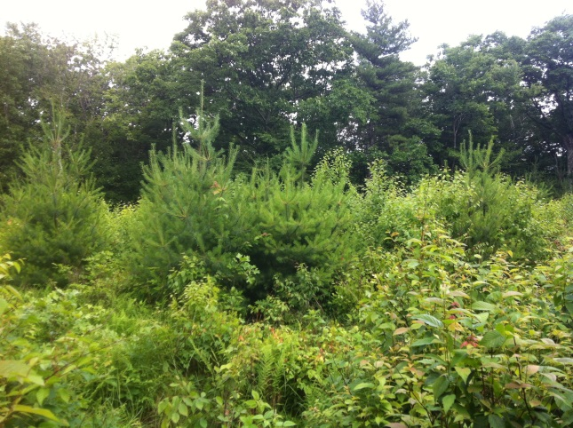
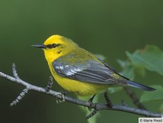
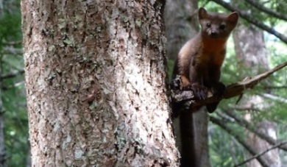
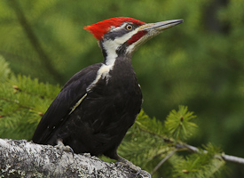
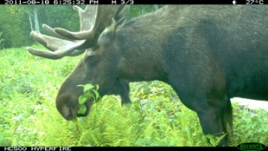
Implications of forest change
Forest structure
carbon
carbon

Slide 7
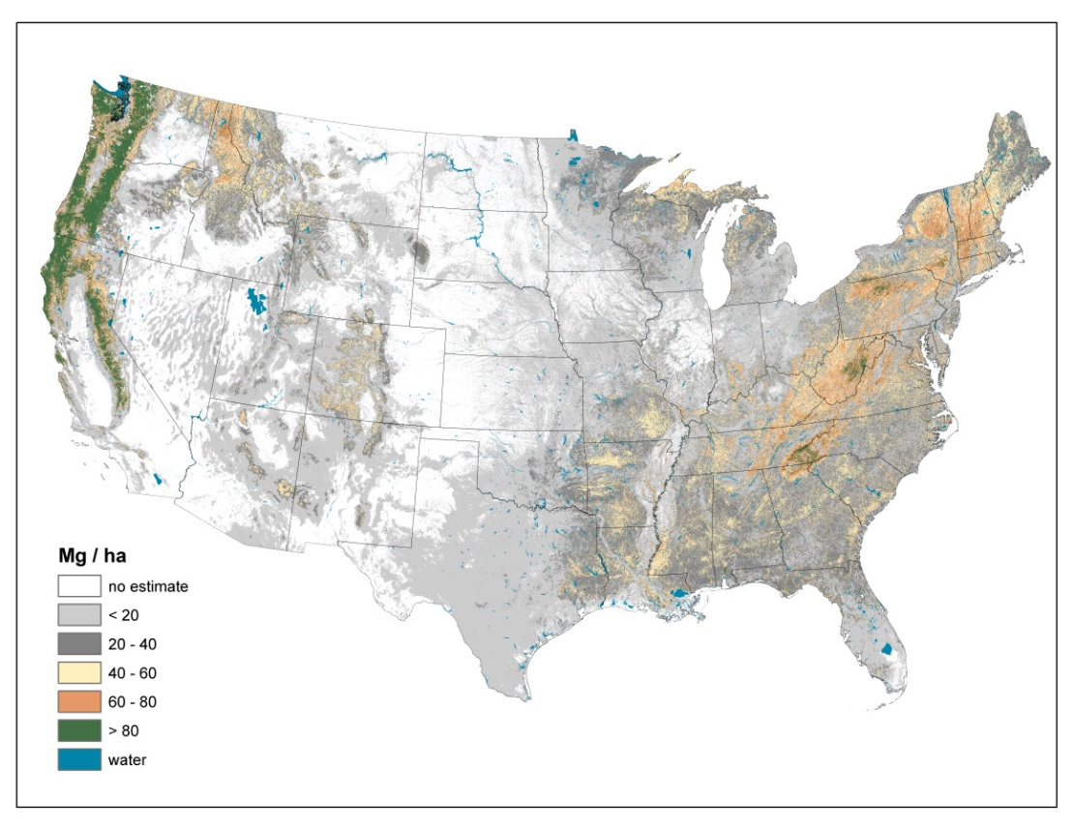
Implications of forest change
Carbon Storage

Slide 8
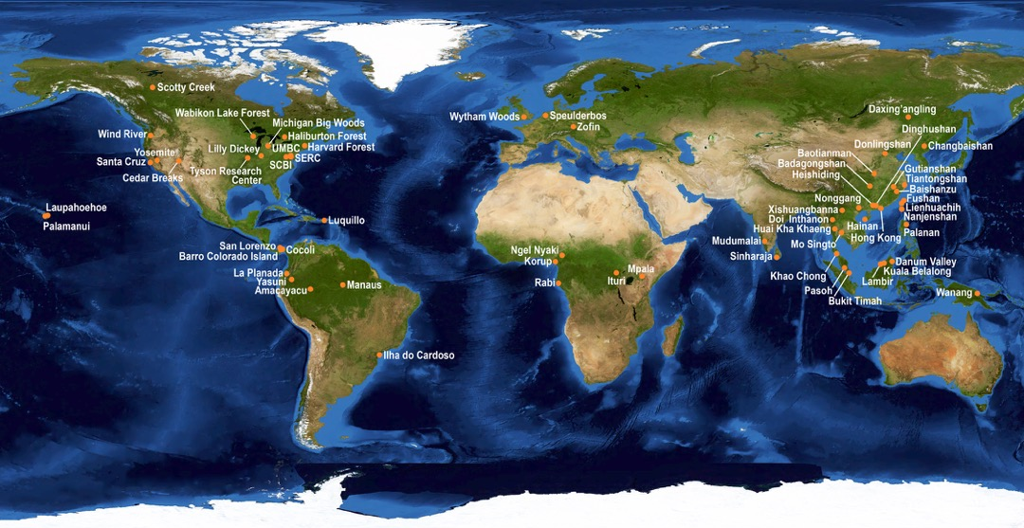
How do we track forest change?
Plots
Used by ecologists, conservationists, land managers around the world

Slide 9
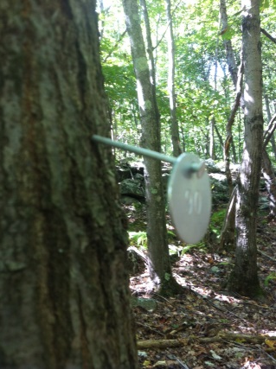
Changing Forests Protocol
10 meters
Year 1
1. Establish and permanently mark at least one 10 x 10 meter square plot
2. Measure all trees and shrubs at least 2.5 cm in
diameter
a. record species
b. record the tree diameter at “breast height”
c. record whether alive or dead
d. mark each stem with a numbered tag
3. Record field site characteristics about the plot
Year 2
Establish 2nd 10 x 10 meter plot
10 meters
Notes:
So here are the basics of what will you be doing in this project.
You will set up a 10 x 10 m plot (that’s about 33 x 33 feet for those of you not inclined to think in metric) in the woods and permanently mark the 4 corners with PVC pipe.
Record various observations about the physical location of the plot and any clues to past and current disturbance that you notice in the vicinity
Measure all trees and shrub stems that are at least 2.5 cm (1 inch ) in diameter. For each
tree:…
And mark tree with a numbered tag and we’ll go over tagging trees in the field
This is an example of a tagged tree that you’ll want to try to avoid – the tag getting swallowed up by the widening tree.

Slide 10
Changing Forests Protocol
Return to each plot every 2-3 years and repeating tree measurements.
Comparing initial measurements to subsequent measurements to determine change over time

Slide 11
Where do you Put your Plot?
What forest do you have available near your school?
What type of forest do you want to study? (old, young, hemlock, oak etc.
Hints:
At least 8-10 trees in the plot
Not too conspicuous
Basic Monitoring (schoolyard): examines what is changing in the plot, but does not address why changes are occurring)
Comparative or Question Driven Monitoring (advanced): how is a particular disturbance changing the forest
Notes:
So one of the first question you might have is how you decide where to put the plot. The answer depends on what forestland you have available to work in near your school and what you are interested in studying?
Generally some sort of comparison will provide you with a greater variety of data and your students to ask and answer more questions. Such comparisons can take many forms and will depend on your personal interests etc.
I would say select a plot that has at least 10 trees to measure so there is enough for your students to do

Slide 12
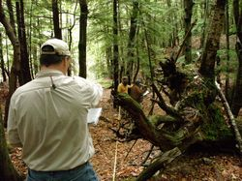
Laying out the Plot
E
N
10 meters
14.2 m
S
W
10 meters
Hint: set up two sides of the square and then check the diagonal (14.2meters).
Find where 14.2 meters meets up with 10 meters in corner. Repeat with diagonal for
other two sides.
Notes:
So once you have selected your location, you can set up the plot by extending a tape 10 m along each side of a square until you return to where you started; you’ll want to check the diagonals and if we remember some basic geometry and the Pythagorean theorem we s
You’ll want to use a compass to help you keep the sides 90 degree angles from each other by following cardinal directions along each edge. It’s helpful to have a partner in the field can stand behind you with a compass and help you stay on course.
Setting the plot up correctly takes some practice and getting used to the compass – it’s easy to get off course so it may take a few tries to get right. You’ll want to try to end up so that when you return to the starting pint with the tape you are as close to 40 mters as posiible – I would say that if you are within 10-20 cm that is OK (39.8-40.2)

Slide 13
Data Sheet-Field Site Description
Harvard Forest Schoolyard Ecology
Our Changing Forests
Field Site Description Sheet
School Name: ____________________Date (month, day, year):______ ____
Teacher Name: ______________________________________________
Plot Number_______ __________
Survey Number___________________
Time Start: Time End
Plot Location: County___________ State______ Town_____________
GPS Coordinates: Lat____________ Long _____________
Additional Directions Plot:_____________________________________
Notes:
So once you have your plot selected and set up, you begin to fill out the data sheet the first section of the data sheet is a field site description which includes basic information about the plot name, the date, locations start time and end, which is helpful to know for future years
Good directions to relocate the plot are essential particularly if you do not have a GPS unit to mark the plot with coordinates. We just relocated some plots this summer after 6 years and it was more challenging than you might think even with GPS Directions about where corners are located (next to big rock etc. are helpful)

Slide 14
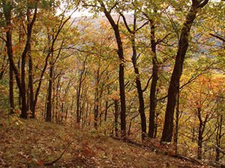
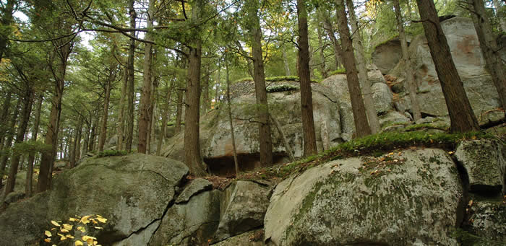
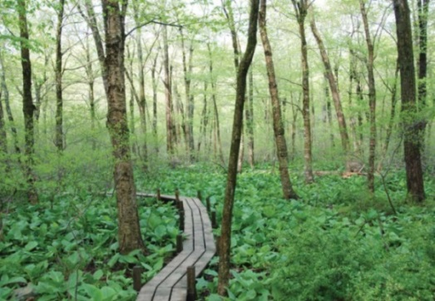
Data Sheet-Field Site Description
Topography/Physical Features:
Landscape position – Check one:
ridge/hilltop hillside dry flat wet flat rolling upland
2. Slope – Check one:
none slight moderate steep
3. Aspect_____⁰
4. Water in Plot – Check one or more:
stream temporary stream flooded area vernal pool
5. Rock Cover in Plot – Check one:
<1% 1-5% 6-25% 26-50% 51-75% >75%
Notes:
So the next step will be to fill in some basic information about the physical features of the plot that will help you and others interpret and understand the vegetation that you eventually record. The physical features have a strong effect on the vegetation.
In most case, you will be given a series of choices and you will select the most appropriate choice .
Landscape position is the setting of the plot location relative to the surrounding landscape and affects microclimate, moisture, and nutrient avaliability
Slope: steepness of the incline of the plot which influences soil depth and amount of water drainage
Aspect refers to the direction which the slope is facing (i.e. nw , se etc.) and has a strong effect on microclimate – southwest facing slopes are typically warmer and drier and north and east facing slopes are cooler and moister.
Water in Plot is of course related to slope and landscape position as is the amount of exposed rock in the plot.

Slide 15
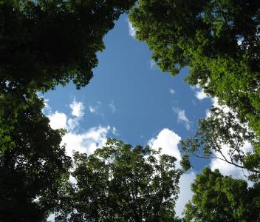
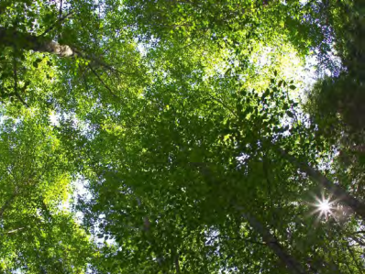
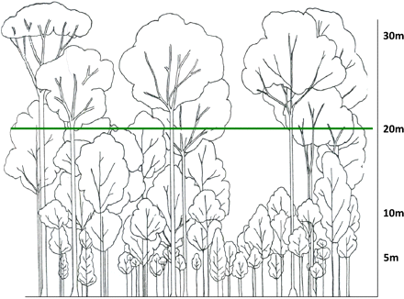
Data Sheet-Field Site Description
Forest Canopy Characteristics:
Canopy Cover Estimate : (Check One)
1-25%, 25-50%, 51-75% 76-100%
Notes:
Estimate of Canopy Cover gives you some indication of the amount of canopy disturbance in your plot and how much light is reaching the forest understory which can influence the growth rates of the smaller shade of your forest plot including whether one or more of the canopy trees has died or fallen and created a gap. This provides insight into the smaller trees growing in the understory as some species are more shade tolerant than others and more apt to survive under low light understory species.
so estimates of canopy cover of the largest trees rather than the understory trees because a dead tree will not create a gap in the canopy unless its one of the big trees
Here are some examples of what these different % categories look like from below
In general, an undisturbed forest canopy will fall into the 75-100% category, and some type of disturbance from tree fall or insect attack is neccesary to bump it down to one of these lower categories.
Invariable you will find a canopy cover that is difficult to decide between the 50-75 and the above 75% and you’ll have to make a judgement. In general I’ve found that canopy closure is greater than it looks in the field and so I would default on the higher end if you are unsure
– so we’ll go over this more in the field

Slide 16
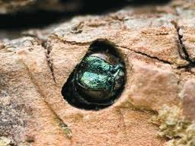
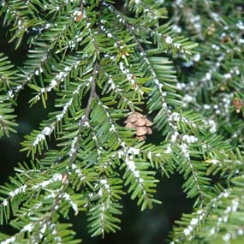
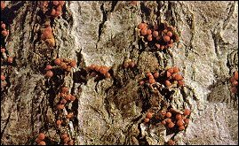
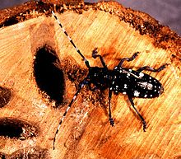
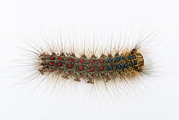
Data Sheet-Field Site Description
Evidence of Disturbance:
1. Forest Pests and Pathogens in Plot: Check one or more:
Hemlock Woolly Adelgid Gypsy Moth Ash Yellows
Asian Long-horned Beetle Beech Bark Disease Emerald Ash Borer
Hemlock Borer other­­___________ None
Notes:
The next part of the data sheet involves recording presence of various natural and human disturbances, which as we know have very important effects on the vegetation and the first is forest pests and pathogens.
Some of you have experience identifying HWA, but many of these pests take an experienced eye or at least a guidebook and pictures to identify. You should have a handout of these supply you with these; but this is important because some pests like emerald ash borer and Asian long horned beetle have just arrived so it will be good to keep an eye on these

Slide 17
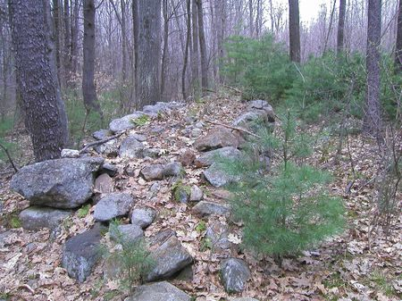
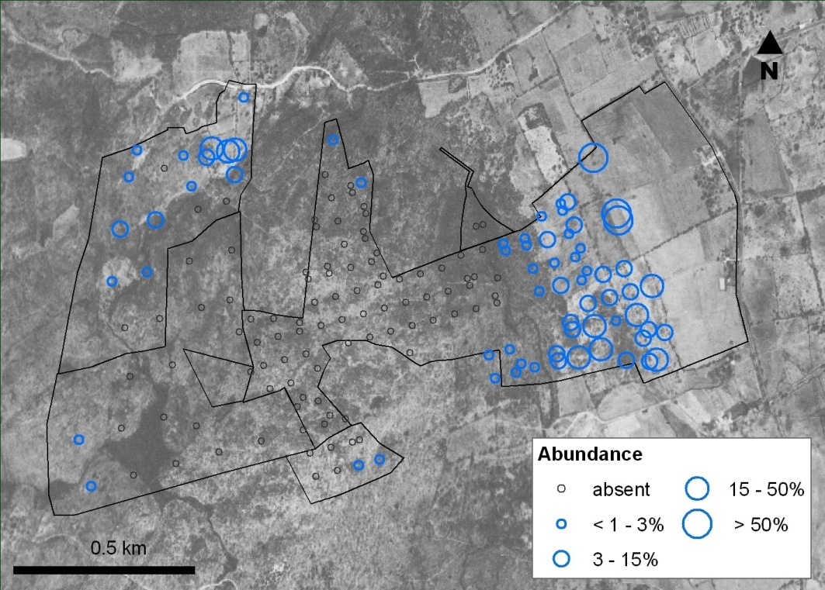
Data Sheet-Field Site Description
Evidence of Disturbance:
2. Human Activity in or Near Plot: Check one or more
cut stumps footpath stone wall
forest road building cellar hole
barbed wire open field skid trail
other_______ None
Notes:
Evidence of human activity both past and current is important to document because both can influence the current vegetation. For example– white pine tended to invade old fields in Massachusetts, and nearby stonewalls signify former open fields that have converted to forest. Invasive plants also tend to be strongly associated with past and current human disturbance. Can vbe related to both current distance to edge and fragmentation and also past land use
This is a graph showing the abundance of Japanese barberry on forest plots at Highstead overlaid on a historical 1930s map showing which forest plost used to be on open field; bigger circles denote more barberry and you can see the association of this exotic plant with where open field were located.

Slide 18
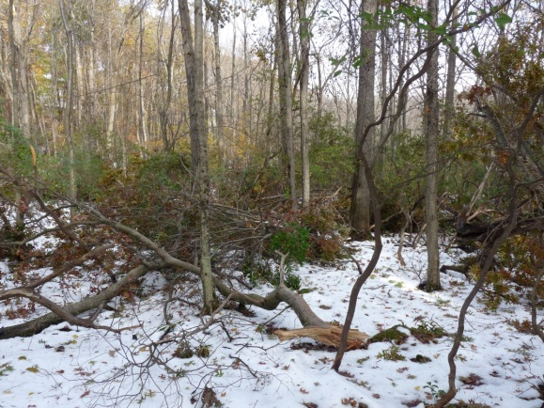
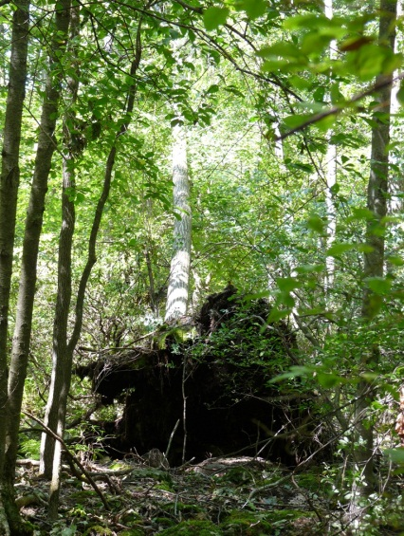
Data Sheet-Field Site Description
Evidence of Disturbance:
3. Weather Events in Plot: Check one or more
uprooted trees snapped trees large downed branches
fire scars river flooding other_____ None
4. Downed Woody Debris Cover in Plot (pieces at least 10 cm in diameter): Check one:
<1% 1-5% 6-25% 26-50% 51-75% >75%
Notes:
Natural disturbances will also be important to document including snapped and downed trees and branches which effect canopy cover and light levels in the forest and the growth rates of remaining trees that either have more growing space or have lost some of their leaves and braches from the storm
We will estimate % cover of large downed wood pieces on the forest floor as part of this

Slide 19
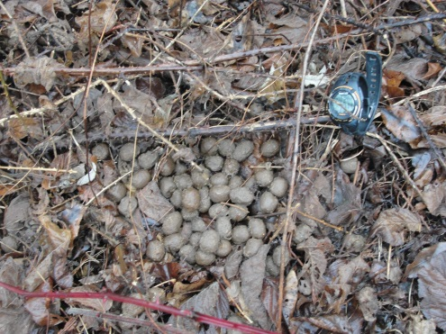
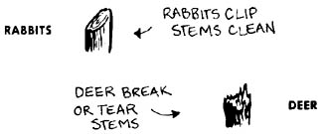
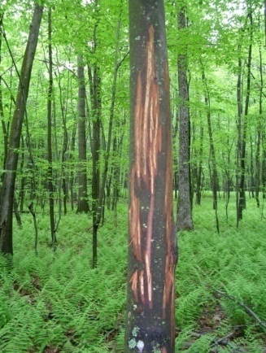
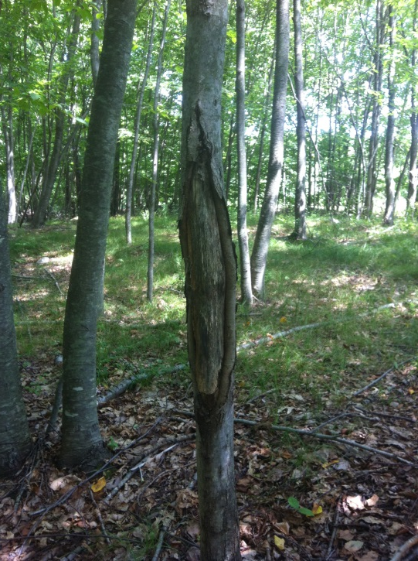
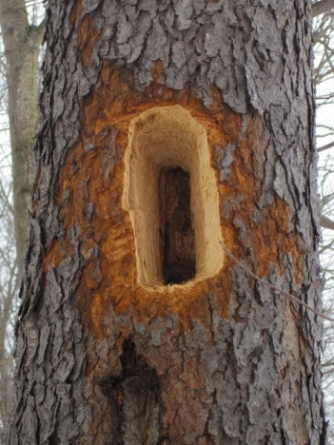
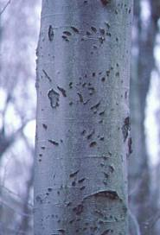
Data Sheet-Field Site Description
Evidence of Disturbance:
5. Wildlife Sign in Plot: Check one or more
deer pellets moose pellets deer/moose browsing
moose bark-stripping deer antler rubs tree girdling [porcupine]
beaver felled tree woodpecker hole bear claw marks on beech
rabbit/porcupine browse other__________ None
Notes:
With the exception of beaver activity, wildlife activity is often a subtle and overlooked part of a forest but can have significant effects on the structure and composition of the forest and thus is important to document. Moose and deer can reduce forest density and change forest composituion and can effect larger trees by antler rubbing and bark stripping,. Bears often reshape the canopy of smaller beech trees that they spend a lot of time feeding on beech nuts. Woodpecker holes can weaken trees and often is a sign of forest pests.

Slide 20
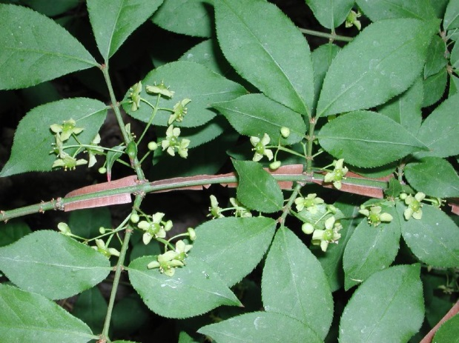
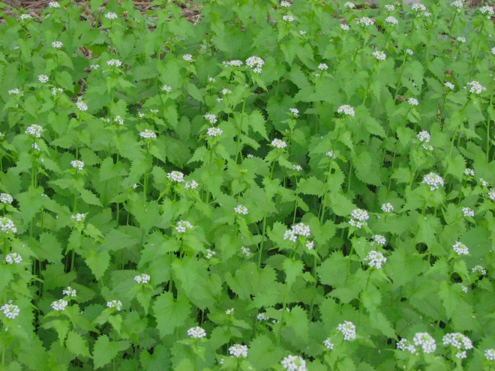
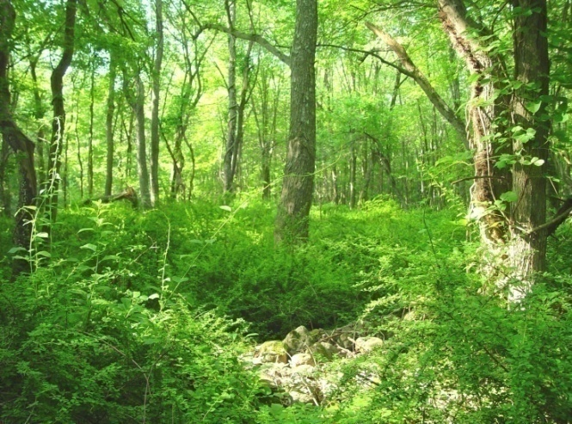
Data Sheet-Field Site Description
Evidence of Disturbance:
6. Invasive Plant Species in Plot: Check One or More:
Garlic Mustard Oriental Bittersweet Japanese Barberry Burning Bush Multiflora Rose Honeysuckle
Autumn Olive Buckthorn Japanese Stilt Grass
Other None
Notes:
And we caan’t forget about invasive plants. Although we will be documenting invasive trees in the actuall data collection, it will be important to document shrubs and herbs that occur in the plot. Invasives of course can effect the diversity of native ecosystems

Slide 21
Tree Identification Number | Tree Species | Diameter at Breast Height (DBH) Record all stems > 2.5cm DBH | Condition (living, dead)
#### | Chestnut Oak | 45.6 | Alive
woodlandstewardship.org
Notes:
The 2nd part of the data sheet is more straightforwrad; you will measure and record all trees at least 2.5 cm in diameter (which is 1.37 m in height) identify the species, and record whether it alive or dead and you will place a tree Id tag on the tree and record the tag number on the data sheet.
Questions

Slide 22
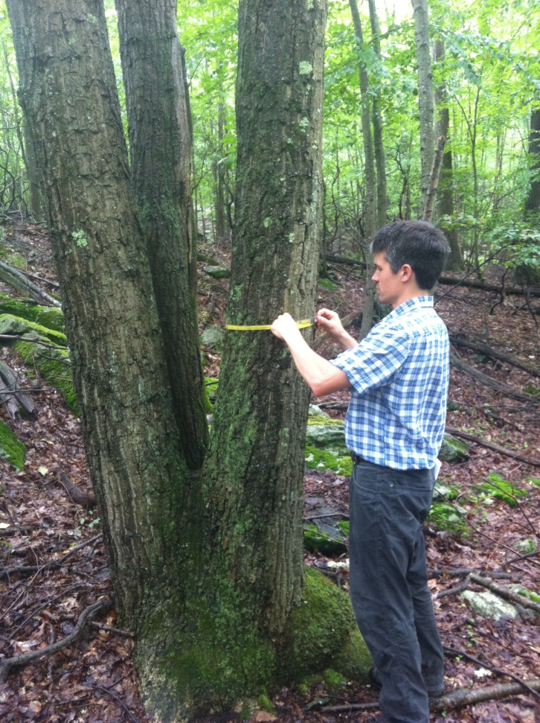
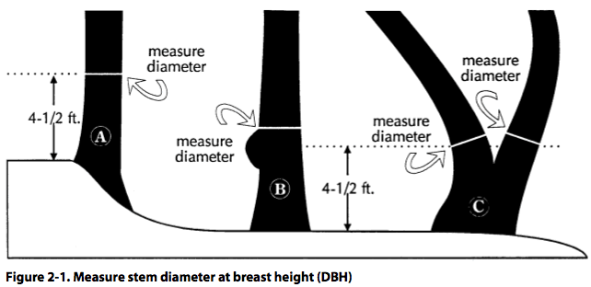
Measuring the diameter of unusual stems
Notes:
Field work is always messier than you would like, and inevitably you will come across trees to measure that are either growing in an unusual way or in an unusual location

