Slide 1


Harvard LTER Schoolyard Program
-------------------------------------------------------
Teacher Developed Lessons and Documents that integrate
Harvard Forest Ecology Themes into curriculum.
Lesson Title: HF Field Trip Land Change Activity
Teacher/Author: Louise Levy
School: Belchertown High School
Level: High School
Date: October 2017

Slide 2
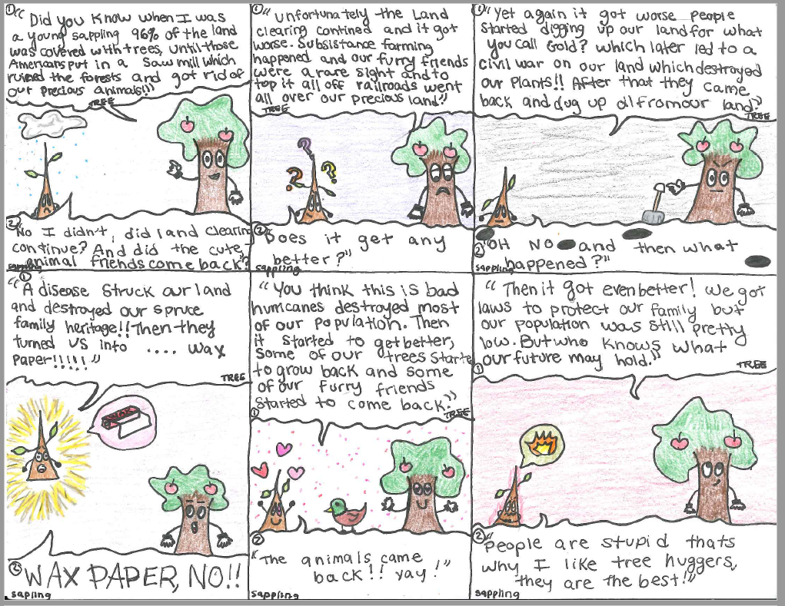
Assignment:
Recap Massachusetts Forest History for a 10 year old student using a 20 line dialog or 6 panel comic strip.

Slide 3
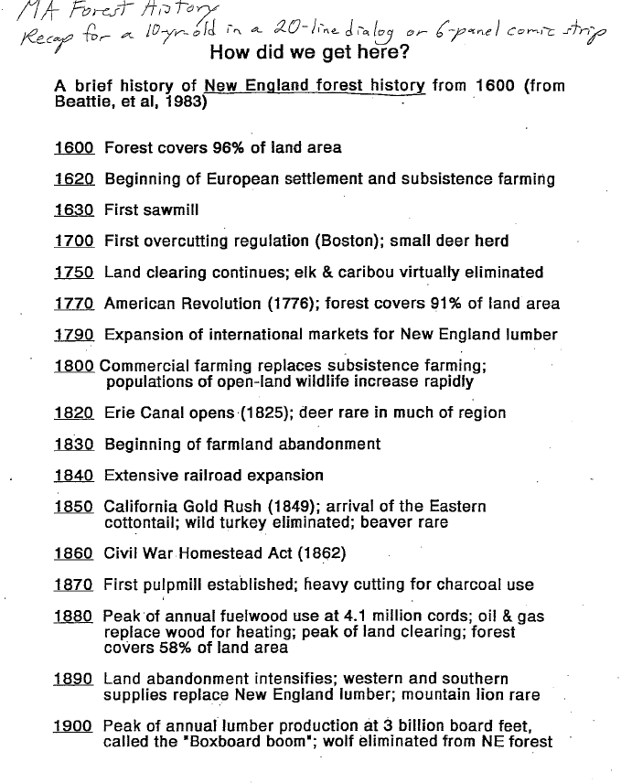

Slide 4
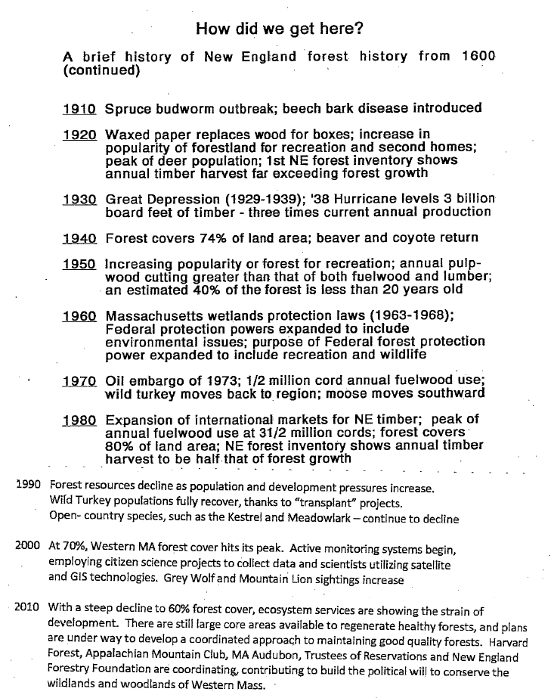

Slide 5
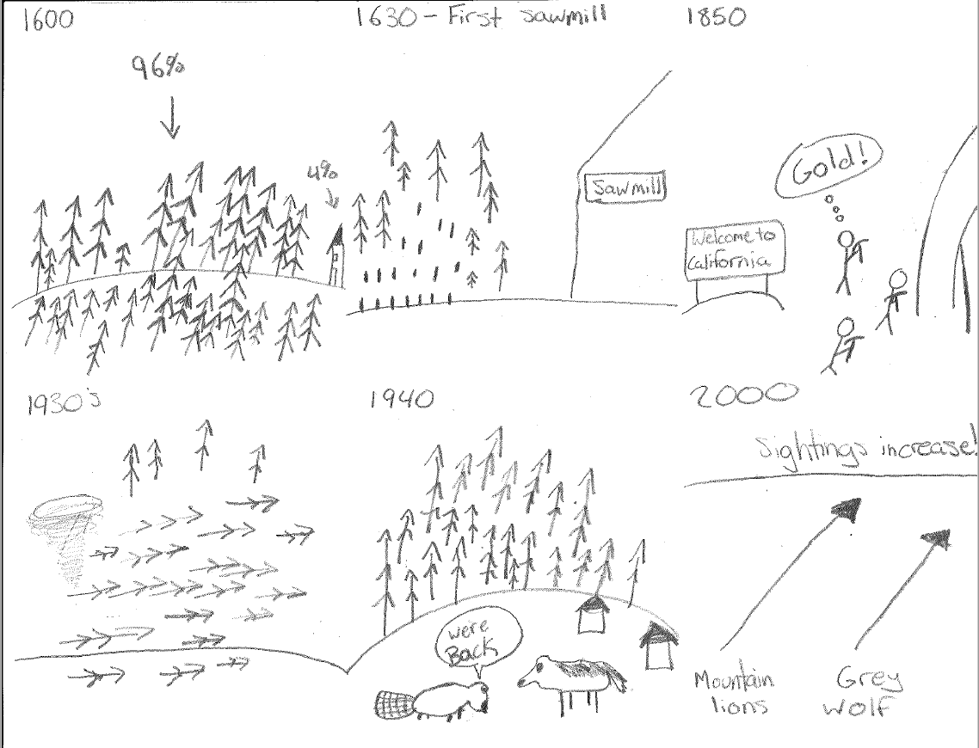
Student Sample 2

Slide 6
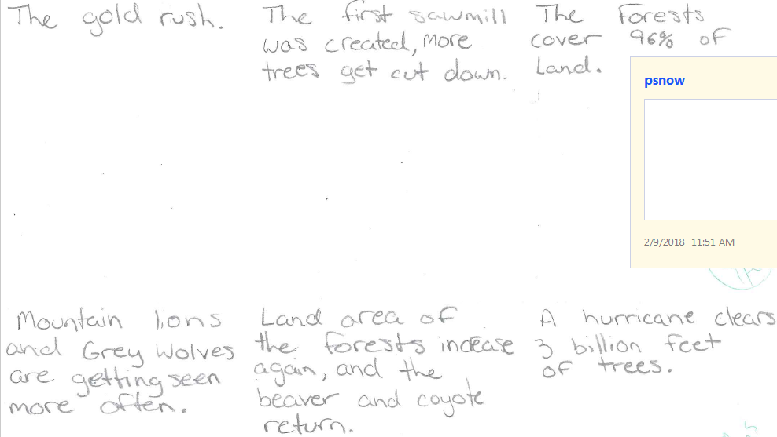
Student Sample 2 Notes

