Slide 1


Harvard LTER Schoolyard Program
-------------------------------------------------------
Lessons and Documents that integrate Harvard Forest Schoolyard Ecology themes into the curriculum.
Lesson Title: Resource Packet and Teaching Prompts to Support the “Dirty Water” Data Nugget
Author: Amanda Suzzi, University of Massachusetts—Amherst
Level: High School
Date: September 2021

Slide 2
Supported MA Education Frameworks
2016 MA STE Standards:
HS-ESS2-2. Analyze geoscience data to make the claim that one change to Earth’s hydrosphere can create feedbacks that cause changes to other Earth systems.
HS-ESS3-1. Construct an explanation based on evidence for how the availability of key natural resources and changes due to variations in climate have influenced human activity.
[HS.LS.2.7] - Analyze direct and indirect effects of human activities on biodiversity and ecosystem health, specifically habitat fragmentation, introduction of non-native or invasive species, overharvesting, pollution, and climate change. Evaluate and refine a solution for reducing the impacts of human activities on biodiversity and ecosystem health.
VANR.VENVR.2.B.02.07. Distinguish categories and sources of water pollution.
VANR.VENVR.2.C.01.03. Define a watershed.
Connections to AP and Environmental Science Topics:
Unit 1: The living World: Ecosystems- the water cycle
Unit 4: Earth Systems and Resources- watersheds
Unit 5: Land and water use- impacts of urbanization, methods to reduce runoff
Unit 8: Aquatic and Terrestrial Pollution: Sources of pollution, impacts on ecosystems

Slide 3
Land Acknowledgement
We collectively acknowledge that the Merruasquamack (Merrimack River) watershed is located on the traditional, ancestral, and contemporary lands of the Pennacock, Wobanaki, and Massachusett peoples. We also recognize the continuing presence of the neighboring Wampanoag and Nipmuc peoples. We acknowledge the painful history of genocide and forced removal from this territory and honor, respect, and celebrate the many Indigenous peoples still connected to this land and this community. Let us take a moment of silence to pay respect to their Elders and to all local Indigenous people, past and present.
Notes:
The name Merrimack is believed to have been adopted by early European settlers from Merruasquamack, a name meaning "swift water place" that given by Native American tribes for the portion of the river between Manchester, New Hampshire and Lowell, Massachusetts. A number of tribes occupied the watershed and gave the river several different names.
Background
In the United States today, there are more than five hundred federally recognized Indigenous nations comprising nearly three million people. These people are the descendants of the fifteen million Native people who once inhabited this land. Most non-Indigenous Americans know very little, and are taught very little, about those who originally lived and thrived on the lands we now occupy – or about Native lives and cultures today. Learning about and acknowledging the people on whose land we live is one way we can begin to take responsibility for our country’s ongoing injustices against Native peoples. And it is a step that can be mind-opening and enriching for us.
Work with students to arrive at a working definition of what a “land acknowledgement statement” is and its purpose is.
Ask students:
Who lived on the land we are on before European colonizers arrived?
This Interactive Lands map may be helpful: https://Native-land.ca/
If we DO know, what do we know about those people?
If we DON’T know, why don’t we?
--
It is a formal statement that pays tribute to the original inhabitants of the land you are on. The purpose is to show respect for Indigenous peoples and recognize their enduring relationship to the land. This is often done at the beginning of ceremonies, lectures, or any public event. It can be a way to recognize the history of colonialism and a need for change in settler societies.
--
Land acknowledgements do not exist in a past tense, or historical context: colonialism is a current ongoing process, and we need to build our mindfulness of our present participation. Land acknowledgment alone is not enough. It’s merely a starting point. Going forward we must all do our part when it comes to dismantling colonization and seeing the world in a new light. How do you plan to take action to support Indigenous communities?

Slide 4
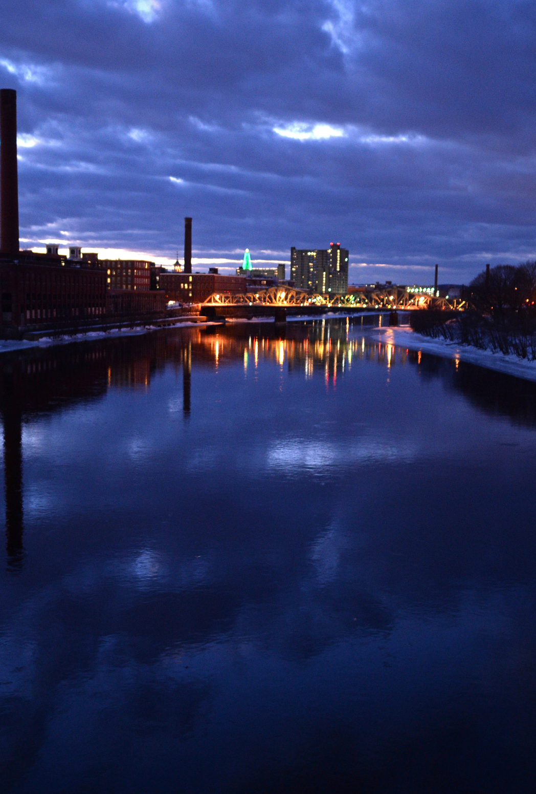
Love that Dirty Water
the Connection Between Land and Water in the Merrimack river watershed
Photo Source: Christopher Evans
Notes:
A good precursor to this lesson is the Don’t Flood the Fidgets video game, where students are introduced to the stormwater infrastructure types and terminology.
------------------------
Instructor: Clean water is something that is easily taken for granted, especially in highly developed areas. Like many issues, it can be hard to sympathize with another city’s plight if we are not experiencing it ourselves.
------------------------
Photo Source: Christopher Evans

Slide 5
Building background understanding and knowledge
Notes:
This would make a good Think, Pair, Share activity.
------------------------
Instructor: Tell a personal story about water. Students, tell me about a personal experience you have with water. This can be a special place you’ve visited, a stream near your school that you’ve explored, a large storm you remember, or something else.

Slide 6
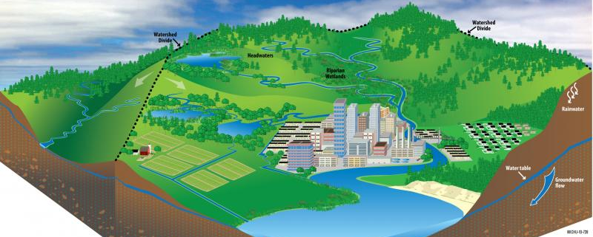
What is a watershed?
Image Source: Michigan Sea Grant
Notes:
Instructor: No matter where you live, your home is situated in a watershed: a land area that drains to a central location, such as a lake, river, or ocean. You can think of it as a shallow depression or bowl in the landscape, where the “rim” is a ridge or hill: even if your home is situated on the rim of the bowl, water washing off your neighborhood is draining to the same place as areas on the opposite side of the bowl—everything is connected.
The water that you see dripping down your window, pooling in the street, or flowing through a creek leads elsewhere, whether that’s a wastewater treatment facility, a wetland, a larger tributary, or the ocean. Because of this interconnectivity, what may seem like a small action in one area of the watershed can have a big impact on natural systems elsewhere in the watershed, including the plants, animals, and people that depend on them.
Can you explain where/what the boundaries of a watershed are?
------------------------
Image Source: Michigan Sea Grant

Slide 7
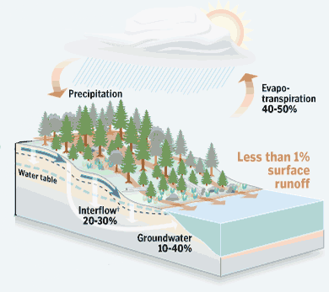
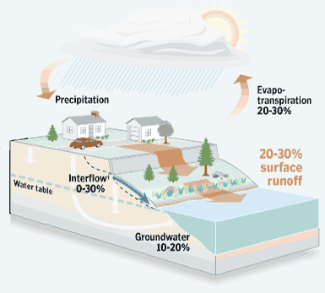
Forests soak up rainfall, reducing runoff
Removal of forest cover increases stormwater runoff
Image Source: Unknown
Notes:
Instructor: For every inch of rainfall, one acre of paved surface can generate 27,150 gallons of runoff. As rainfall hits the ground and washes over impervious surfaces, it picks up pollutants. Look at this diagram. What can you tell me about it?
On the left, we see a forested landscape, which has very little runoff.
On the right we have an urban landscape, where 20-30% of the precipitation runs off into the water.
------------------------
Image Source: Unknown

Slide 8
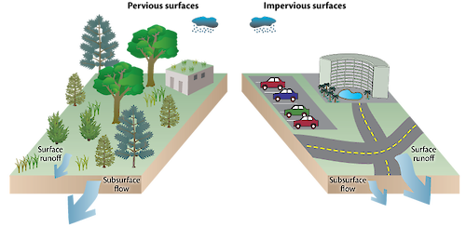
Runoff Picks Up:
Pet Waste
Fertilizers
Motor Oil
Detergents
Chemicals
Litter
Which will send more pollutants into the river?
GREEN FILTER OR GRAY FUNNEL?
Image Source: Unknown
Notes:
Instructor: Imagine a rainstorm in a wooded area. Grass, leaves, soil, and vegetation act like a sponge, soaking up the water into the floor of the forest. Now imagine the same rainstorm on a road, or in a parking lot. Which will send more water into the river? Which will send more pollutants into the river?
Some of these pollutants include:
Pet waste
Fertilizers
Motor Oil
Detergents
Chemicals
Litter
------------------------
Image Source: Unknown

Slide 9
~ two-thirds of water-cycle-regulating forests
worldwide are degraded
~ water pollution
has increased in most African, Asian, and Latin American rivers since the 1990s.
Notes:
Instructor: read the slide

Slide 10
The Global Issue
Notes:
Instructor: Water insecurity presents significant human rights and social justice concerns. While the human right to water was adopted by the United Nations as binding international law nearly a decade ago, today more than 2 billion people—about 30% of the global population—still do not have their right to water fully realized. This water injustice reality disproportionately impacts marginalized individuals and communities, including the world’s 370-500 million Indigenous Peoples.
------------------------
Data Source: UN

Slide 11
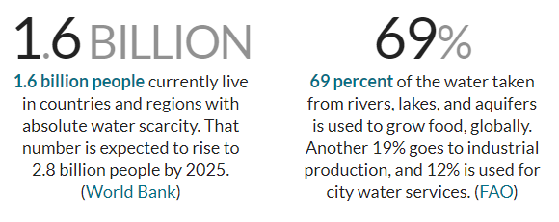
Statistics about the water crisis
Data Source: World Bank and FAO
Notes:
Instructor: read the Statistics about the water crisis
------------------------
Data Source: World Bank and FAO

Slide 12
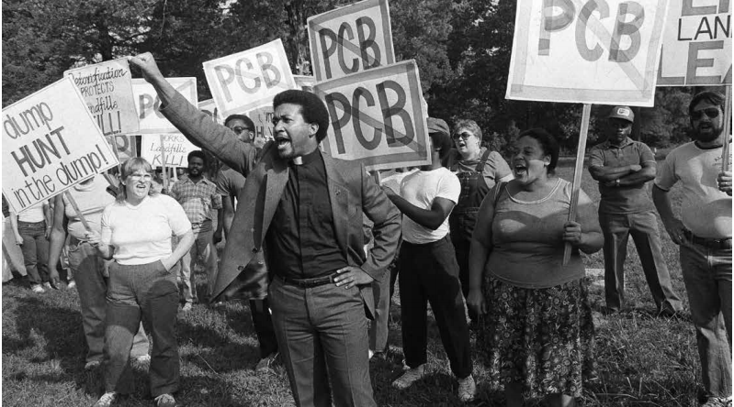
Communities of color, low-income communities, or Indigenous communities or populations that experience disproportionate environmental harms and risks, compared to communities with more white or affluent people
Image Source: AP; Data Source: NPR
Notes:
Instructor: Around the world, communities of color and marginalized groups disproportionately feel the effects of pollution and other environmental impacts. Environmental racism has long exposed poor people and people of color to dangerously high levels of lead, contaminated water and bad air. These communities suffer from high incidences of related ailments, such as cancer and asthma.
This is a photo of Civil rights leader Rev B. Chavis leading a rally against toxic PCB landfill near poor, Black community in Warren County, NC
------------------------
Image Source: AP
Data Source: NPR

Slide 13
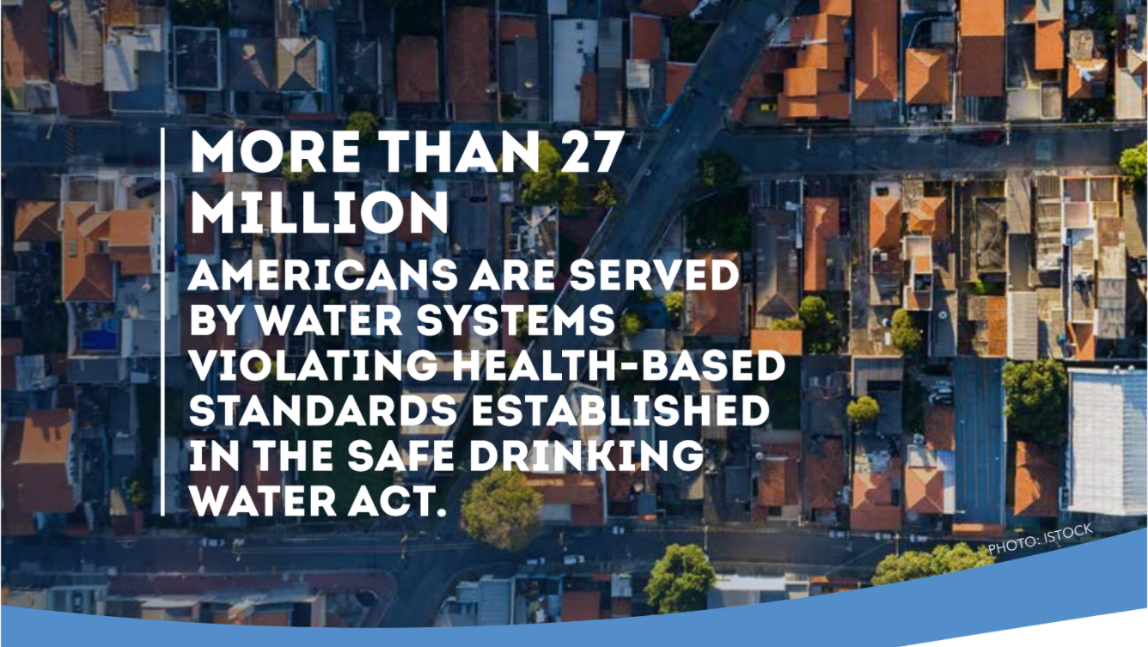
Data Source: Water Infrastructure Solutions for Health & Justice | NRDC
Notes:
Instructor: All too often, our water infrastructure is failing our communities—especially vulnerable populations, such as low-income communities and communities of color. Over time, infrastructure investments have closely followed the geography of wealth. As a result, higher-income areas enjoy high-quality infrastructure while low-income areas have suffered decades of underinvestment and disinvestment.
People of color live in areas with higher rates of contaminated water, stormwater and wastewater overflows, and increased risks of flooding.
------------------------
Data Source: Water Infrastructure Solutions for Health & Justice | NRDC

Slide 14
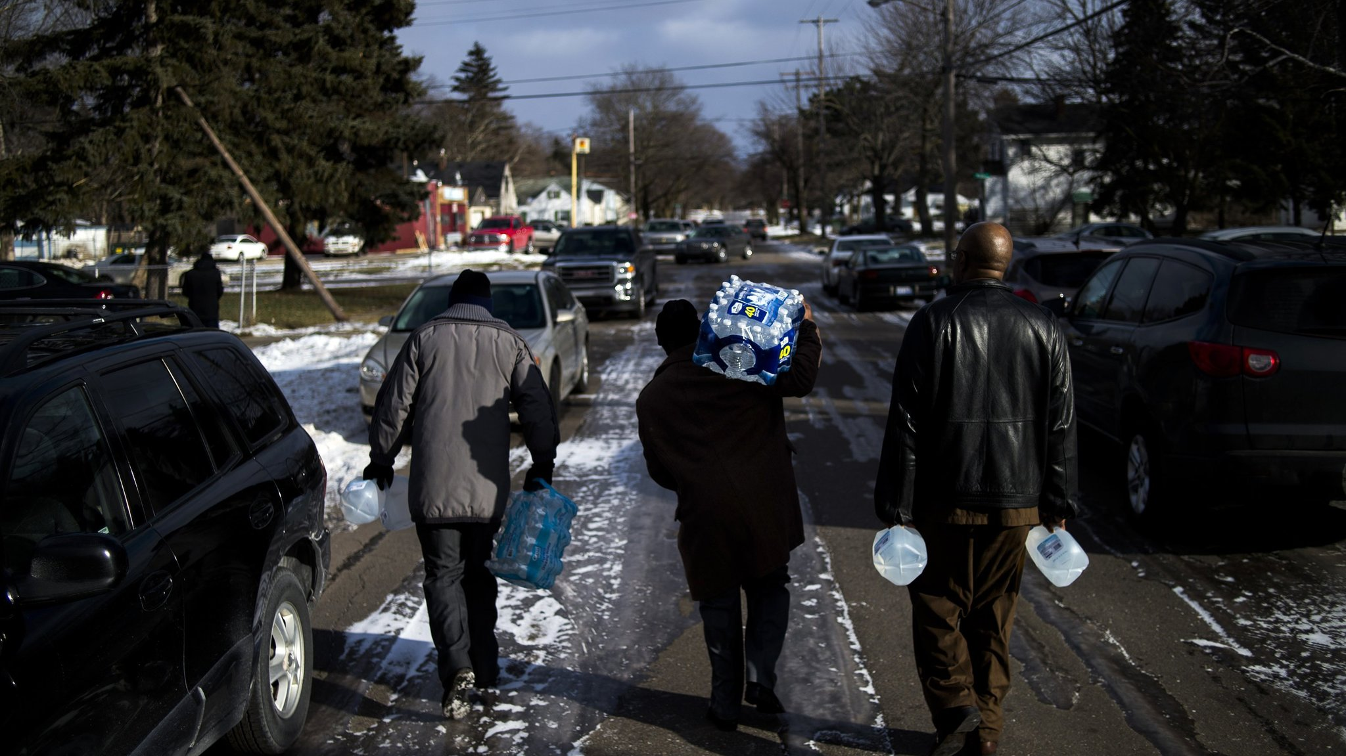
If the city of Flint, MI were rich and mostly white, would the state government have responded more quickly and aggressively to complaints about its polluted water?
Image Source: Max Ortiz, The Detriot News; Data Source: Clean Water and the EJ Movement | sharedjustice.org
Notes:
Instructor: Flint, Michigan is one of many examples of a poor community bearing the brunt of an environmental crisis, with 40 percent of Flint’s population living below the poverty line. In Flint, 12 people died of Legionnaires disease linked to contaminated water in 2014. An additional 6,000 to 12,000 children were exposed to lead in their water from old pipes, a hazard that also caused a 58 percent spike in fetal deaths. Many consider Flint’s crisis the result of environmental racism; most of its population (56%) is black, significant because its state is predominantly white. The Michigan Civil Rights Commission’s report found that racism played a role in Flint’s water crisis.
------------------------
Image Source: Max Ortiz, The Detriot News
Data Source: Clean Water and the Environmental Justice Movement | sharedjustice.org

Slide 15
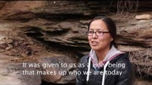
Video Source: Cynthia Wilson, Traditional Food Director for UDB; Camera/Sound/Editing by Angelo Baca
Notes:
Instructor: Water is sacred to many tribal nations and is vital to tribal subsistence, cultural practices, health and welfare, agricultural production, and economic development. Yet 6.5 percent of American Indian and Alaska Native homes— approximately 26,000 households—lack access to a safe water supply and/or waste disposal facilities, compared to less than 1 percent of homes for the U.S. general population.
Utah Diné Bikéyah (pronounced di-NAY bi-KAY-uh) means “people’s sacred lands” in the Navajo language. They are working with the five sovereign Tribes of the Bears Ears Inter-Tribal Coalition to protect the Bears Ears National Monument, an ancestral site, from mining and future development. This site has held cultural significance for generations of Diné, Hopi, Zuni, Pueblo and Ute peoples. Their strategy includes raising awareness and identifying solutions that address the stark discrimination over access to water for Diné (Navajo) people and ensuring Native people’s voter rights are protected and that they have appropriate representation in local government leadership. Recent elections provide hope to this issue.
PLAY THE VIDEO
------------------------
Video Source: Cynthia Wilson, Traditional Food Director for UDB; Camera/Sound/Editing by Angelo Baca
Data Source: NPR

Slide 16
Too much, too little, too dirty, undervalued.
When water supplies are out of sync with human and environmental needs, life suffers.
Ethical, moral, economic, and scientific principles must be united to guide local and global responses to world’s urgent water challenges.
Notes:
Instructor: read the slide

Slide 17
The local connection
Notes:
Instructor: USA Today reported that as many as 63 million Americans were exposed to unsafe drinking water between 2007 and 2017. Unclean water can cause serious and costly health issues, and studies have found that poor and minority communities across the U.S. are disproportionately affected by polluted waters.
------------------------
Data Source: USA Today

Slide 18
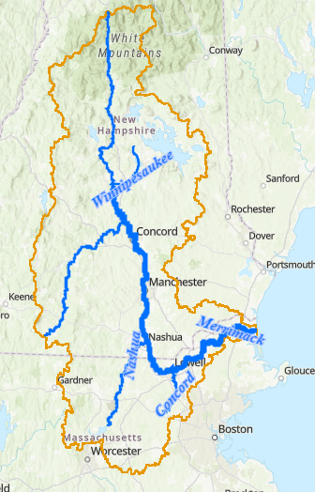
Where Does Your Drinking Water Come From?
The only water supply for Lowell's Water Treatment Plant is the surface water from the Merrimack River.
Lowell Regional Water purifies more than 4.6 billion gallons (4,633,279,000) of drinking water delivering to approximately 135,000 residents and businesses in the communities of Lowell, Dracut, Tyngsboro, and Chelmsford.
Image Source: EPA
Notes:
Instructor: In the towns of Foxborough, Canton, Dedham, Dover, Medfield, Randolph, Sharon, Stoughton, Walpole, and Westwood, drinking water mainly comes from groundwater aquifers.
The communities of Hyde Park, Mattapan, Milton, Norwood, and Quincy get their drinking water from the Massachusetts Resources Water Authority (MWRA) reservoirs The MWRA gets water from the Quabbin & Wachusett Reservoirs in Central MA as shown in the image.
Where does Lowell get its water from? The only water supply for Lowell's Water Treatment Plant is the surface water from the Merrimack River. Lowell Regional Water purifies more than 4.6 billion gallons (4,633,279,000) of drinking water delivering to approximately 135,000 residents and businesses in the communities of Lowell, Dracut, Tyngsboro, and Chelmsford.
--
Additional Reading: https://www.bostonherald.com/2018/01/10/the-big-stink-raw-sewage-and-untreated-wastewater-pouring-into-massachusetts-rivers-video/

Slide 19
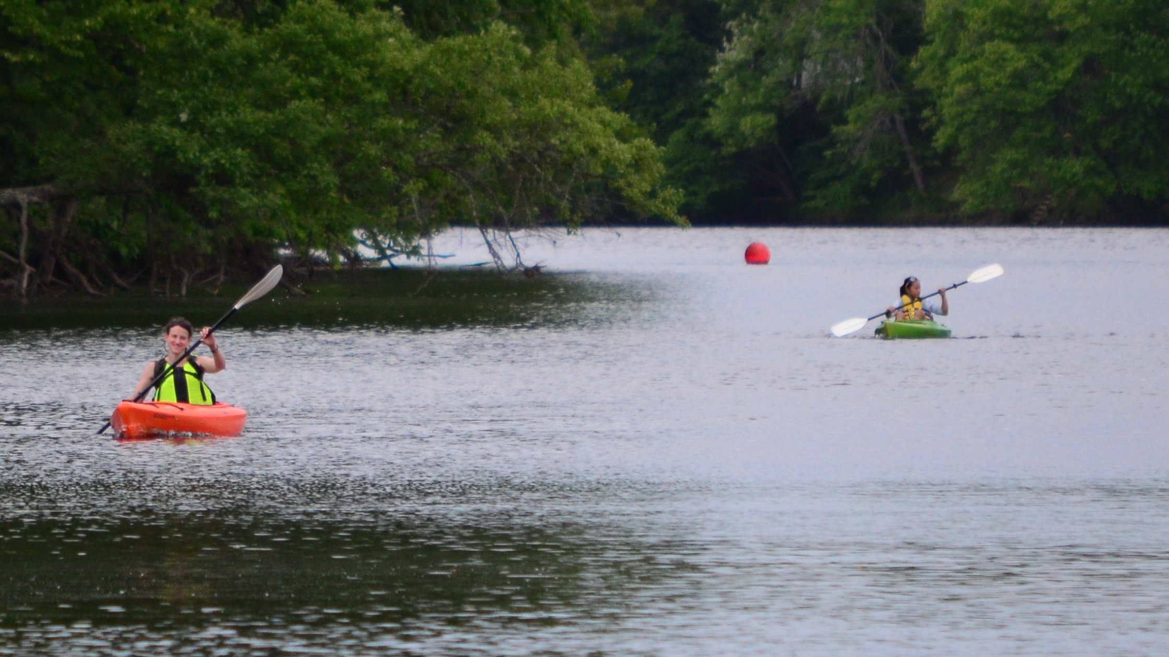
Photo Source: Tom Hinkle
Notes:
Instructor: This photo, of Innovation Academy Charter School students retracing Thoreau’s trip along the Merrimack, in Tyngsboro, is a couple of miles upstream of where Lowell gets its water.
Massachusetts has some of the highest quality drinking water in the country and some of the strictest standards.
------------------------
Photo Source: Tom Hinkle

Slide 20
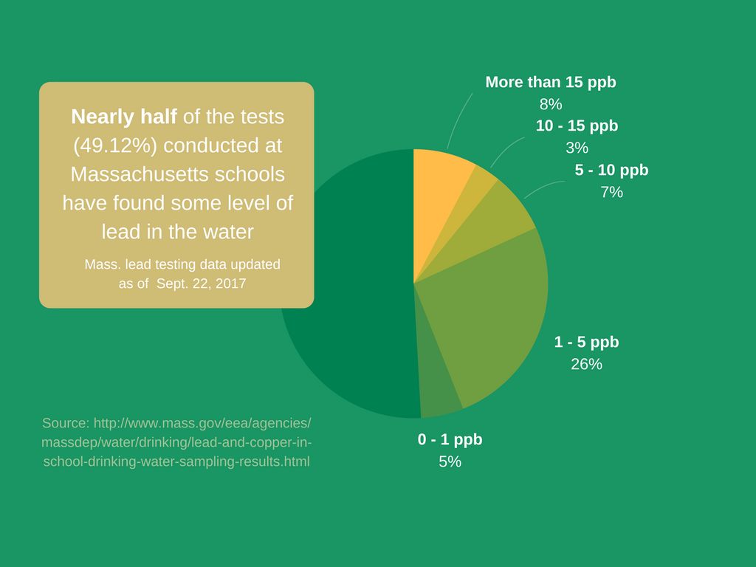
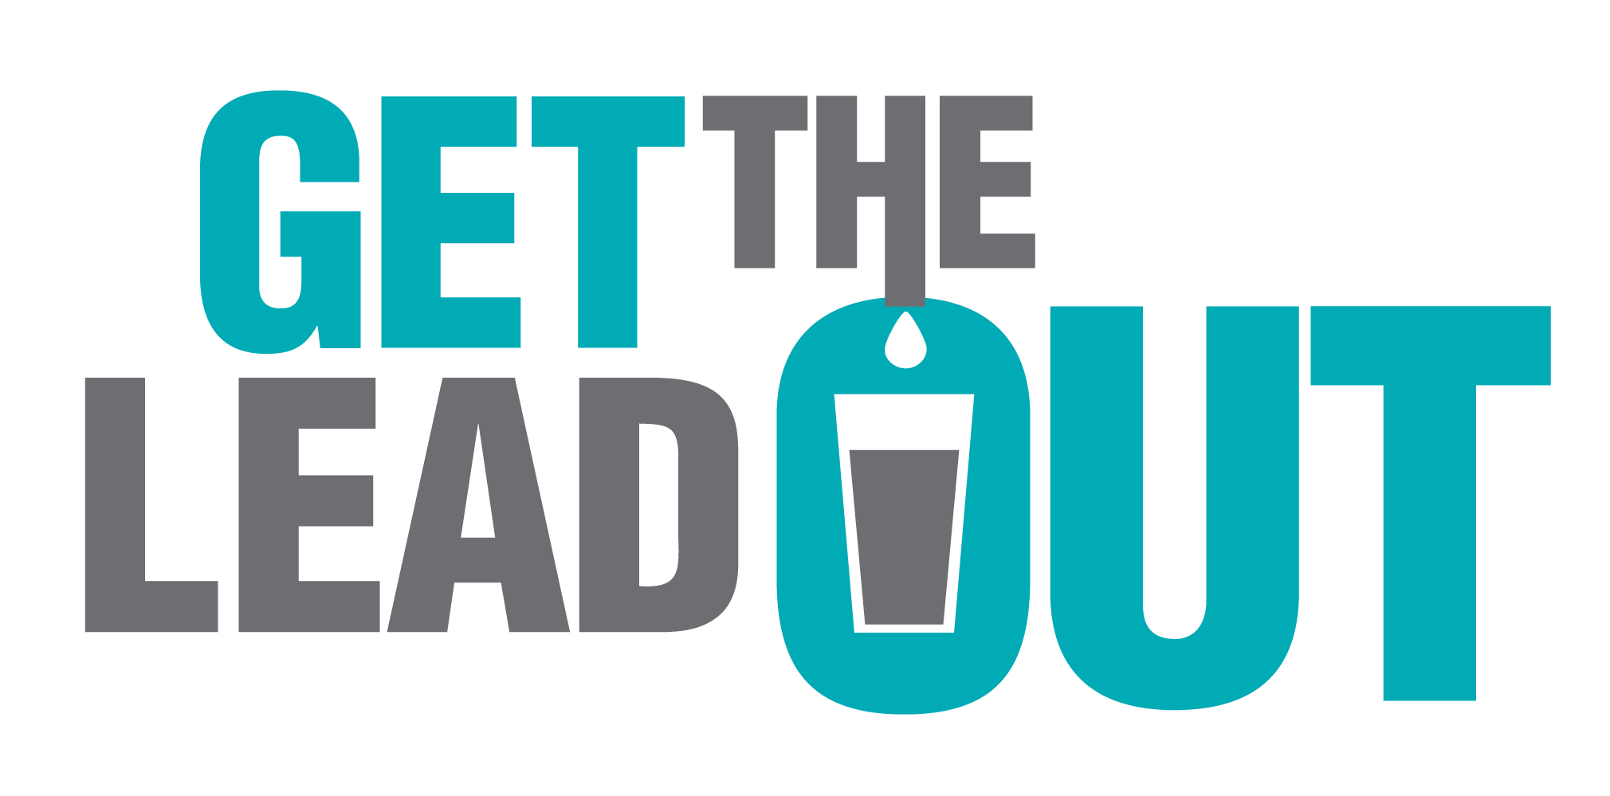
Massachusetts has some of the highest quality drinking water in the country and some of the strictest standards.... and yet 44% of MA schools that were tested have lead > 1 ppb.
Data Source: Clean Water Action
Notes:
Instructor: The crisis that began unfolding in Flint, Mich., in 2014 provided a tragic reminder of the dangers of lead exposure. The drinking water of an entire city had been contaminated with lead. More than 8,000 children under the age of six drank lead-contaminated water. Now we know this toxic threat extends well beyond Flint.
Lead is so toxic that experts recommend a health standard of 1 part per billion. Massachusetts has some of the highest quality drinking water in the country and some of the strictest standards.... and yet 44% of MA schools that were tested have lead > 1 ppb.
In all likelihood, these confirmed cases only scratch the surface of this problem. Most schools have at least some lead in their pipes, plumbing or fixtures. And where there is lead, there is risk of contamination.
The only way to ensure safe drinking water for our children is to “get the lead out” of our schools and pre-schools. This involves proactively removing lead-bearing parts from schools’ drinking water systems—from service lines to faucets and fixtures—and installing filters certified to remove lead at every tap used for drinking or cooking.
------------------------
Data Source: Clean Water Action

Slide 21
Urban Water Issues: Merrimack river
Pennacook people met at the Pawtucket Falls on the banks of the Merrimack to fish salmon and sturgeon during the day and conduct business at night.
Later
Now
Then
The growth of Lowell and other industrial cities on the Merrimack dramatically changed the river's ecosystem.
The river is still afflicted with pollution problems. Salt, grease, trash, and pesticides run off into the river from cities.
It is the MOST impaired drinking water source in New England (EPA).
Data Source: National Park Service
Notes:
Instructor: Hard as it may be to believe, the Charles and the Merrimack started out on equal footing. They were both fertile fishing grounds that Native Americans stewarded for thousands of years. Then the first waves of European settlers arrived, and the rivers went to hell.
The Merrimack River has had its ups and downs. It was a pristine salmon and sturgeon river before being polluted and dammed during the Industrial Revolution. During the heyday of the textile mills, the color of the Merrimack River changed colors daily depending on what materials were being dyed at the factories. The canals of Lowell were especially loaded with trash and dyes, making the water unfit for drinking. In the 1920s, 12 million gallons of Lowell human waste and run-off entered the river each day. The river is still afflicted with pollution problems. Salt, grease, trash, and pesticides run off into the river from cities.
The most stubborn problem now is Combined Sewage Overflows (CSOs). Normally, sewage treatment plants treat both runoff and sewage. However, heavy rains can cause such an excess of water that some waste goes into the river untreated, periodically lowering water quality. Statewide, about 200 active outfall pipes located in 18 cities discharge billions of gallons of sewage annually.
------------------------
Data Source: National Park Service

Slide 22
Urban Water Issues: Charles river
Charles was a tidal river, surrounded by hundreds of acres of salt marshes and mudflats.
Now
Then
In the nineteenth century, the basin was damned for mills and filled for industrial, commercial, and residential purposes, including two prisons, three coal-burning power plants, and several gas works.
The water quality of the Charles has improved from a grade of “D” in 1995 to a “A-” in 2018. People can now swim in it, if they don't touch the bottom.
Later
Recent
By the mid 1960s, major industrial activities along the Charles had ceased and an environmental movement emerged advocating for improved water quality and ecological health of the Charles River.
Data Source: Conservation Law Foundation
Notes:
Instructor: Just like the Merrimack River watershed, Native Americans inhabited the Charles River watershed. By 1700s, the river was dammed for industrial usage which limited fish migration. Paving of street surfaces and creation of other impervious surfaces continues; turns an "absorbent" land surface into a "waterproof" land surface. By the 1880s, raw sewage had been dumped into river for over 100 years.
In1988, as a result of the EPA/CLF (Conservation Law Foundation) Boston Harbor Cleanup Lawsuit, Massachusetts Water Resources Authority (MWRA) creates its combined sewer overflow (CSO) program. Lower Charles had 19 CSOs discharging 1.7 billion gallons per year into lower Charles, 150 million gallons per year (MGY) untreated. Under orders issued in the fall of 2004, Waltham, Watertown, Newton and Brookline required to eliminate illicit discharges. Work continues illicit discharges by Boston Water & Sewer Commission by 2012 consent decree. CSO flows in lower Charles have been reduced by 90%.
------------------------
Data Source: Conservation Law Foundation

Slide 23
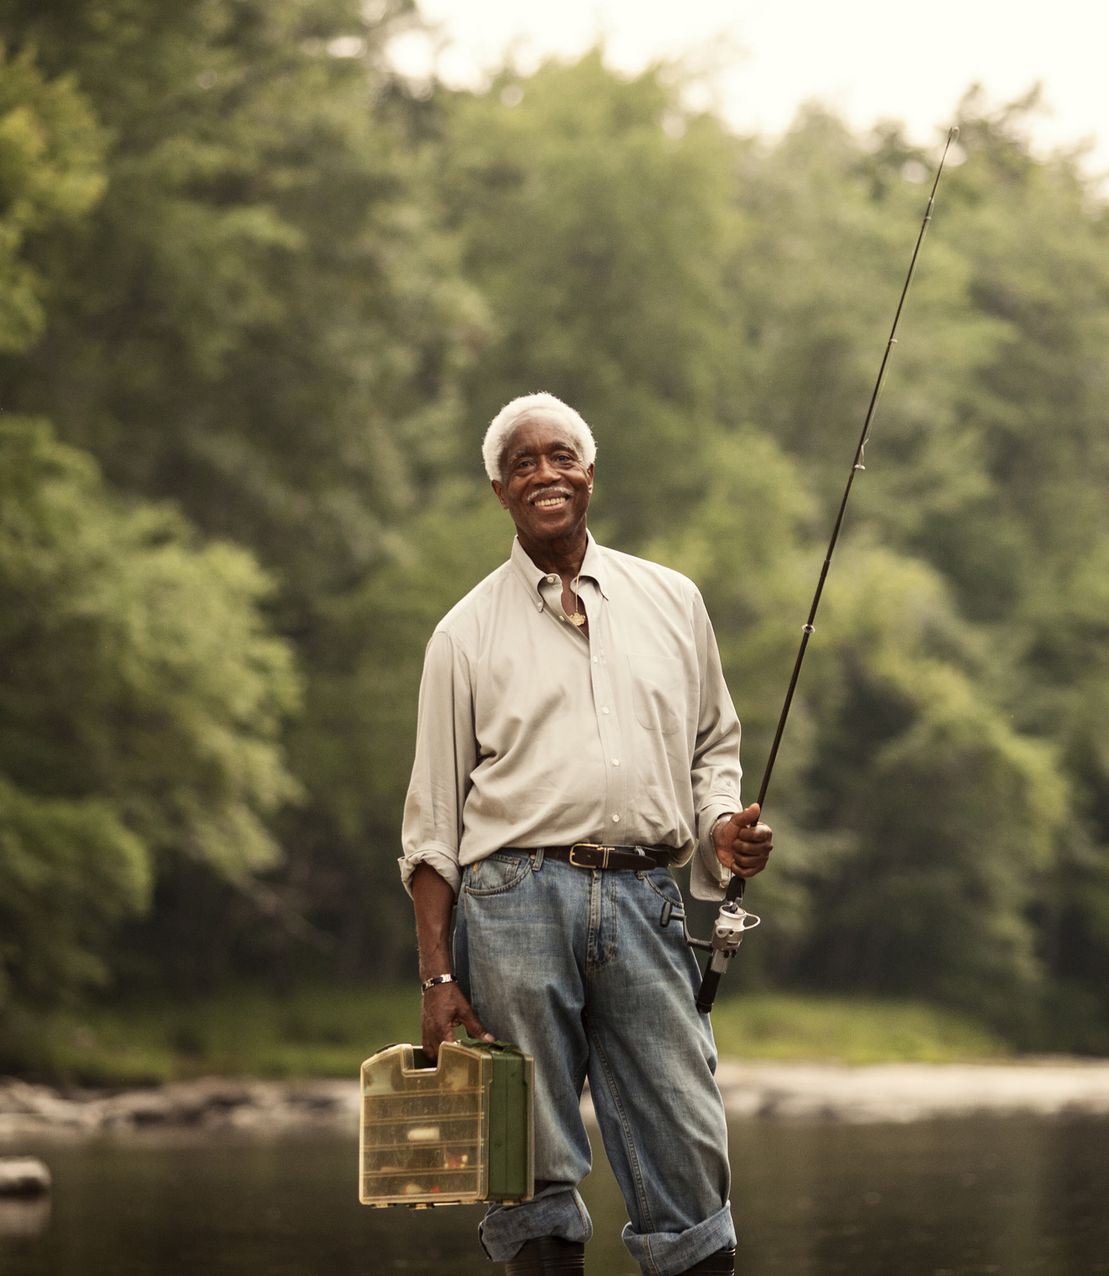
NONPOINT SOURCE SUCCESS STORY:
Eliminating Stormwater Runoff Restores Shellfishing Area in Fisherman’s Cove,
Bourne, MA
Data Source: EPA
Notes:
Instructor: Fisherman’s Cove, located within Butler Cove in Bourne, Massachusetts, had been closed to the harvesting of shellfish for decades due to polluted stormwater runoff. A single stormwater outfall pipe drained stormwater from 1.5 acres of impervious surface, including a large parking lot and building, directly into Fisherman’s Cove, which resulted in closed shellfish areas. Project partners began work in 2013 to construct infiltration biofilters and other low impact development techniques to remediate stormwater inputs to the cove. As a result of this project, no water flow was observed from the outfall pipe, even after heavy rains. Based on these findings, the closed area was reclassified to “approved” and opened to shellfishing on December 3, 2014.
------------------------
Data Source: EPA
More details here: https://www.epa.gov/sites/production/files/2016-12/documents/ma_butler_cove_508.pdf

Slide 24
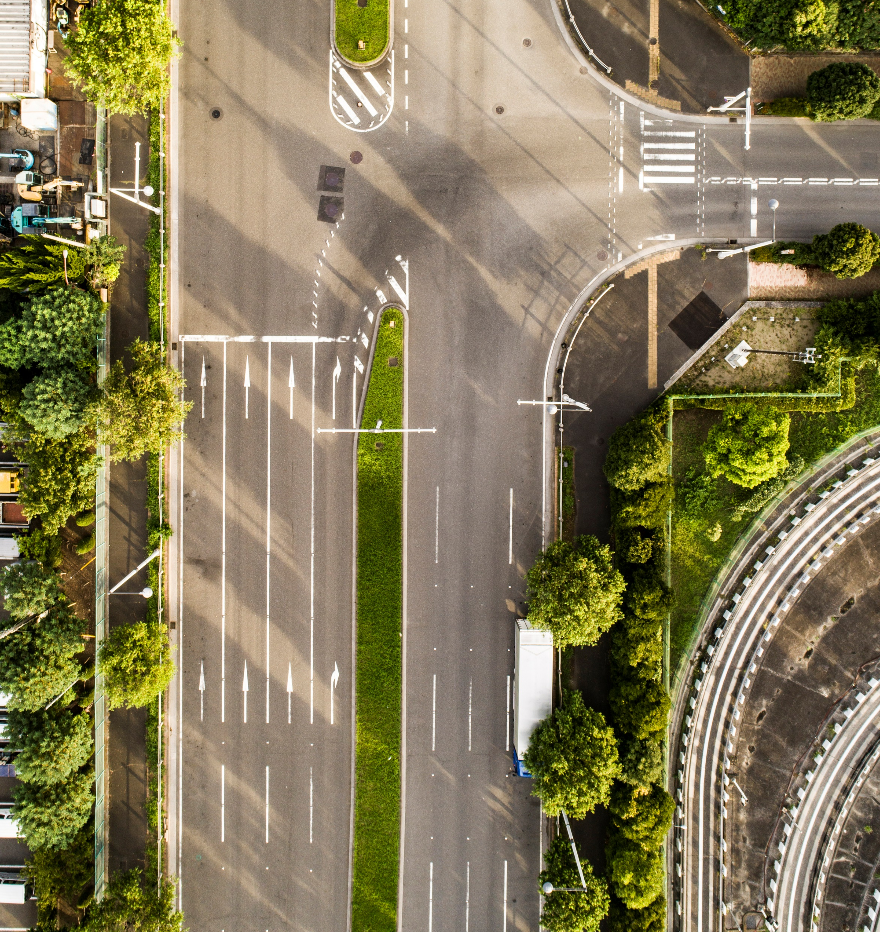
NONPOINT SOURCE SUCCESS STORY:
Installing Rain Gardens, Permeable Pavers and a Pocket Wetland
Restores Recreational Uses to Sunset Lake
Data Source: EPA
Notes:
Instructor: Polluted stormwater runoff from a parking lot and access drive affected recreational uses at the town of Braintree’s Sunset Lake. High bacteria levels and dense nuisance aquatic plant growth resulted in several beach closings during each swimming season. The Massachusetts Department of Environmental Protection (MassDEP) placed Sunset Lake on the 1992 Clean Water Act (CWA) section 303(d) list of impaired waters for Eurasian watermilfoil, an invasive species. Project partners implemented a series of structural and nonstructural best management practices (BMPs) to address stormwater runoff to the lake. As a result, bacteria levels have decreased and water quality has significantly improved at Sunset Lake, allowing swimmers and boaters to return.
------------------------
Data Source: EPA
More details here: https://19january2017snapshot.epa.gov/sites/production/files/2016-12/documents/ma_sunset_lake_508.pdf

Slide 25
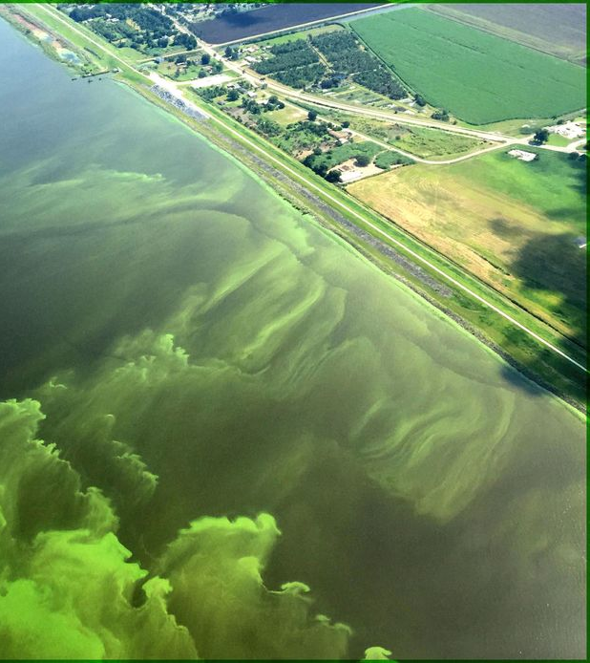
NONPOINT SOURCE SUCCESS STORY:
Addressing Agricultural Runoff Restored Martin’s Pond Brook
Data Source: EPA
Notes:
Instructor: Martin’s Pond Brook, which flows through a critical area known for its unique biological, physical and cultural resources, had been impacted by agricultural nonpoint source pollution since the late 19th century. Excess sediments and nutrients from livestock areas caused in-stream turbidity, siltation, and organic enrichment/ low dissolved oxygen, which prompted the Massachusetts Department of Environmental Protection (MassDEP) to add Martin’s Pond Brook to the state’s 1992 Clean Water Act (CWA) section 303(d) list of impaired waters. The Town of Groton partnered with local watershed groups, farmers, and state and federal agencies to implement best management practices (BMPs). A local farm also lowered its herd size. As a result, Martin’s Pond Brook now meets Massachusetts’ state water quality standards, prompting MassDEP to remove the brook from the impaired waters list in 2012 for turbidity, siltation, and organic enrichment/low dissolved oxygen.
------------------------
Data Source: EPA
More details here: https://www.epa.gov/sites/production/files/2020-12/documents/ma_martins_pond_brook_1904_508.pdf

Slide 26
How's My Waterway?
Activity mywaterway.epa.gov
Notes:
Instructor: Now it’s your turn. Today, we will be exploring your watershed. Does anyone know what watershed we are in right now? .
We are in the Merrimack River Basin. The Merrimack River is the drinking water source for 600,000 people in NH and MA. It is also the MOST impaired drinking water sources in New England.

Slide 27

Massachusetts Water Quality
Swimming in Rivers and streams:
47% or 1,367 miles contain Bacteria.
8% or 222 miles contain Algae.
6% or 168 miles have Murky Water.
5% or 138 miles have Other Causes.
5% or 137 miles contain Trash.
Data Source: EPA
Notes:
Instructor: As you explore around your watershed, let’s check out some statistics on the entire state. This is how the overall water quality is f
or swimming in rivers and streams in Massachusetts. Read the slide.
------------------------
Data Source: EPA

Slide 28

Massachusetts Water Quality
Eating Fish from Rivers and streams:
57% or 361 miles contain PCBs.
32% or 203 miles contain Mercury.
23% or 147 miles contain Pesticides.
< 1% or 5 miles contain Toxic Organic Chemicals.
< 1% or 5 miles contain Dioxins.
< 1% or 5 miles contain Metals.
Data Source: EPA
Notes:
Instructor: As you explore around your watershed, let’s check out some statistics on the entire state. This is how the overall water quality is for eating fish from rivers and streams in Massachusetts. Read the slide.
------------------------
Data Source: EPA

Slide 29

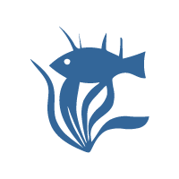

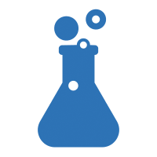



Find your watershed
Enter a location in the search box to explore waters in your area and find out information about the following:
Swimming: EPA, states, and tribes monitor and assess water quality to keep you safe while swimming, wading, or boating.
Eating Fish: EPA, states, and tribes monitor and assess water quality to determine if fish and shellfish are safe to eat.
Aquatic Life: EPA, states, and tribes monitor and assess water quality to determine the impact of impairments on plants and animals living in the water.
Drinking Water: Who provides drinking water in your community?
Monitoring: View monitoring locations.
Identified Issues: View identified water quality issues.
Restore: View EPA funded nonpoint source pollution grants and waterbody restoration plans.
Protect: How can you help?
mywaterway.epa.gov
Notes:
Instructor: These are the categories you can explore. Place students in 4 - 5 groups or do this as a guided activity.
I will give you 10 minutes to work with the people in your group. Your group will report back to the class 3 surprising results.

Slide 30
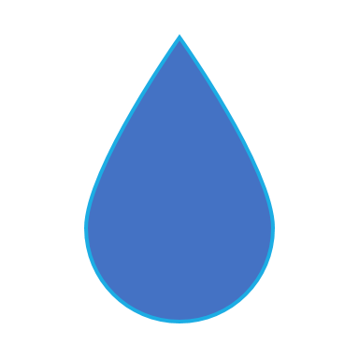
Your Water Quality
What are the results for your watershed?

Slide 31
Connection to the New England Landscape Futures (NELF) explorer tool and Dirty Water Data Nugget
Notes:
Instructor: Now that we learned about impervious surfaces increasing stormwater runoff, let’s explore the future growth of our community.

Slide 32
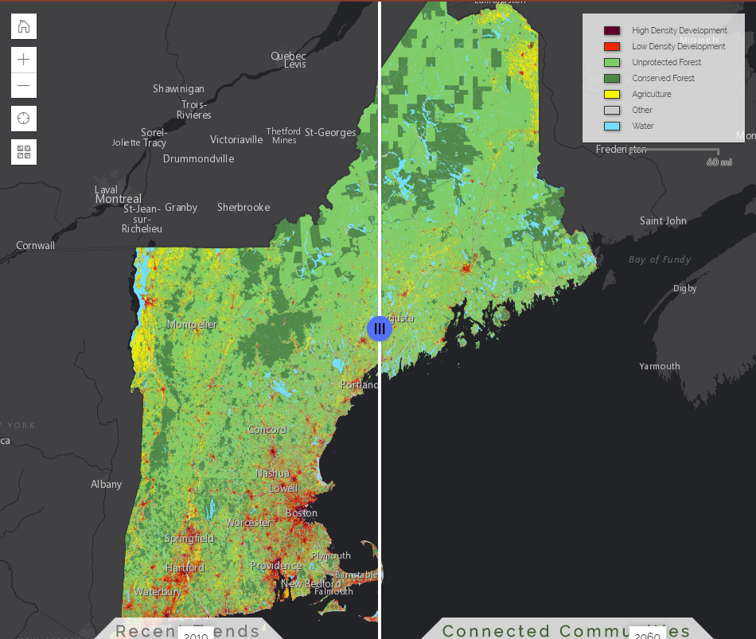
The NELF Explorer
The NELF Explorer helps us understand long-term consequences of land-use decisions we make today, via maps, graphs, and scenario narratives.
This tool can be used by land-users and landowners, including conservationists, planners, developers, government leaders, and citizens who want to explore possible futures of our land.
Notes:
Instructor: The New England Landscape Futures Project seeks to understand possible trends and impacts of landscape change in New England.
------------------------
You can access the lesson plan here: TBD

Slide 33
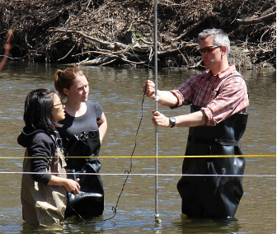
Dirty Water Data Nugget
How will development decisions impact the future of the Merrimack River and the health of humans that rely on it?
Notes:
Instructor: Now that we have an idea of the future growth of our community, we can use that to make predictions about our local rivers. Combining research like this gives scientists, government organizations, and the public valuable information that can be used to help make decisions about how land should be used in the future.
------------------------
You can access the lesson plan here: https://datanuggets.org/2021/06/love-that-dirty-water/

Slide 34
In what ways can youth and climate crisis activists advocate for sustainable water resilience?
Notes:
Instructor: Read the slide

Slide 35
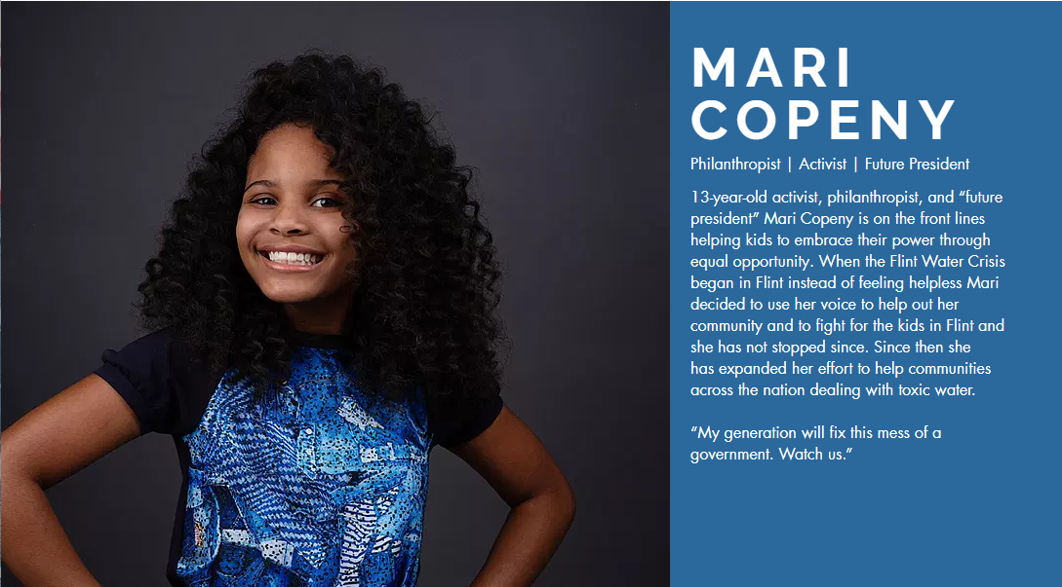
Data Source: http://www.susted.com/
Notes:
Instructor: One Flint resident, 12-year-old activist Mari Copeny, also known as “Little Miss Flint,” wrote to President Obama at the height of the crisis (Copeny, 2019). Obama responded to Copeny with a visit to Flint and through the Environmental Protection Agency, awarded Michigan $100 million to allocate towards efforts to upgrade Flint’s drinking water system. Copeny started a “Dear Flint Kids” letter campaign, which has distributed thousands of letters into the hands of Flint kids with positive messages. She also started #WednesdaysforWater, a campaign to bring awareness to access to clean water around the world.
------------------------
Data Source: http://www.susted.com/

Slide 36
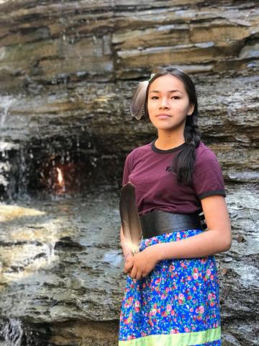
AUTUMN PELTIER
Autumn is a Canadian water activist and she advocates for clean drinking in First Nations communities and across Mother Earth. She comes from Wikwemikong First Nation/Manitoulin Island and is from Ojibway/Odawa heritage. Autumn has travelled far and wide to carry the message of the importance of clean water and the Sacredness of Water.
Data Source: http://www.susted.com/
Notes:
Instructor: Another activist, 14-year-old Autumn Peltier, is Indigenous to the Anishinaabe tribe of Northern Ontario. She has been advocating for clean drinking water across Canada since she was eight years old. In 2019, she was named chief water commissioner by the Anishinabek Nation, a political advocacy group for 40 First Nations across Ontario.
------------------------
Data Source: http://www.susted.com/

Slide 37
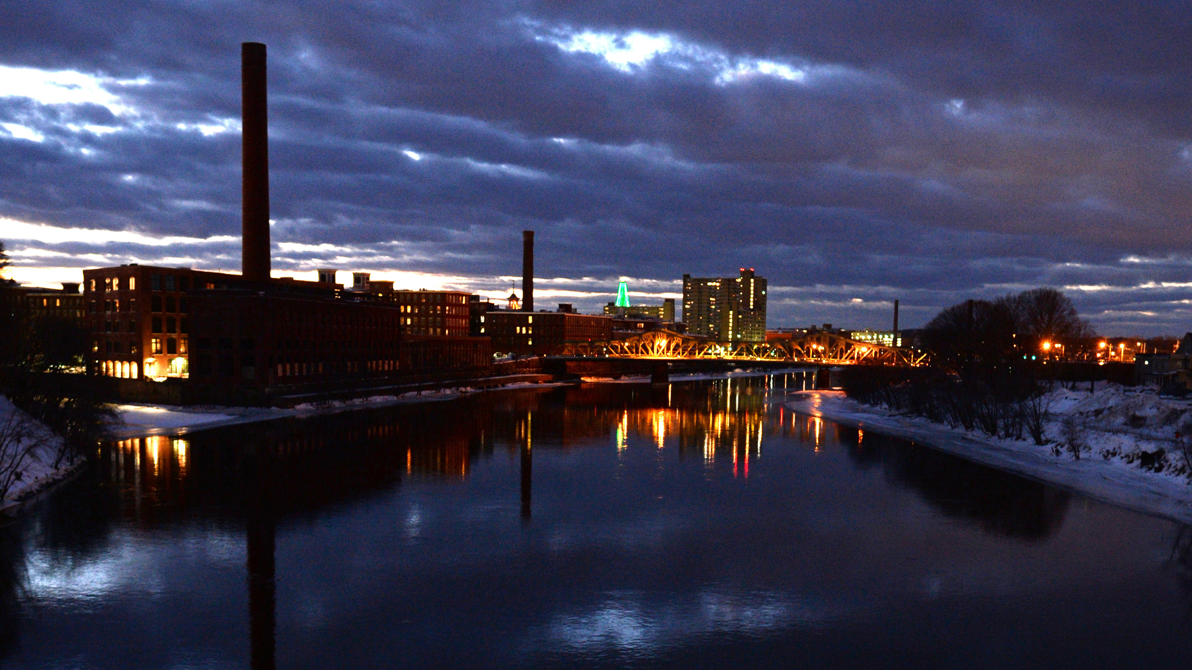
Water is a necessary element for human survival.
Image Source: Creator: Robert Mills | Credit: Lowell Sun
Notes:
Instructor: What are you going to do about the dirty water?
------------------------
Image Source: Creator: Robert Mills | Credit: Lowell Sun

