Slide 1


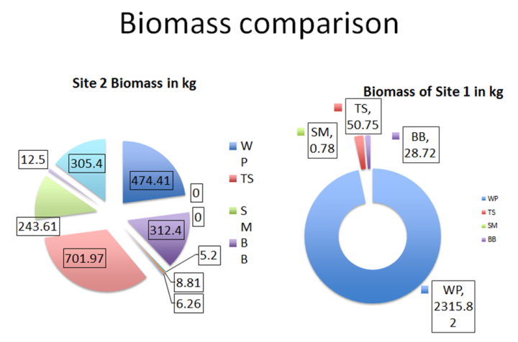
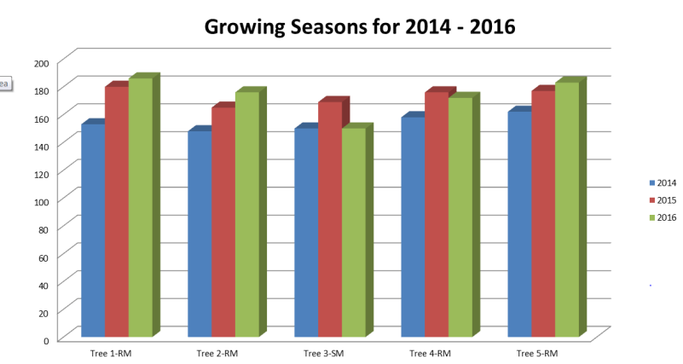
Teacher Developed Graphs and Data Documents
Harvard Forest Schoolyard Ecology
Looking at Data Workshop 2016
Compiled by Pamela Snow
Schoolyard Ecology Teachers: Maryanne Rotelli, Sally Farrow, Jennifer Woodard, Erin Pitkin, Robin Koval, Colleen Casey, Lori Primavera, Louise Levy, Elisa Margarita
Harvard Forest Staff and Mentors: Betsy Colburn, John O’Keefe, Emery Boose, David Orwig, Greta VanScoy, Luca Morreale, Joshua Rapp, Matthew Lau, Matthew Duvenick

Slide 2
Graph 1: Comparison of Tree Species by Plot
Description of graph and related data table: Stacked bar graph comparing number of trees by species in two plots.
Teacher/Author: Maryanne Rotelli
School: Brookline-Hollis High
  School (NH)
Grade Level: 11,12
Harvard Forest Mentor:
Marissa McBride

Slide 3
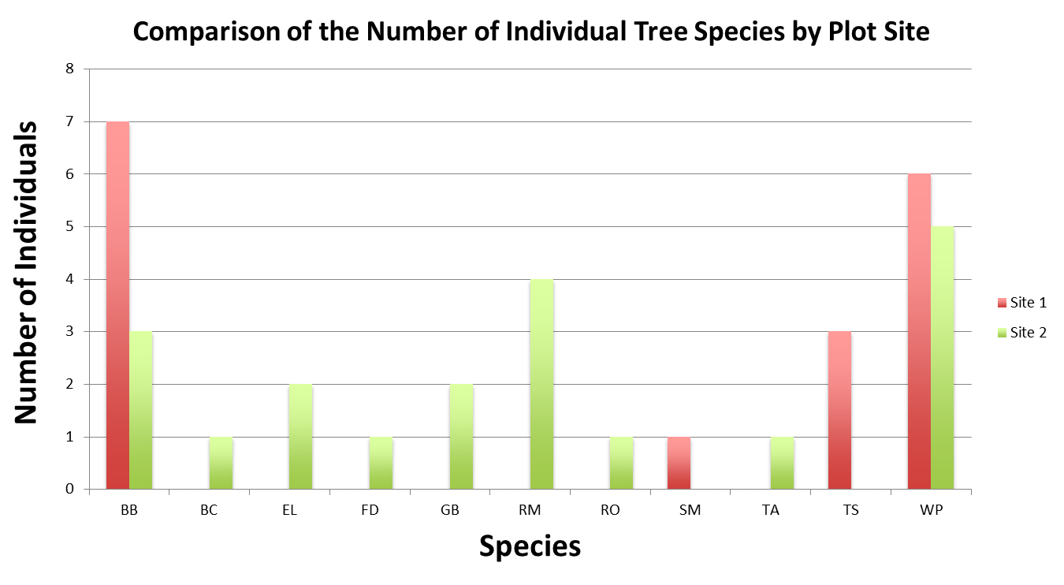
Graph 2: Comparison of Number of Tree Species by Plot
Description of graph: Bar Graph showing Number of Individual Tree Species by Plot
Teacher/Author:
  Maryanne Rotelli
School: Brookline-Hollis High School (NH)
Grade Level: 11,12
Harvard Forest Mentor:
Marissa McBride

Slide 4
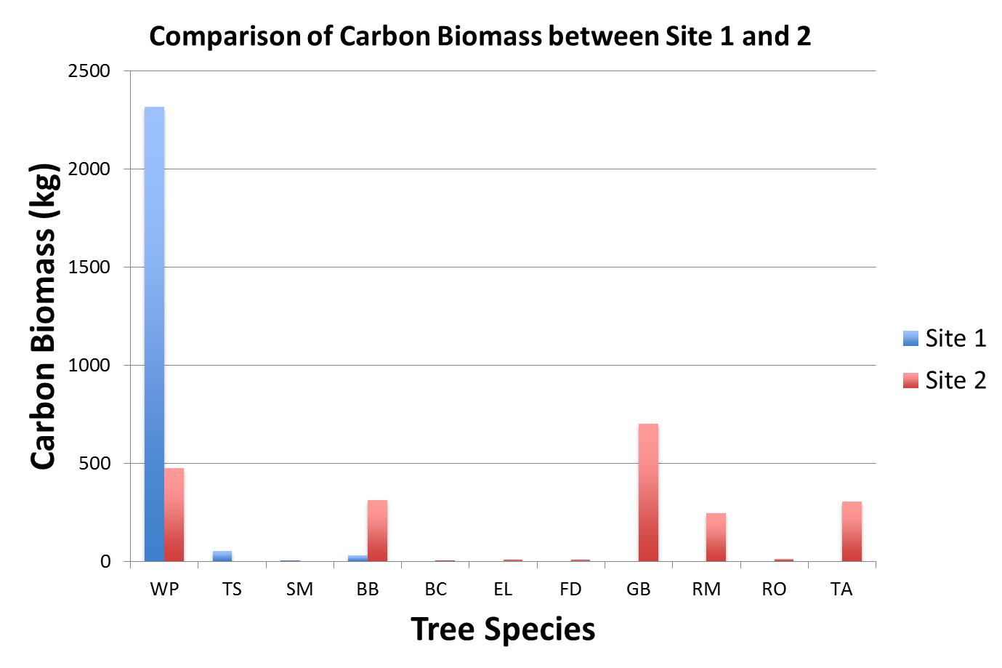
Graph 3: Comparison of Carbon Biomass by Plot
Description of graph: Bar graph of carbon biomass by plot.
Teacher/Author:
Maryanne Rotelli
School: Brookline-Hollis High School (NH)
Grade Level: 11,12
Harvard Forest Mentor:
Marissa McBride

Slide 5

Graph 4: Biomass Comparison by Plot
Description of graph:
  Pie chart comparison of biomass by species and plot.
Teacher/Author:
Maryanne Rotelli
School:
Brookline-Hollis High School (NH)
Grade Level: 11,12
Harvard Forest Mentor:
Marissa McBride

Slide 6
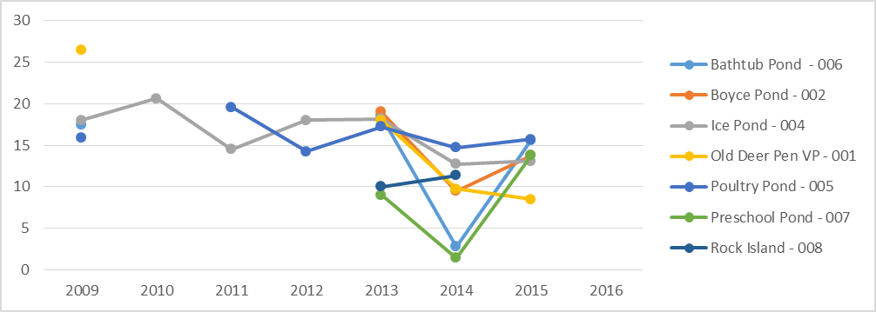
Graph 5: Air Temperatures at 8 Ponds Over 7 Years
Description of graph: Line graph showing average air temperature in spring compared across 8 ponds.
Teachers/Authors:
Sally Farrow
Jennifer Woodard
Erin Pitkin
Site: Drumlin Farm
X Axis: Year
Y Axis: Temperature in
Degrees Celsius
Grade Level: 1-12
Harvard Forest Mentor:
Matthew Duvenick
Average Spring Air Temp at 8 Ponds

Slide 7
Graph 6: Timing of Leaf Drop from 2013-2016
Description of graph: Line graph of leaf drop over three years.
X Axis: Julian Date
Y Axis: Percent Leaves Fallen
Teacher/Author:
  Robin Koval
School: Shore Country Day
    School
Grade Level: 7,9
Harvard Forest Mentor: Greta VanScoy

Slide 8
Graph 7 :
Length of Growing Season Over Three Years
Description of graph: Scatter plot of growing season length over 3 years.
X Axis: Year
Y Axis: Length of Growing Season in Julian Days
Teacher/Author:
  Robin Koval
School: Shore Country Day School
Grade Level: 7,9

Slide 9

Graph 8 : Growing Season At Trinity Catholic Academy
2014-2016
Description of graph: Bar graph of length of growing season at Trinity Catholic Academy over three years.
X Axis: Tree ID Number
Y Axis: Number of Days
Teacher/Author:
  Colleen Casey
  Lori Primavera
School: Trinity Catholic Academy
Grade Level: 4th and 5th
Educational Objectives: Our students are studying the bud burst and leaf fall of 5 trees here on our campus. Here is three years of our data to show the change in our growing season which is the time when the tree is photosynthesizing.

Slide 10
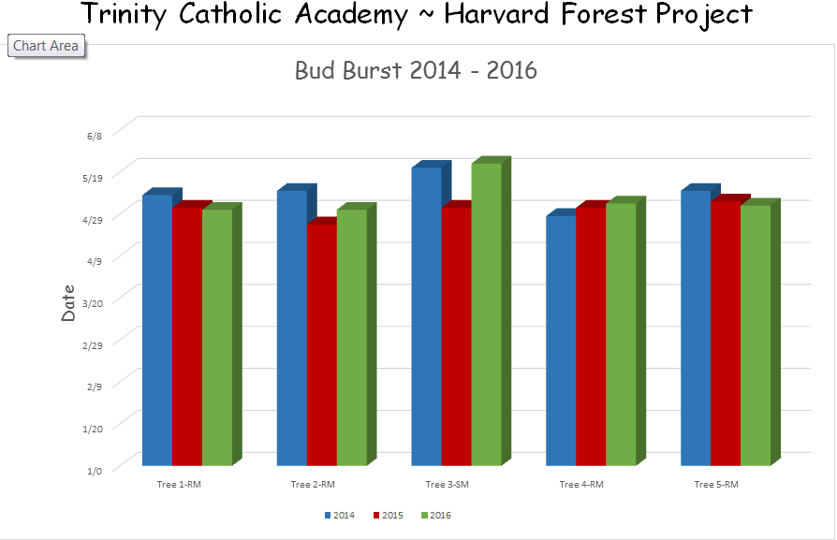
Graph 9 : Timing of Budburst from 2014 to 2016
Description of graph:
This bar graph illustrates the average time of spring bud burst over the last 3 years. Bar colors represent different years.
X Axis: Tree ID Number
Y Axis: Date
Teacher/Author:
  Colleen Casey
  Lori Primavera
School: Trinity Catholic Academy
Grade Level: 4th and 5th
Educational Objectives:
Our students are studying the bud burst and leaf fall of 5 trees here on our campus. Here is three years of our data to show the change in timing of buds opening in Spring.

Slide 11
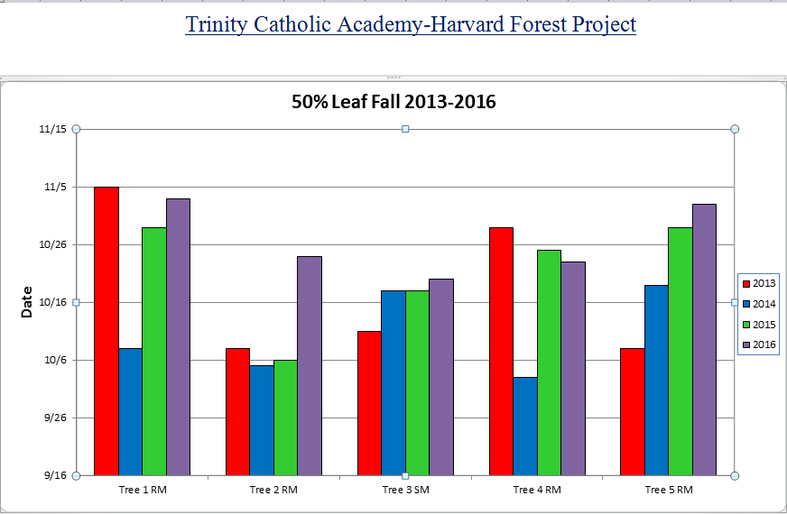
Graph 10 : Timing of Leaf Drop from 2013 to 2016
Description of graph:
This bar graph reflects the average date in which the leaves fell for each year.
X Axis: Tree ID Number
Y Axis: Date
Teacher/Author:
  Colleen Casey
  Lori Primavera
School: Trinity Catholic Academy
Grade Level: 4th and 5th
Educational Objectives:
Our Students are collecting data from 5 tress located on the grounds of Trinity Catholic Academy. This graph helps students see what the data is showing for the timing of leaf fall at our school.

Slide 12
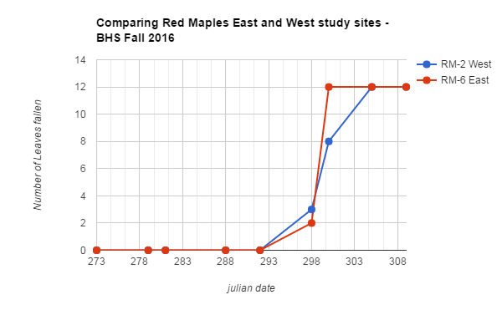
Graph 11 : Timing of Leaf Drop of Red Maples at Two Field Sites at Belchertown High School
Description of graph: Line graph comparing the timing of leaf drop of Red Maples between 2 field sites at Belchertown High School.
Teacher/Author:
  Louise Levy
School: Belchertown High School
Grade Level: 11,12
Educational Objectives: In conjunction with field site visits and characterization, students will assess any differences between the leaf drop of two same-species trees and posit the causes for those differences.

Slide 13
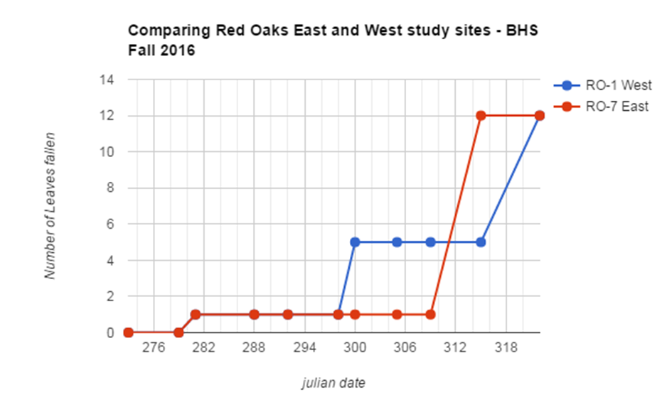
Graph 12 : Timing of Red Oak Leaf Fall Compared Across 2 Field Sites at Belchertown High School
Description of graph:
  Line Graph comparing Red Oak leaf drop at 2 study sites at Belchertown High School.
Teacher/Author:
  Louise Levy
School: Belchertown High School
Grade Level: 11, 12
Educational Objectives: In conjunction with field site visits and characterization, students will assess any differences between the leaf drop of two same-species trees and posit the causes for those differences.

Slide 14
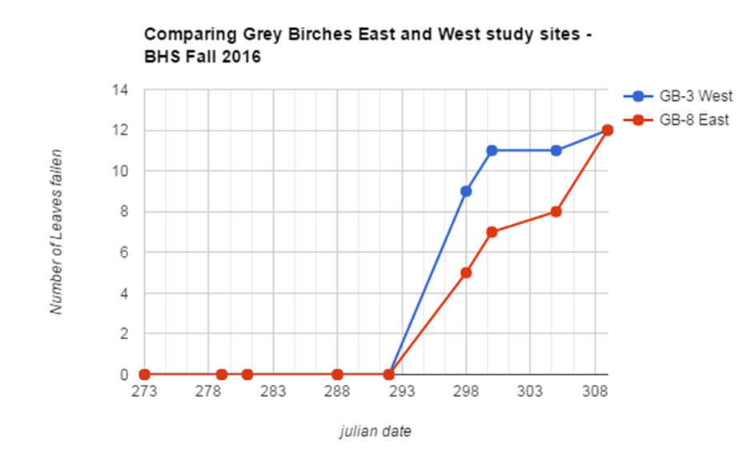
Graph 13 :
Timing of Leaf Drop on Grey Birches at 2 field Sites at Belchertown High School
Description of graph: Line graph of timing leaf drop on Gray Birch in 2 field sites at Belchertown High School.
Teacher/Author:
  Louise Levy
School: Belchertown
High School
Grade Level: 11,12
Educational Objectives: In conjunction with field site visits and characterization, students will assess any differences between the leaf drop of two same-species trees and posit the causes for those differences.

Slide 15
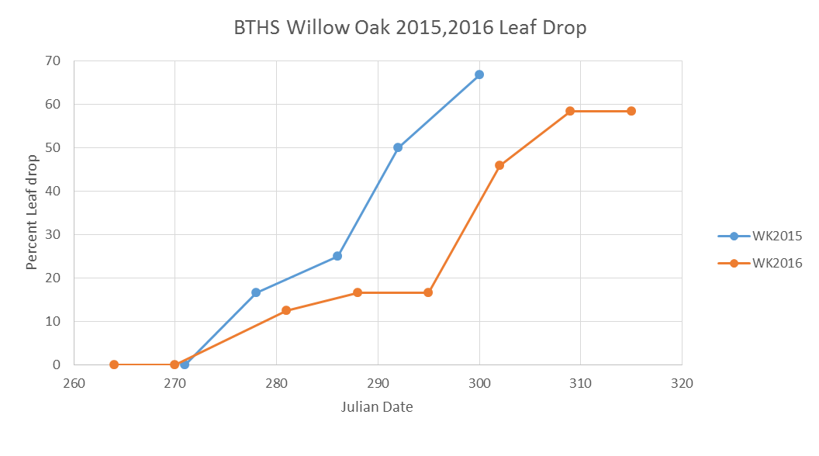
Graph 14 :
Timing of Leaf Drop of 2 Willow Oaks at Brooklyn Technical High School
X Axis: Julian Date
Y Axis: Percent Leaf Drop
Teacher/Author
Elisa Margarita
School:
Brooklyn Technical
High School

Slide 16

Addendum to Looking at Data Graphs, 2016
Data Tables 1-6

Slide 17
Data Table 1
Data for Graph #6
Robin Koval
*Original Data Table for graph 6 is 143 lines long. Rest of Table is available via email at psnow@fas.harvared.edu

Slide 18
Data Table 2
Data for Graph #7
Robin Koval

Slide 19
Data Table 3
Data for Graph #11
Louise Levy

Slide 20
Data Table 4
Data for Graph #12
Louise Levy

Slide 21
Data Table 5
Data for Graph #13
Louise Levy

Slide 22
Data Table 6
Data for Graph #14
Elisa Margarita

